Slide 1
Auroral Ionosphere During Solar Minimum in Very High Time Resolution
Th.Ulich¹, T. Turunen¹, E. Turunen*²
¹Sodankylä Geophysical Observatory, Finland
²EISCAT Scientific Association, Sweden

Slide 2
The New Sodankylä Ionosonde
Sodankylä Geophysical Observatory (SGO) replaced the previous ionospheric sounder by a new FMCHIRPCW sounder in November 2005. The new sounder has been designed and built in-house utilising exceptional solutions in many ways.
We call it “Alpha-Wolf” because of the sound it makes when listening to the sweep by loudspeakers.
It is the third ionosonde in more than 50 years since August 1957.

Slide 3
Sodankylä Ionosonde: IPY Operations
August 1957-November 2005: half-hourly soundings, recorded on film.
November 2005-March 2007: 10-min digital recordings, full raw data archived.
April 2007-March 2008: 1-min digital recording, numerical ionograms every minute, raw data every 5 minutes.
April 2008-today: we forgot to turn off IPY mode!
Today we buffer 1-min raw data for at least 90 days so that special events can be archived in full resolution.

Slide 4
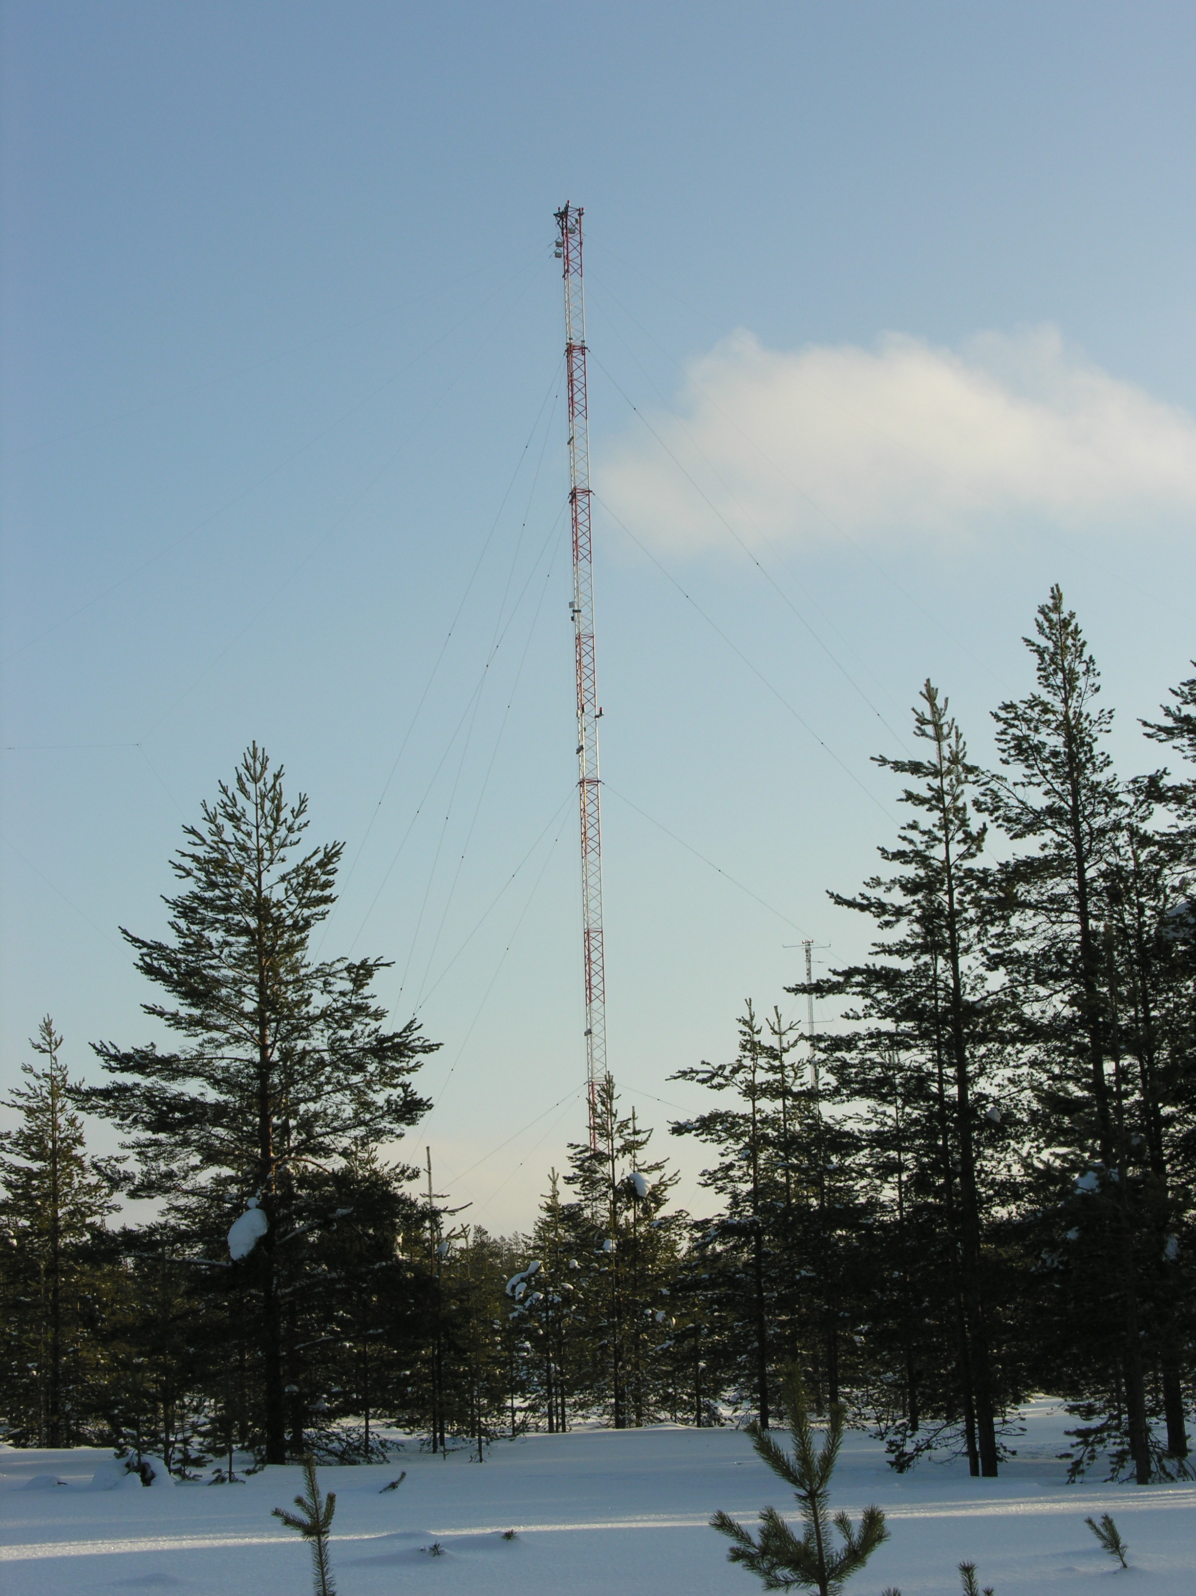
Transmitter and Modulation
Frequency: 0.5 -16 MHz.
Linear FM chirp rate is 0.5 MHz/s.
Rhombic vertical transmitter aerials on 64-meter mast.
Transmitter uses semiconductor amplifier modules. Power levels from 4 W to 100 W used.
Sounding at one minute.
GPS controlled DDS works at 40 bits accuracy level at 200 MHz clock rate.

Slide 5
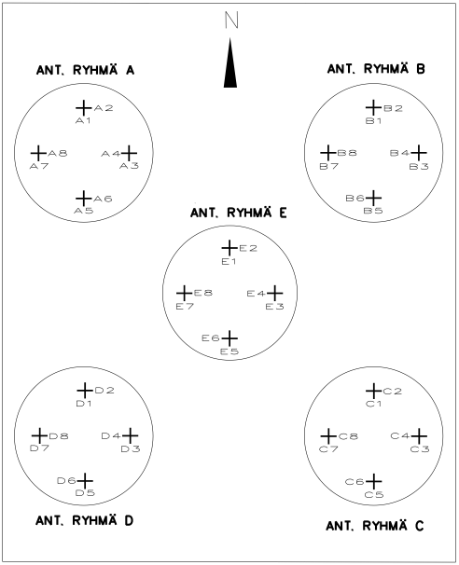
Receiver Array
20 orthogonal active loop antennas (N-S and E-W).
phased array: 5 groups of 4 antennas.
Area of array is 50x50 m².
Essentially flat response covering the sounding band and 12dB/octave roll off outside the band.
The antenna array is located 930 metres from the transmitter antenna.

Slide 6
Example of an Antenna Group
Note that trees have not been removed

Slide 7
RF Filters and Signal Detection
Alpha Wolf sounder uses complex quadrature detection of both received linear components directly to the baseband.
GPS controlled frequency and time reference
Identical frequency synthesisers in receivers and transmitter.

Slide 8
Post Detection Filters
Analog 4-pole +10 kHz low pass filters and 5-pole own carrier suppression filters followed by very steep digital linear phase filter in AD-converters form the low frequency filtering.
The resulting 3 dB bandwidth is +- 10 kHz, which limits the maximum range formally to 3000 km.

Slide 9
Analog to Digital Conversion
Alpha-Wolf uses 24-bit audio AD-converters.
Sampling frequency is 39062.5 Hz,
Both linear received components are stored in complex format.
The dynamic range of the conversion is so high, that it can handle the echo signal and interference under all conditions without any gain control or other adjustments.

Slide 10
The Receiver of the Alpha-Wolf Sounder
The Alpha Wolf receiver and all the other components of the sounder have been designed and built in SGO.
It has been a very reliable instrument.

Slide 11
Ionogram Computations
All polarization control is done in the post processing during real-time ionogram computations.
Numeric ionograms and 5-minute raw data are archived. 1-minute raw data is preserved for half a year in a circular buffer.
The original raw data allows computation of ionograms using different, non-standard resolutions and better noise rejection if new and better filters are available.

Slide 12
Data Quality: Summer
Summertime data is good as can be seen, e.g., from the monthly median curves of June 2008

Slide 13
Data Quality: Winter
In winter time even continuous monthly median for foF2 is difficult. This is very common in winter especially during low solar activity. Almost every day has this well-known problem at high latitudes.

Slide 14
Christmas Day 2008: An Example
Christmas day 2008 is a typical winter day in high-latitude ionosonde data.
One can doubt the night time data and the one who doubts is absolutely right.
An example shows this.

Slide 15
Ionogram 20081225-0200UT: the original version
Here:
A trace of sporadic E-layer (foEs ≈1.5 MHz), and perhaps a weak trace of an F-layer echo around 1.4 MHz plus a lot of interference.
One cannot get anything more out from this ionogram.

Slide 16
Ionogram 20081225-0200UT: New Analysis
Computation of the
same data with a new
program produces
a different result.

Slide 17
Zooming in…
fmin is 0.5 MHz
foF2 is just over 1 MHz
foEs is around 1.4 MHz
fbEs is about 0.7 MHz
the peculiar F-layer echo around 1.4 MHz may be so called gyro echo, although proving it is almost impossible. Weak scatter is seen above foEs below 200 km virtual height.

Slide 18
A typical example, no echoes at all are seen on 20091209-0500UT

Slide 19
Ionogram 20091209-0500UT, new analysis => foF2=0.95 MHz

Slide 20
The New Analysis for Ionograms
Analysis strictly designed for computations needed to handle FMCHIRPCW soundings.
Analysis software contains:
Basic spectral estimate algorithms. Both auto and cross spectral estimates can be used.
Filters for removing interference caused by broadcasting stations.
Background estimate formation and subtraction.
Filters for defining the main echo and scatter patterns.
Numerous system testing possibilities.

Slide 21
One Day in 1-min Resolution

Slide 22
Alpha-Wolf Sounder Performance
Absorption is almost the only reason, which can prevent getting a usable ionogram.
Interference is only very rarely a reason for disappearance of echoes.
These cases occur mostly below 1MHz in winter night-time conditions.
Even with the most demanding filtering selection the computations can be done in real time.

Slide 23
Summary
Alpha-Wolf is a powerful ionosonde producing high quality data.
Common problems exist during winter nights caused by high interference level.
New analysis can to a large extent remove the interference problems.
Original raw ionospheric data are archived every 5 minutes, 1-minute data available for at least 90 days.
We plan to recompute the IPY data using the new analysis routines.

