Slide 1

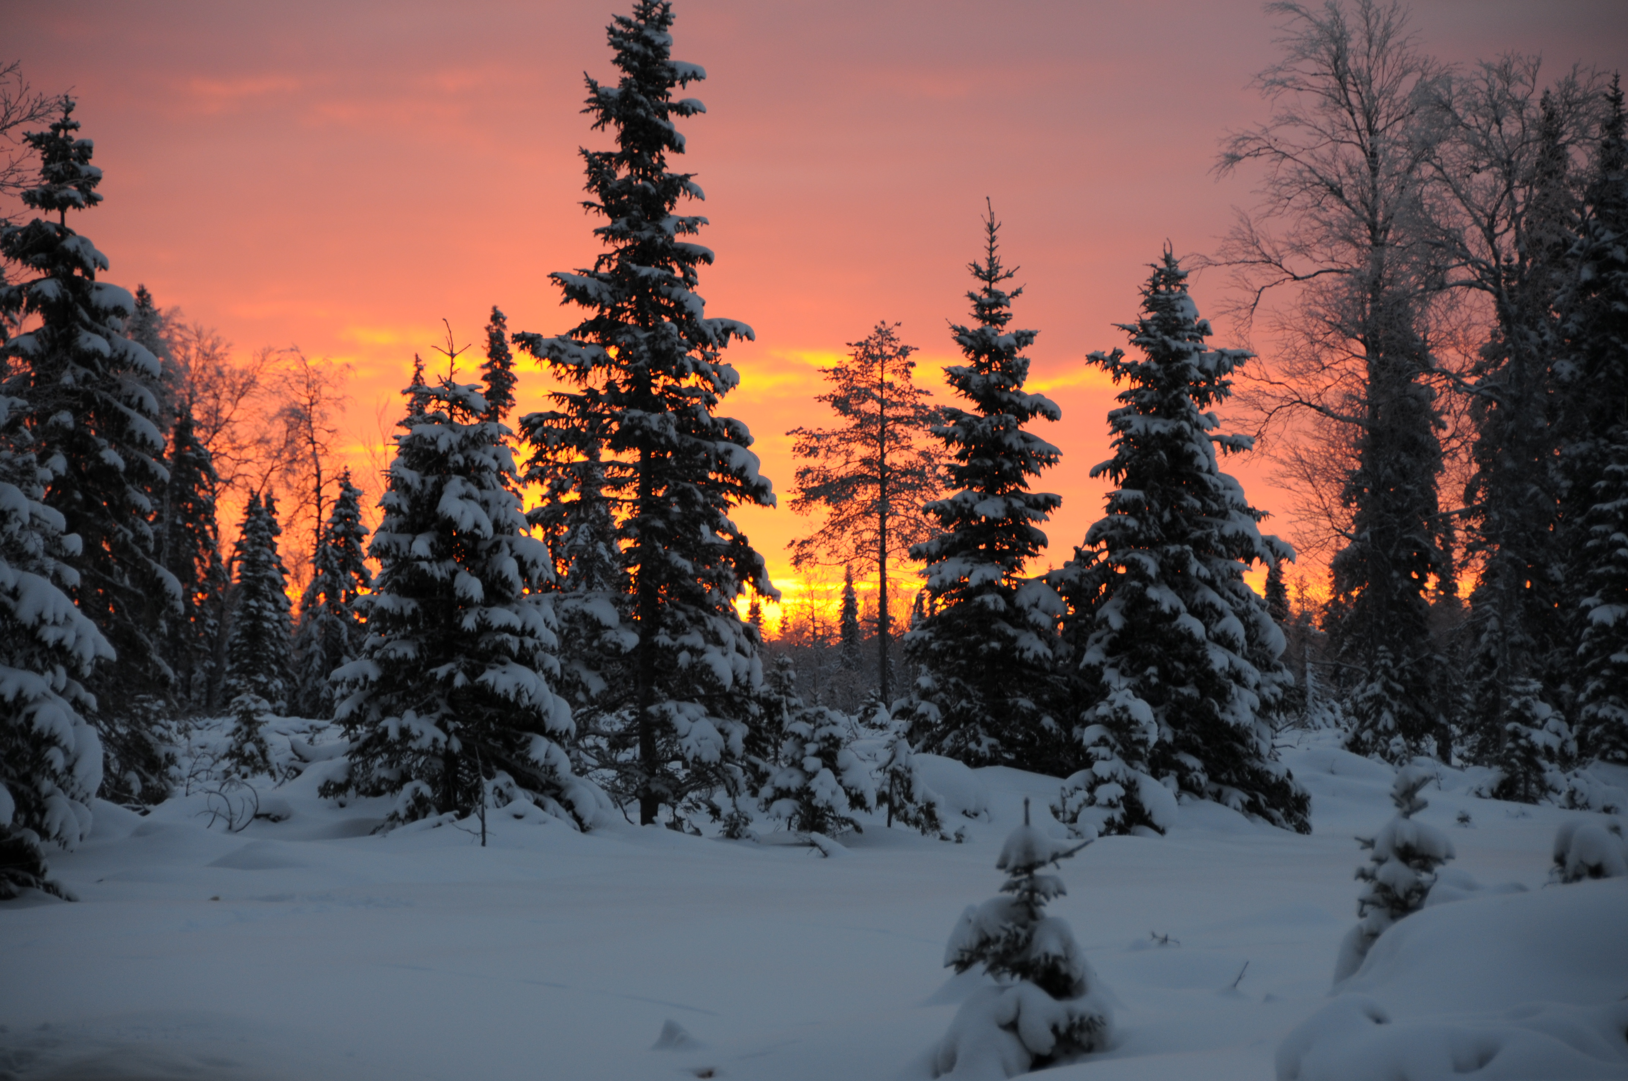
Why it is important to have simultaneous ground-based ELF-VLF observations in every satellite project?
J. Manninen¹⁾, C. Martinez-Calderon²⁾, and T. Turunen¹⁾
¹⁾Sodankylä Geophysical Observatory, Sodankylä, Finland, ²⁾Institute for Space-Earth Environmental Research, Nagoya, Japan

Slide 2
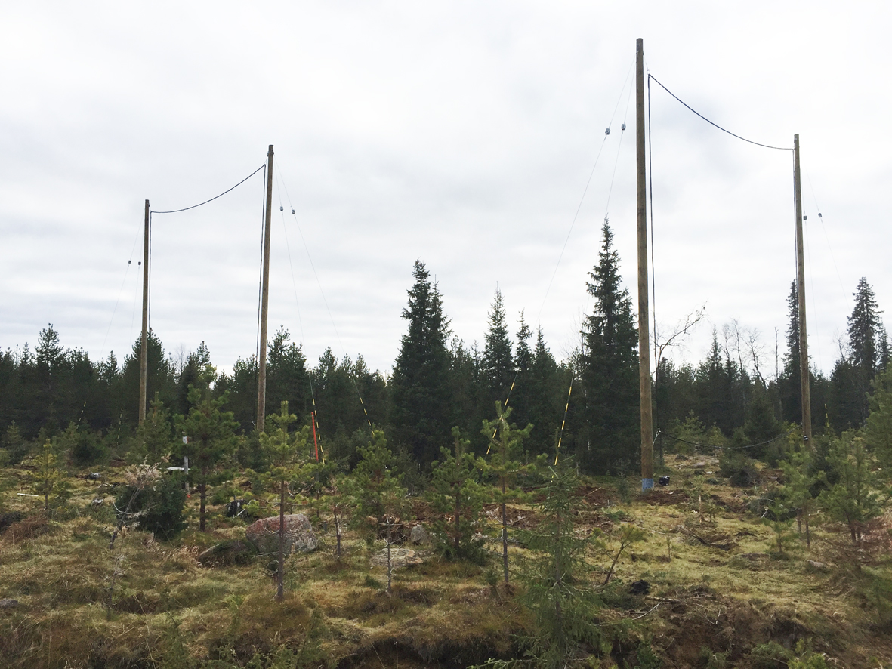
10 m
10 m
Nick name:VLF100aT
Frequency range:0.2 – 39.1 kHz
Noise level: 10⁻¹⁴ nT²/Hz

Slide 3
Campaigns in 2005-2021
So far altogether 20 campaigns has been organised
Durations of the campaigns have been varied from 10 days up to 241 days
Last winter campaign started on 4 Sep 2019 and it continued till 24 Apr 2020
Current campaign started on 14 Sep 2020 and it will be continued till May 2021
Quick-look plots from all campaigns have been made and they are available in the Internet
www.sgo.fi/pub_vlf/
There are 24h, 1h, and 1min plots available in the frequency range of 0 - 16 kHz
Data covers frequencies up to 39 kHz, but routine analysis have not been made for upper frequencies.

Slide 4
PWING VLF receivers
(From Takeshita et al., 2019)

Slide 5
Some facts about Kannuslehto
Kannuslehto CGM: +64.31°; 119.66°; L = 5.5
  electron gyrofrequency at the equator f_{ce} ≈ 5.2 kHz -> f_{ce} /2 ≈ 2.6 kHz
9 km
Nearest power line
45 km

Slide 6
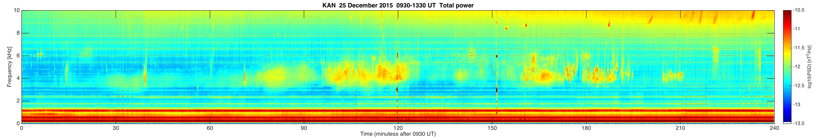
Demekhov et al. (2020) JGR
0930
1000
1030
1100
1130
1200
1230
1300
1330
Time UT

Slide 7
Demekhov et al. (2017) GRL
0930
1000
1030
1100
1130
1200
1230
1300
1330
Time UT

Slide 8
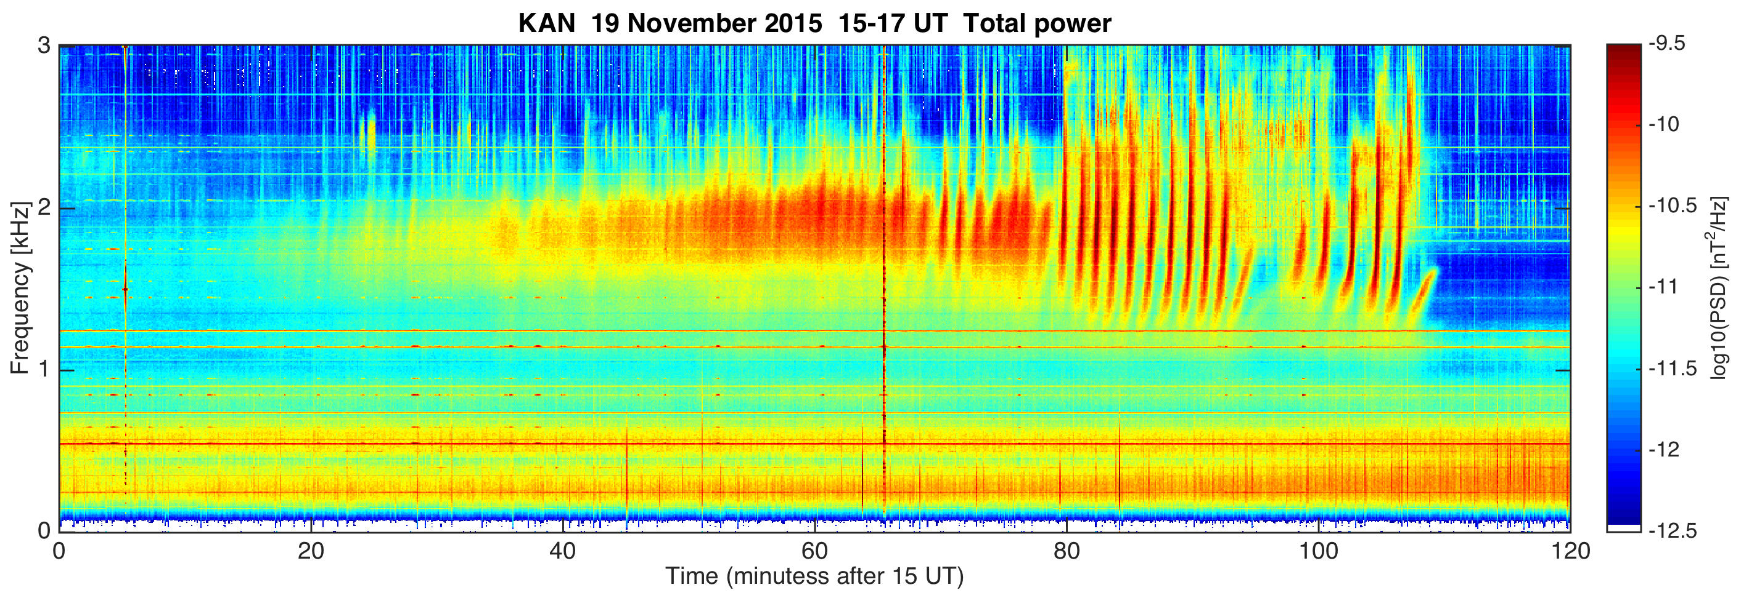
Bezdekova et al. (2020) JGR

Slide 9
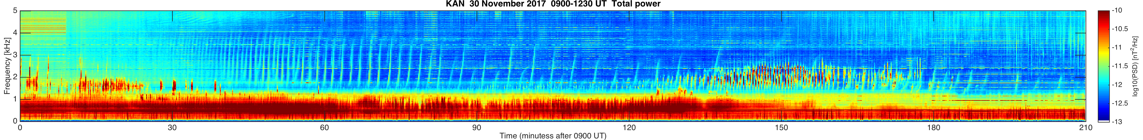
Martinez-Calderon et al. (2020) JGR
0900
0930
1000
1030
Time UT
1100
1130
1200
1230

Slide 10
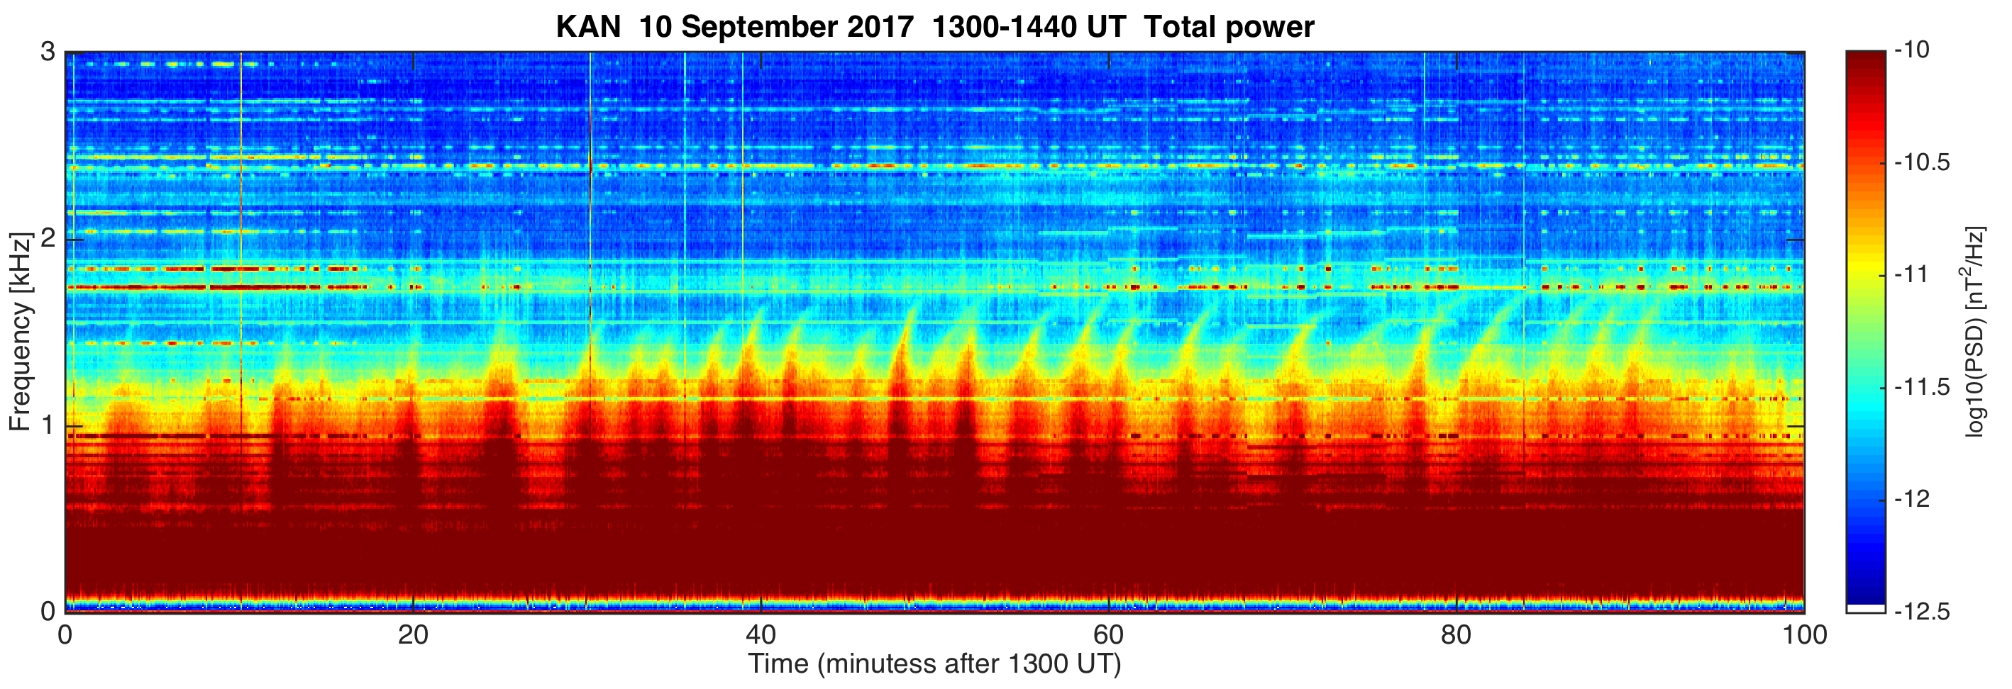
Martinez-Calderon et al. (2021) JGR
13 events studied
Chorus, QP emissions, and bursts
Simultaneous observations from a few minutes to 3 hours
Maximum distance of ERG from KAN was 2500 km
1300
1320
1340
1400
1420
1440
Time UT
1200
1230

Slide 11
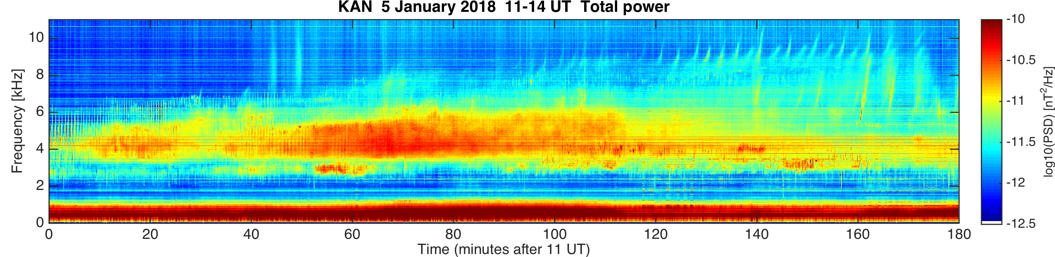
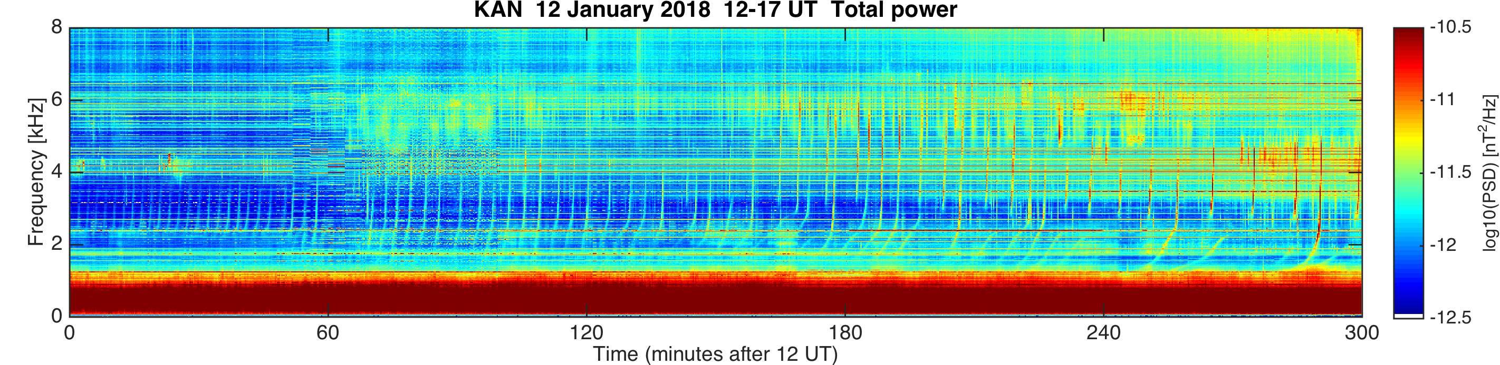
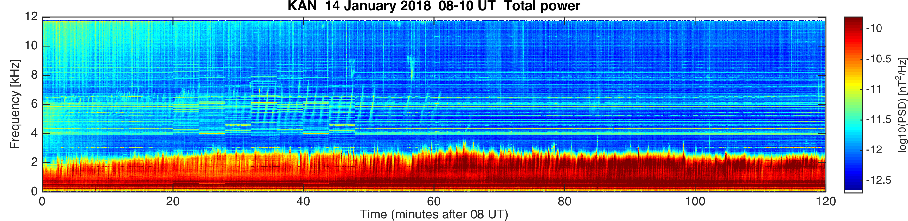
Quasi-periodic (QP) events (1/2)

Slide 12
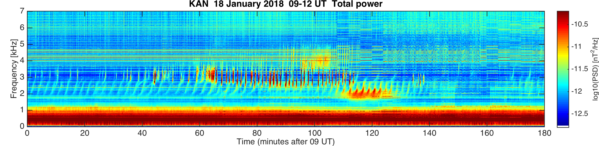
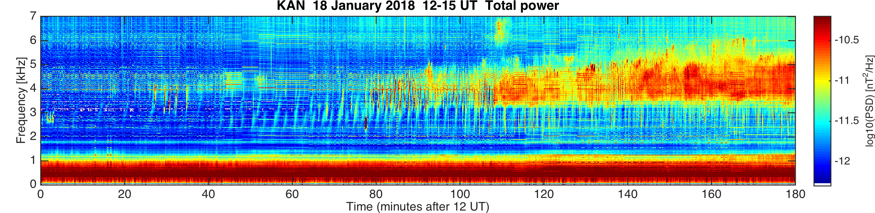
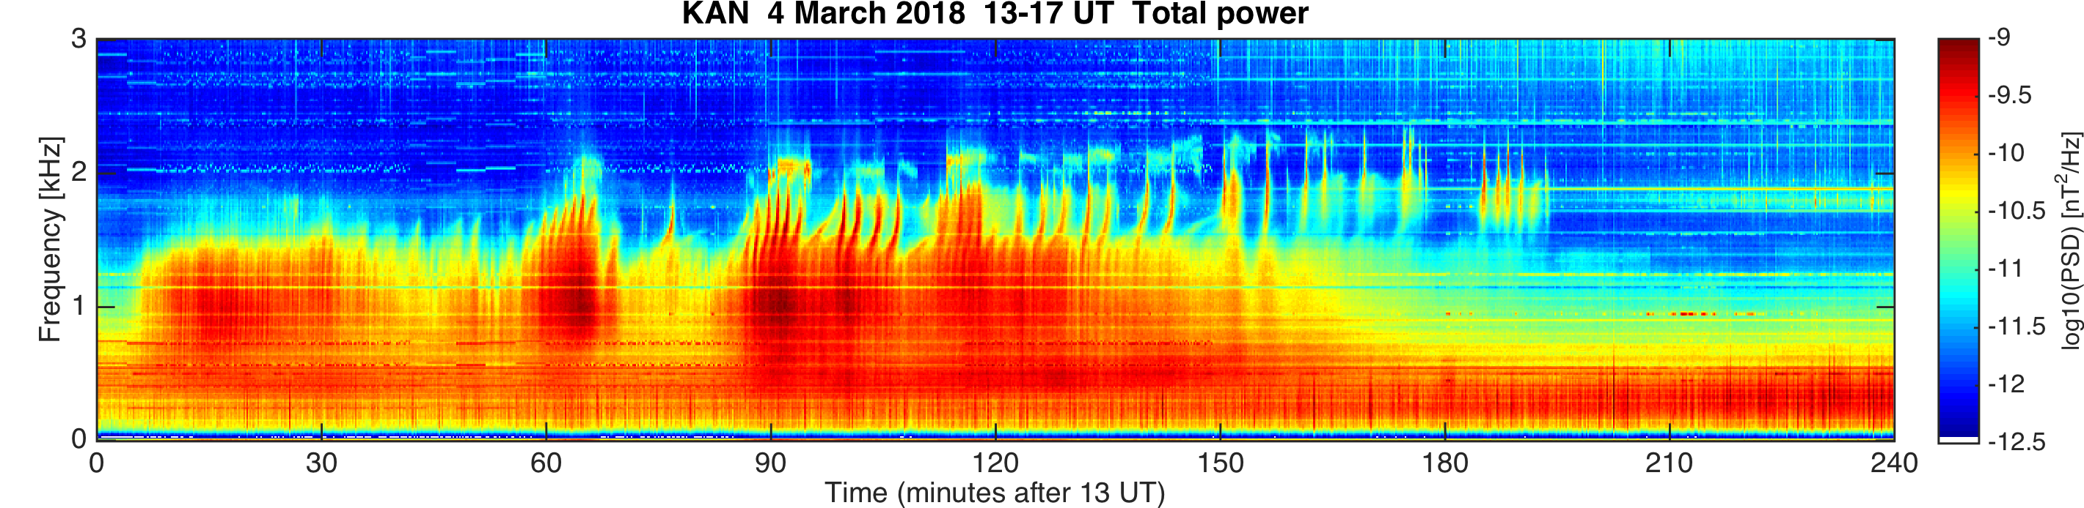
QP events (2/2)

Slide 13
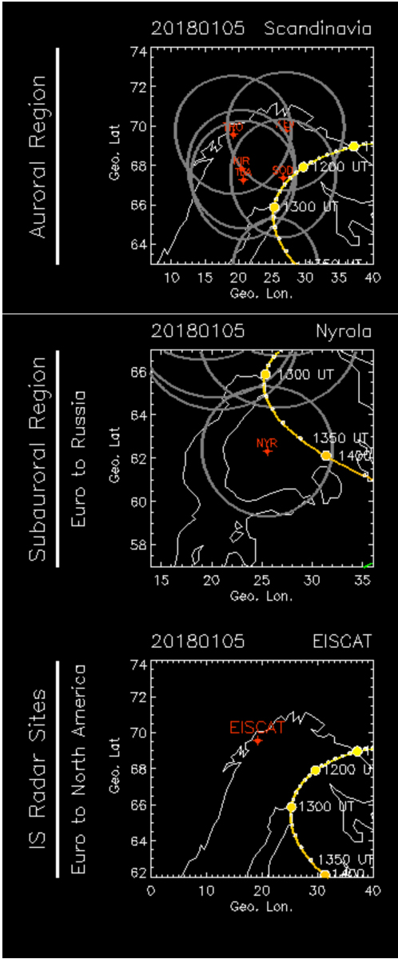
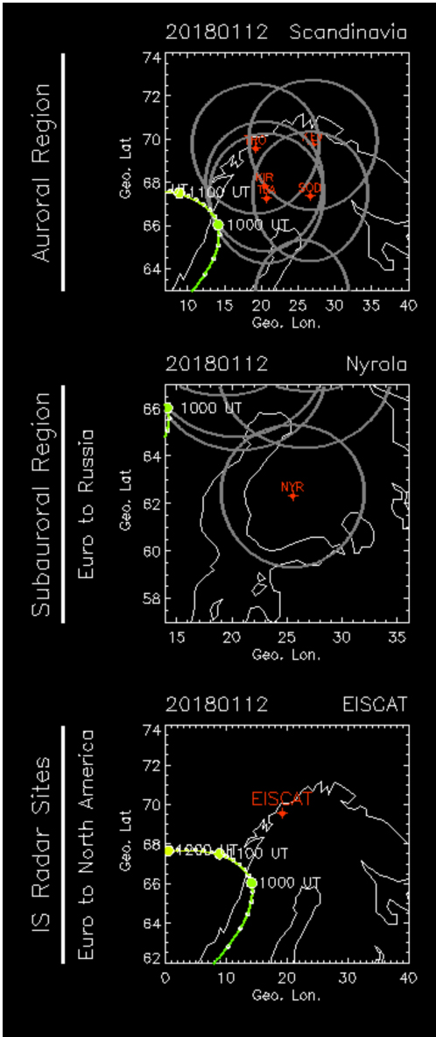
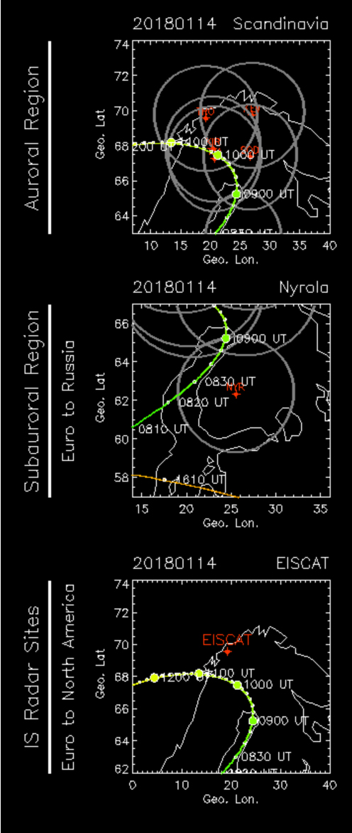
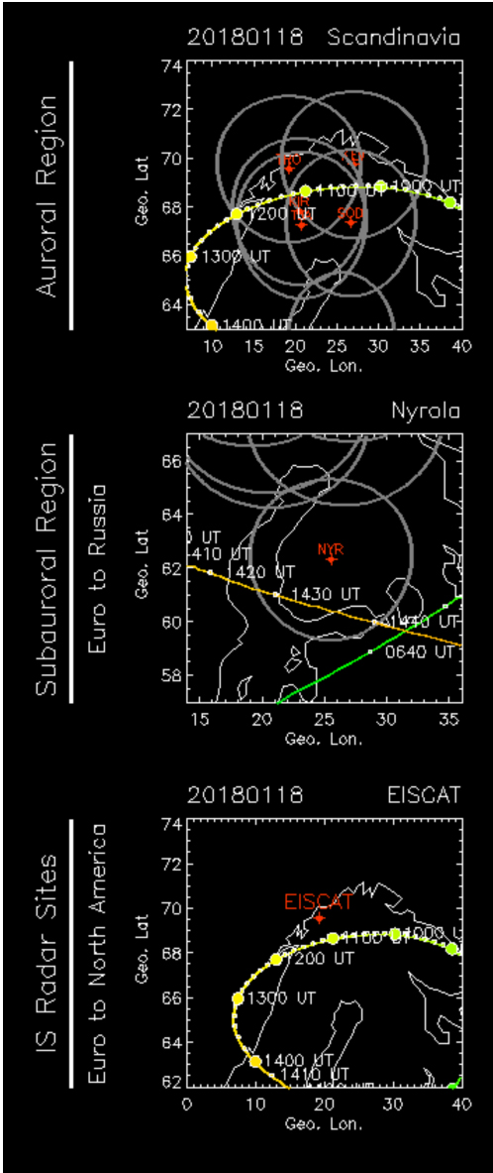
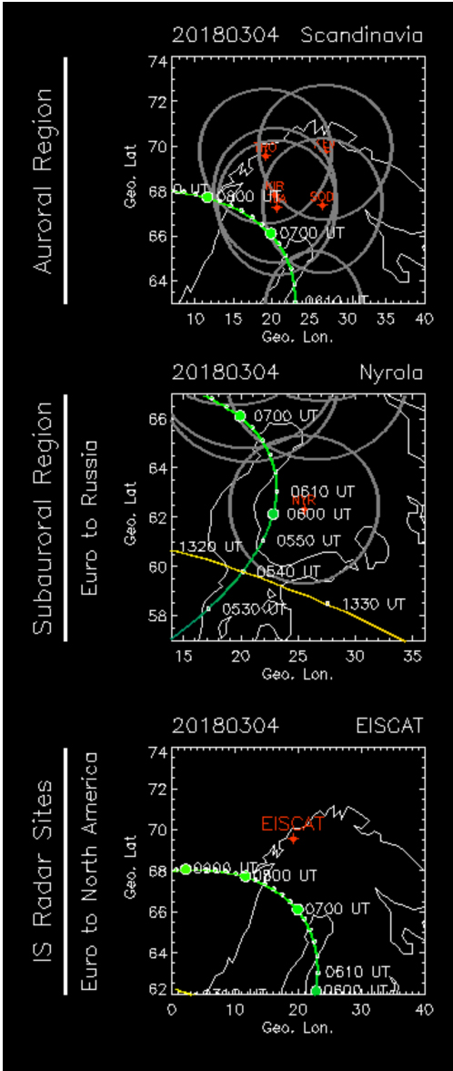
ARASE conjunctions during QP events

Slide 14
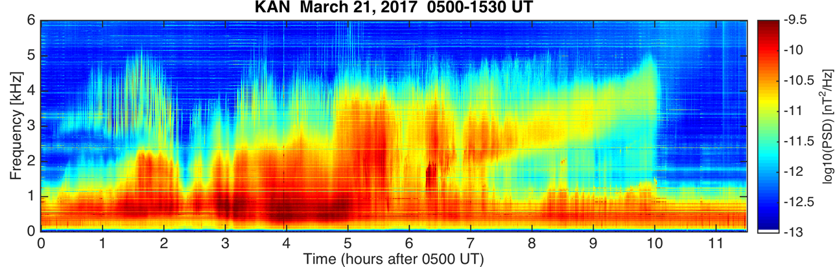
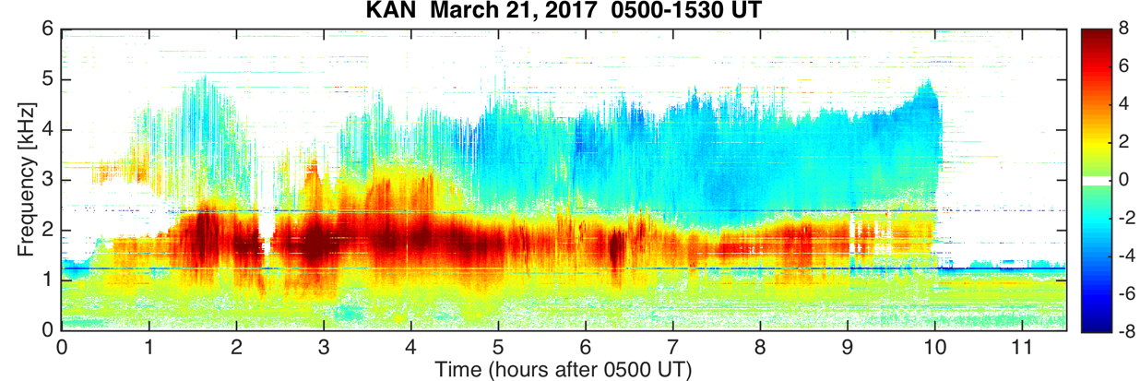
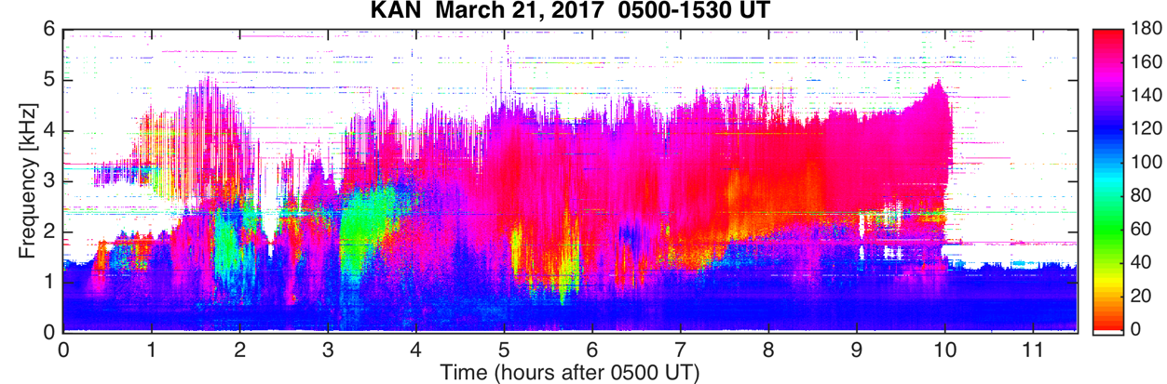
QP emissions 21 March 2017 0500-1630 UT
0500-1630
0500-1630
+ R pol
0 lin pol
- L pol
0500-1630
Angle of
arrival

Slide 15
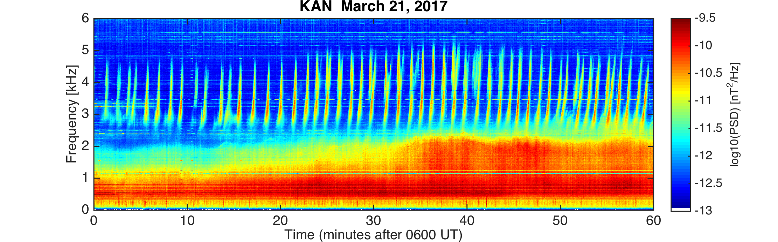
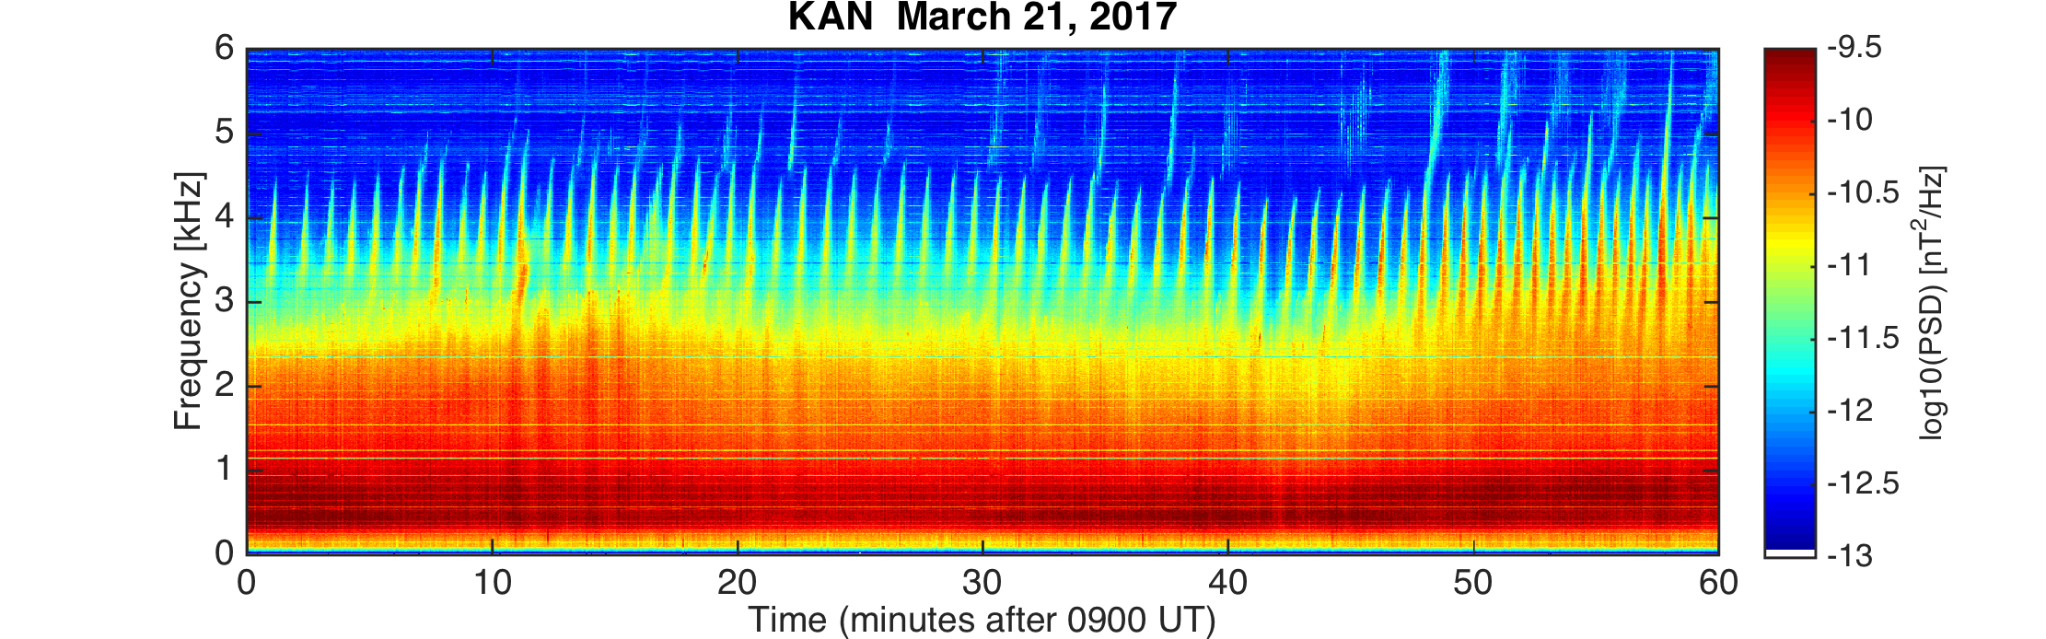
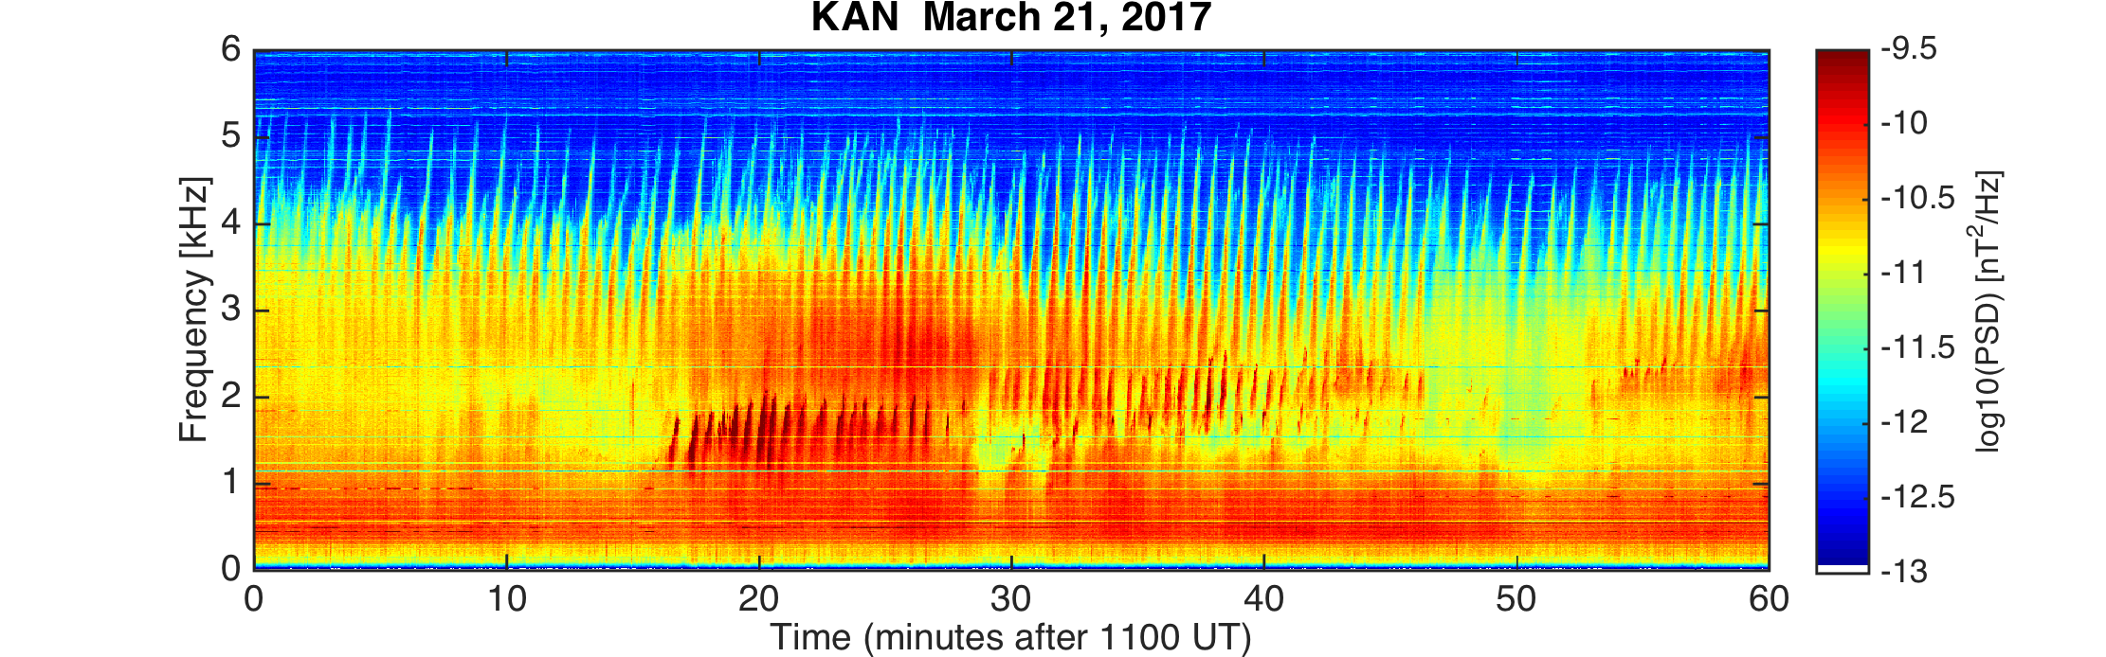
30 October 2016 2202-2204 UT

Slide 16
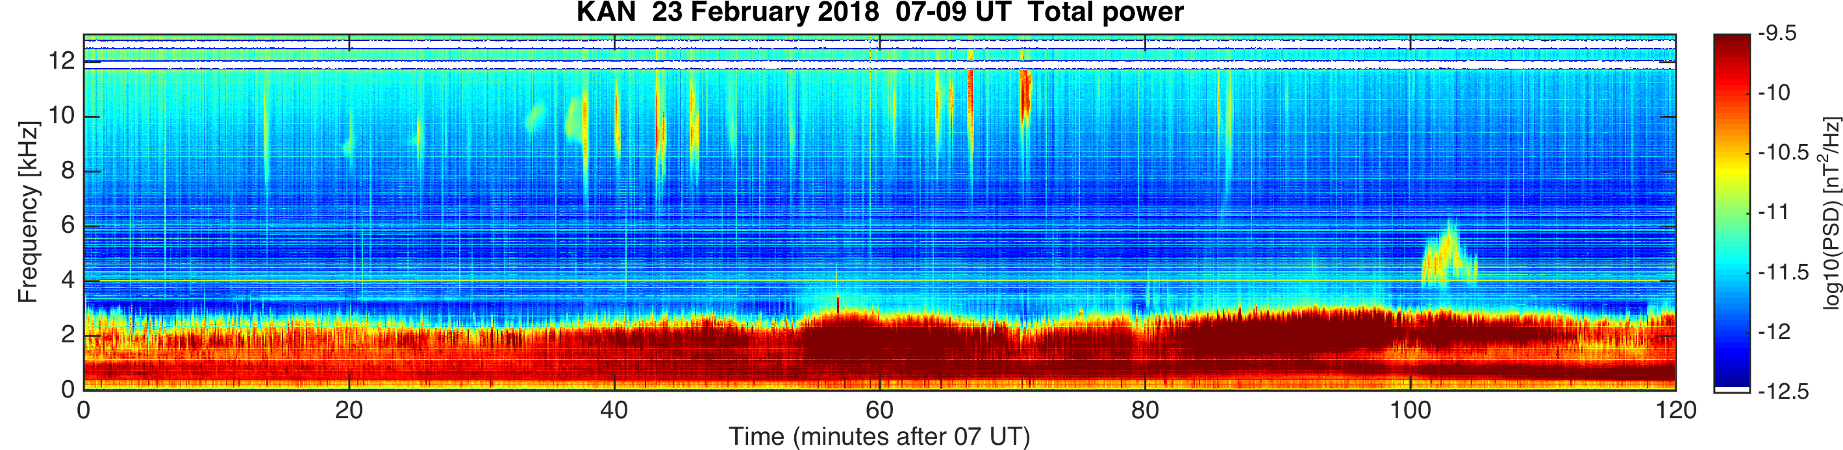
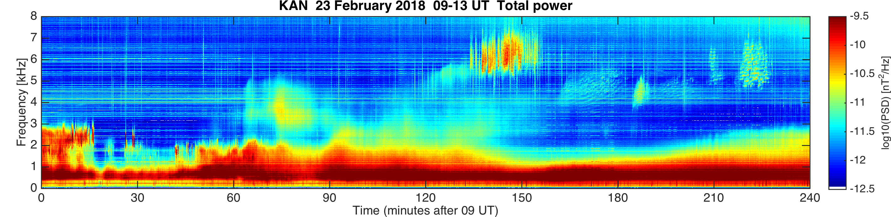
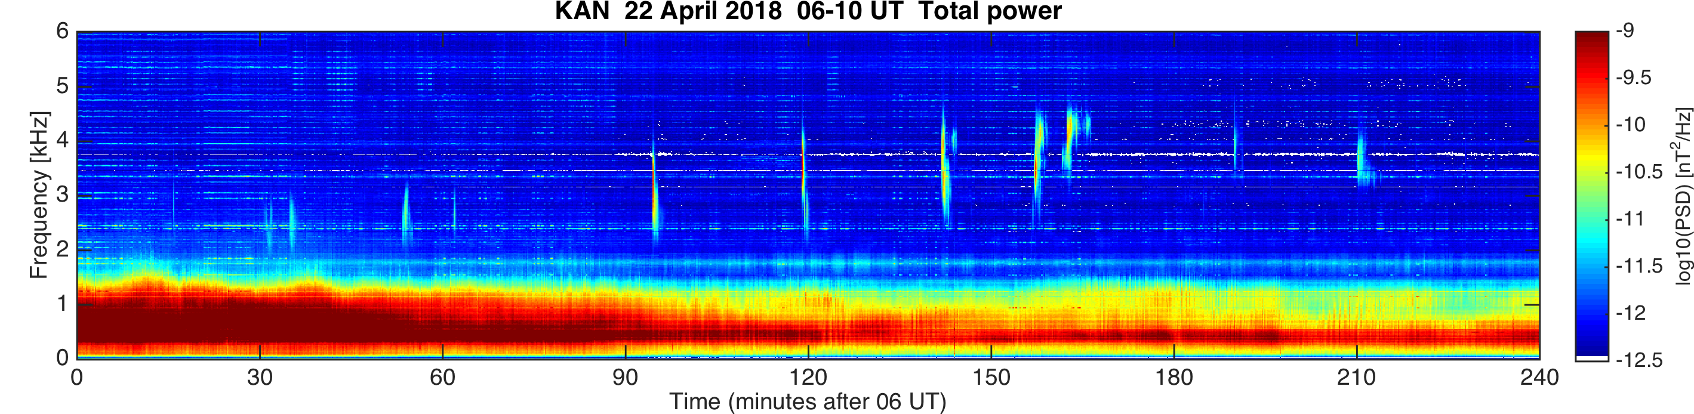
“High-frequency” VLF

Slide 17
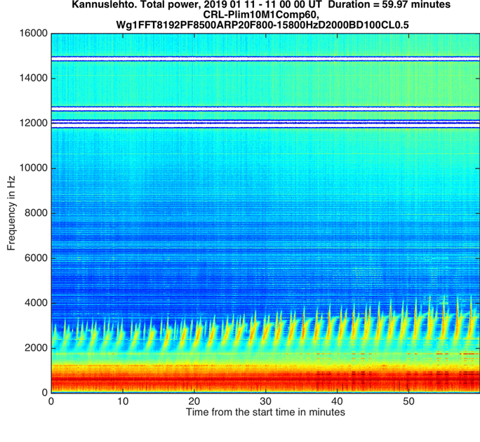
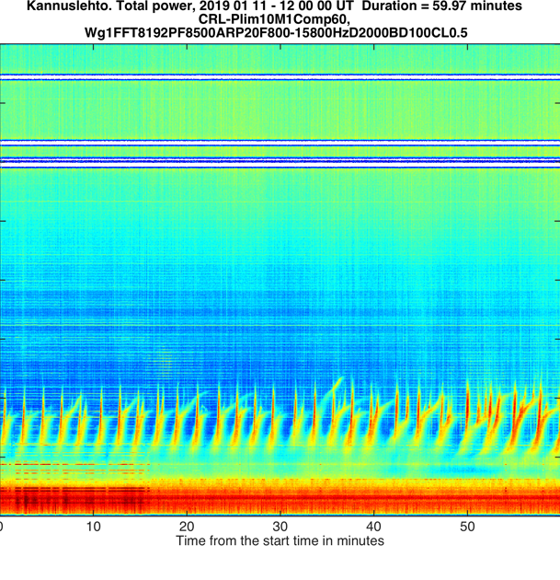
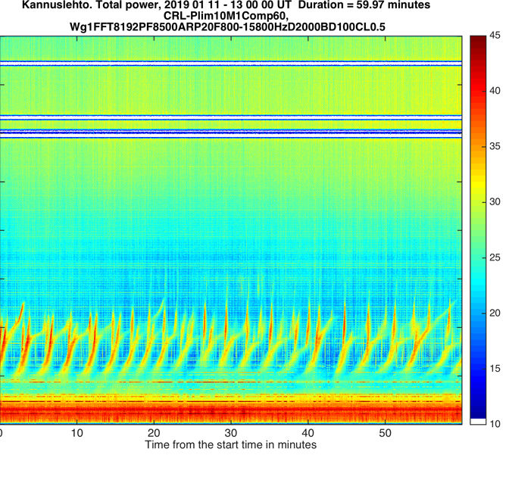
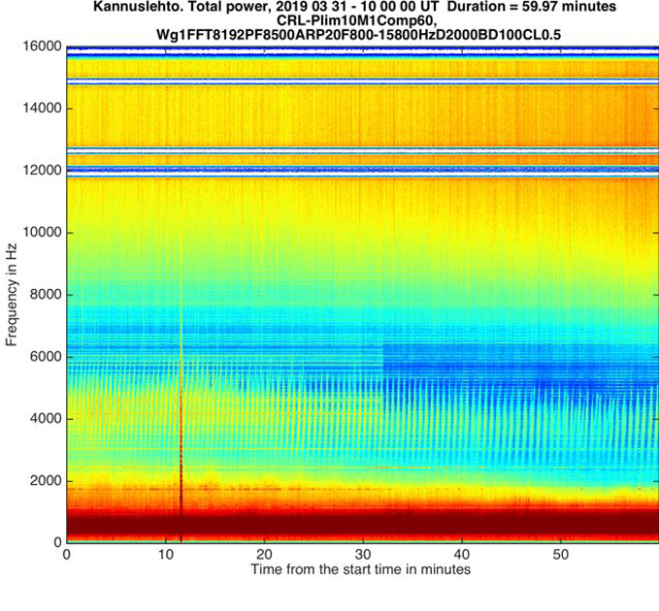
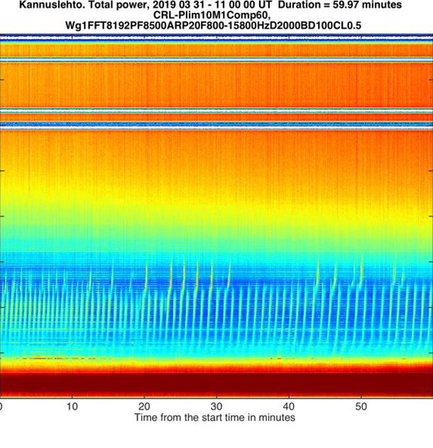
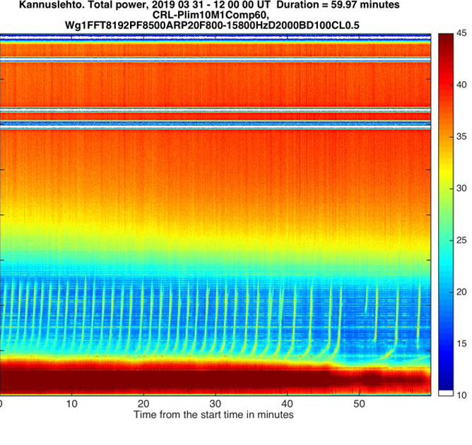
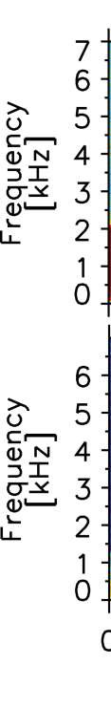
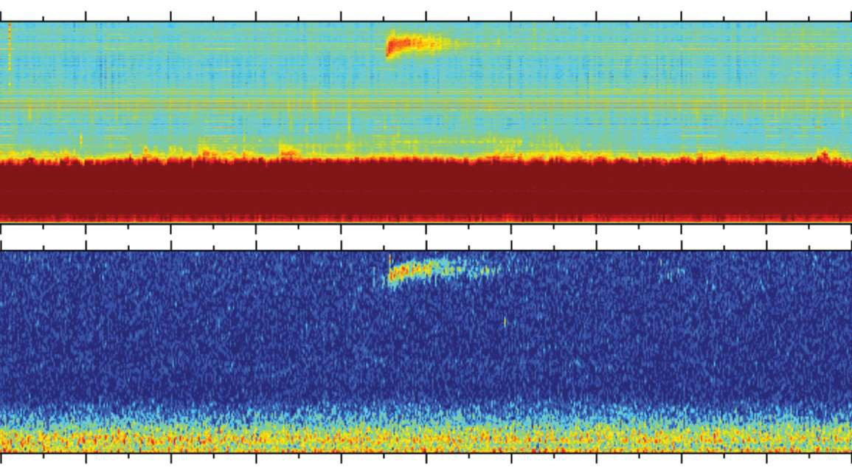
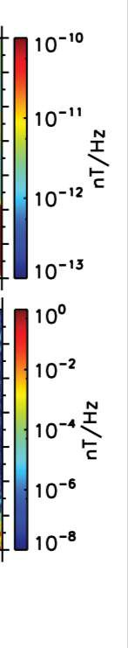
QPs on11 Jan and 31 Mar (Arase fp above Iceland)
2 0 18 .0 1.2 0 13 :15 UT
2 0 18 .0 1.2 0 13 :15 UT
2 0 18 .0 1.2 0 13 :15 UT

Slide 18
Titova et al. (2015) GRL

Slide 19
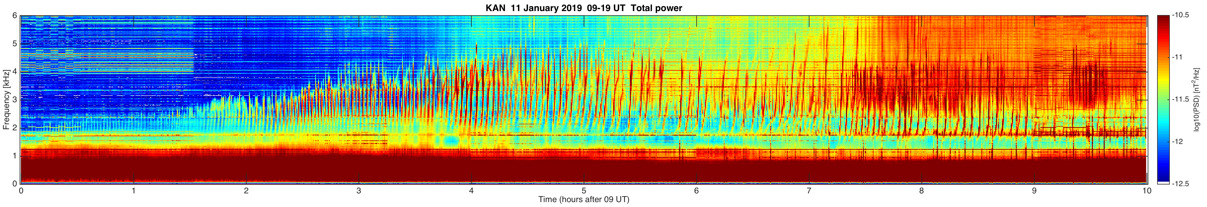
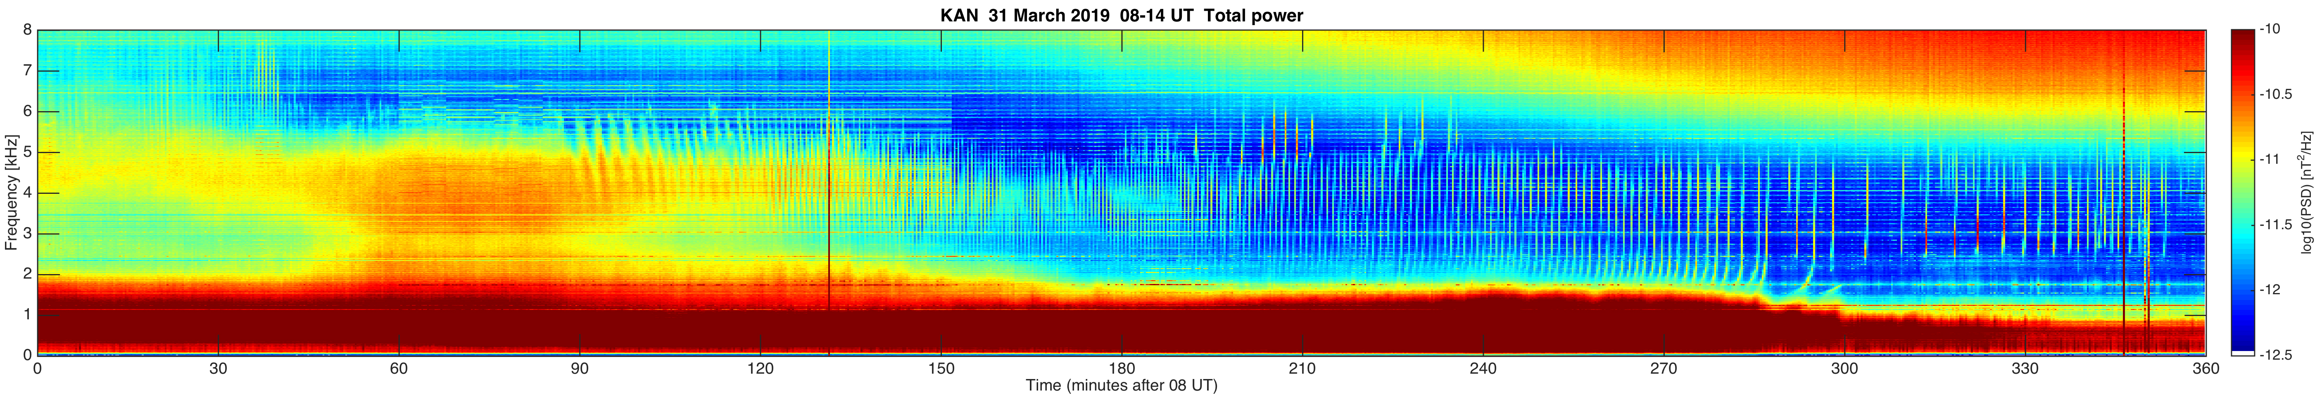
‘Difficult events’
QP lasting 10 hours (09-19 UT) on 11 Jan 2019
QP lasting 6 hours (08-14 UT) on 31 Mar 2019
One more event here
2 0 18 .0 1.2 0 13 :15 UT
2 0 18 .0 1.2 0 13 :15 UT
2 0 18 .0 1.2 0 13 :15 UT

Slide 20
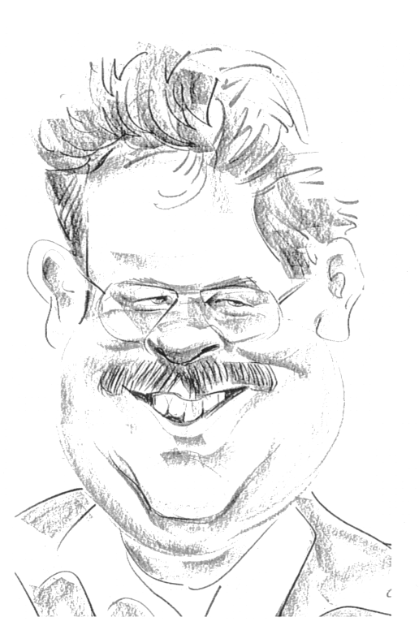
Conclusion
Several examples of simultaneous ELF-VLF events on the ground and satellites:
  Typically the duration of the events is much longer than observed on the satellites
  Ground-based observations show temporal behaviour while satellite observations show spatial extent
  Plenty of possibility for good studies
Hundreds of days with interesting conjunctions found, so far
www.sgo.fi/pub_vlf/
THANK YOU!

Slide 21
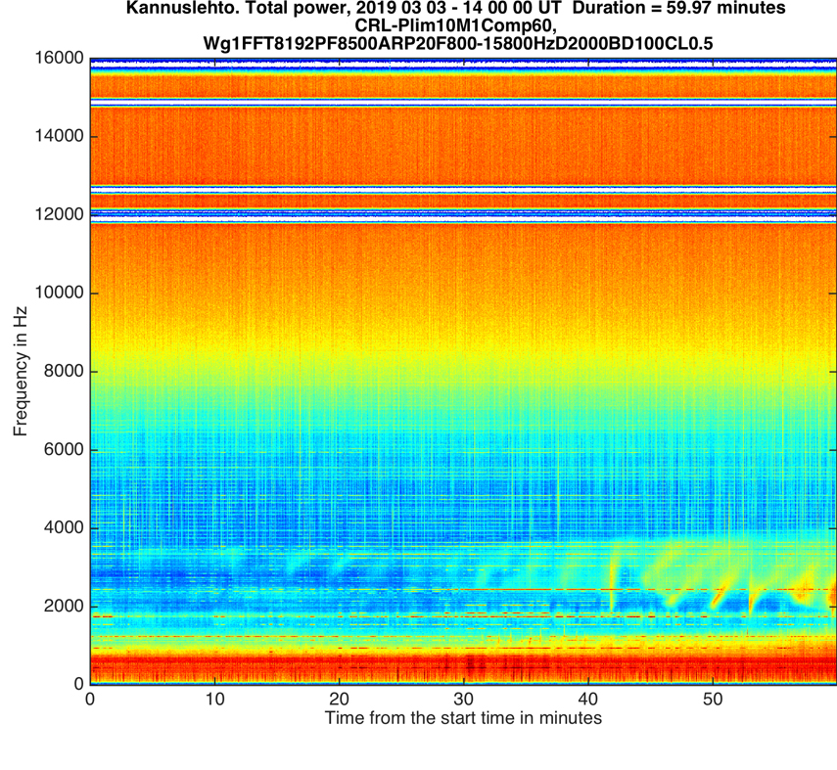
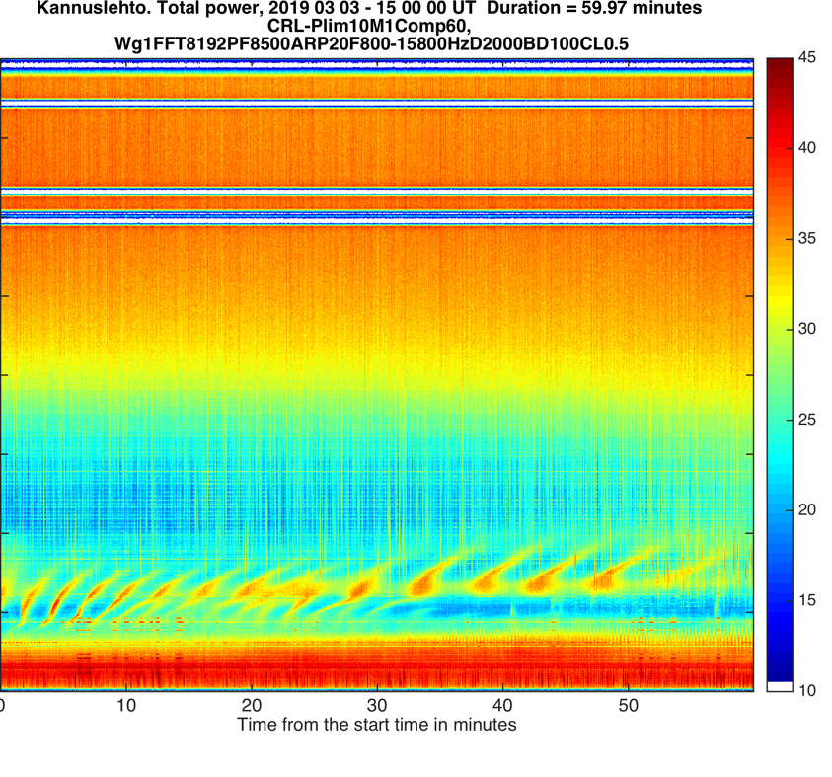
One new event on 3 Mar 2019 (14-16 UT)
2 0 18 .0 1.2 0 13 :15 UT
2 0 18 .0 1.2 0 13 :15 UT
2 0 18 .0 1.2 0 13 :15 UT

