Slide 1

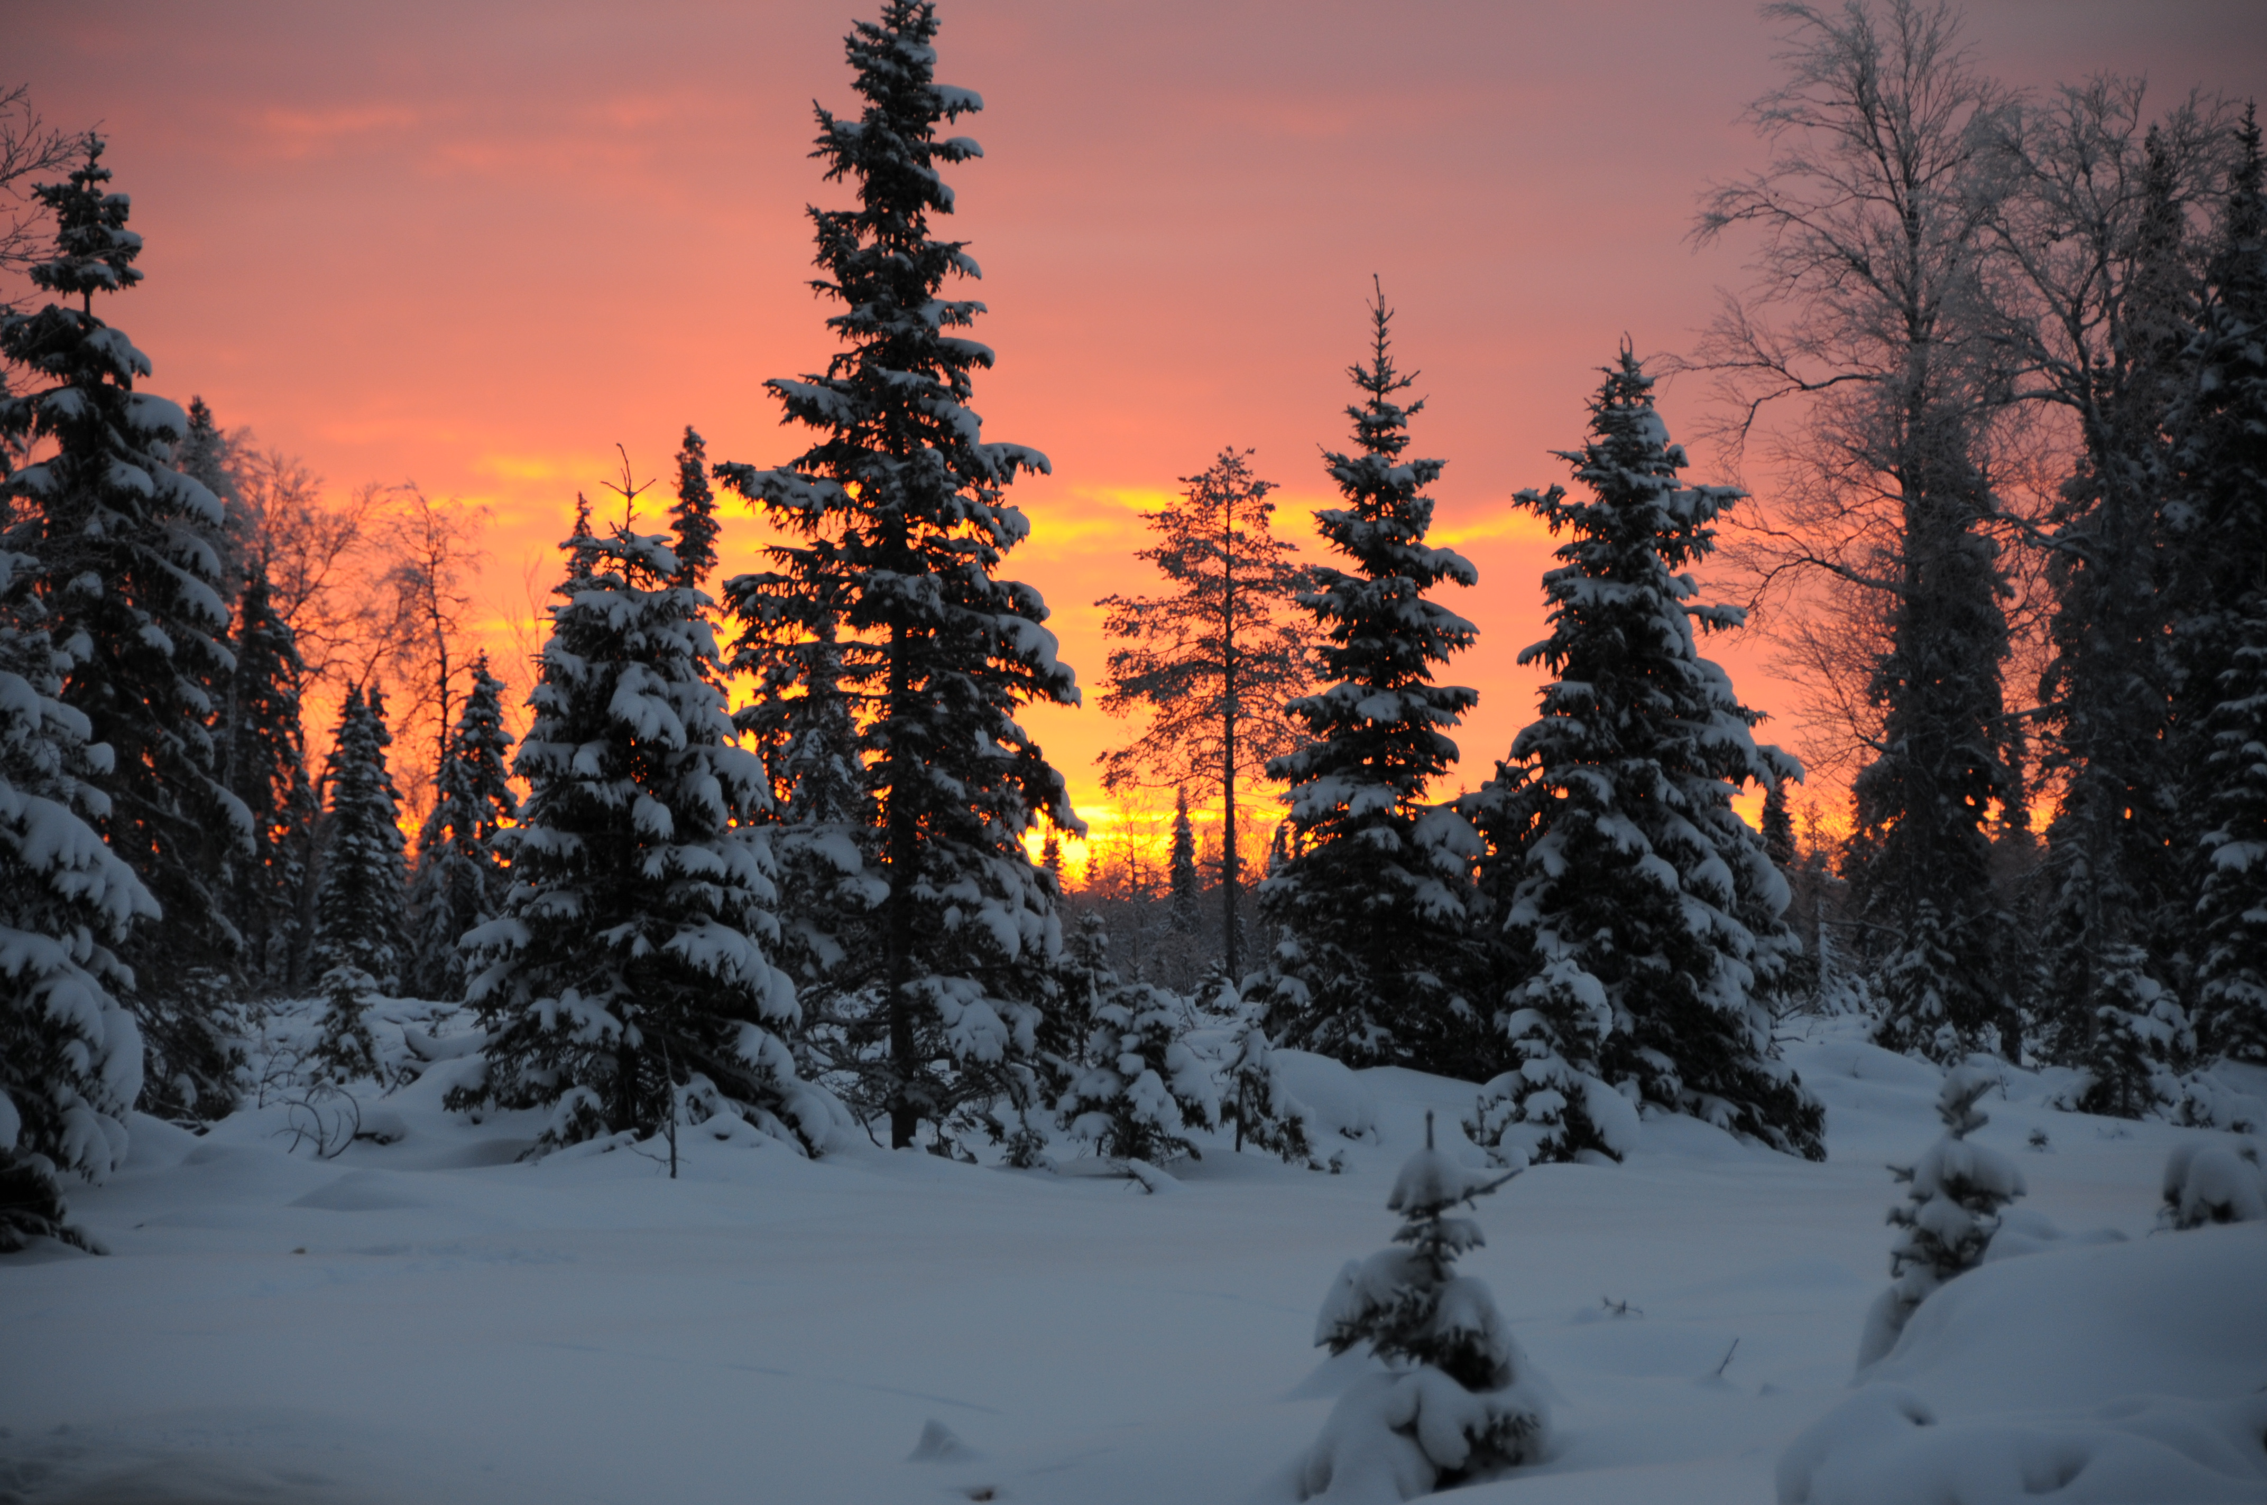
Ground-based ELF-VLF observations at Kannuslehto during the first year of ARASE
J. Manninen and T. Turunen
Sodankylä Geophysical Observatory

Slide 2
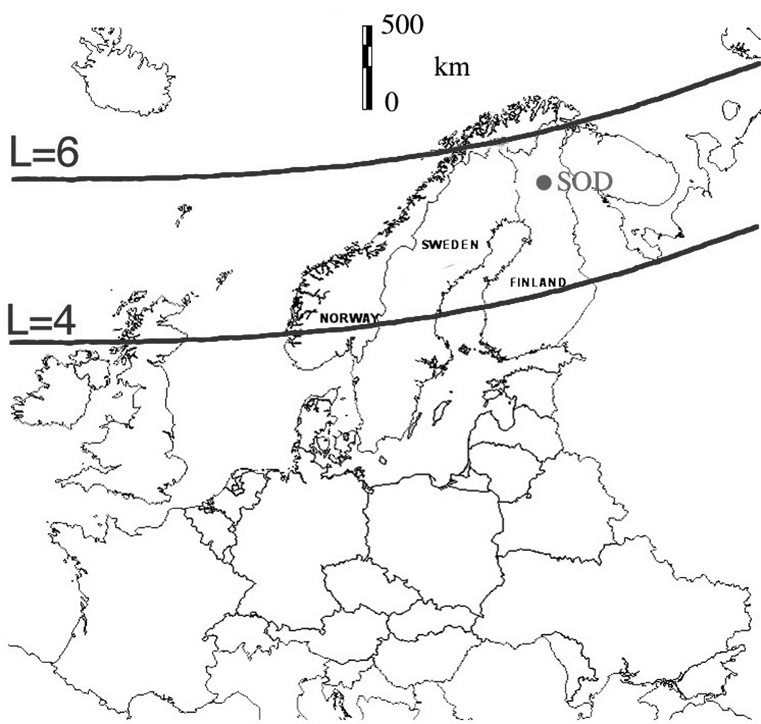

Slide 3
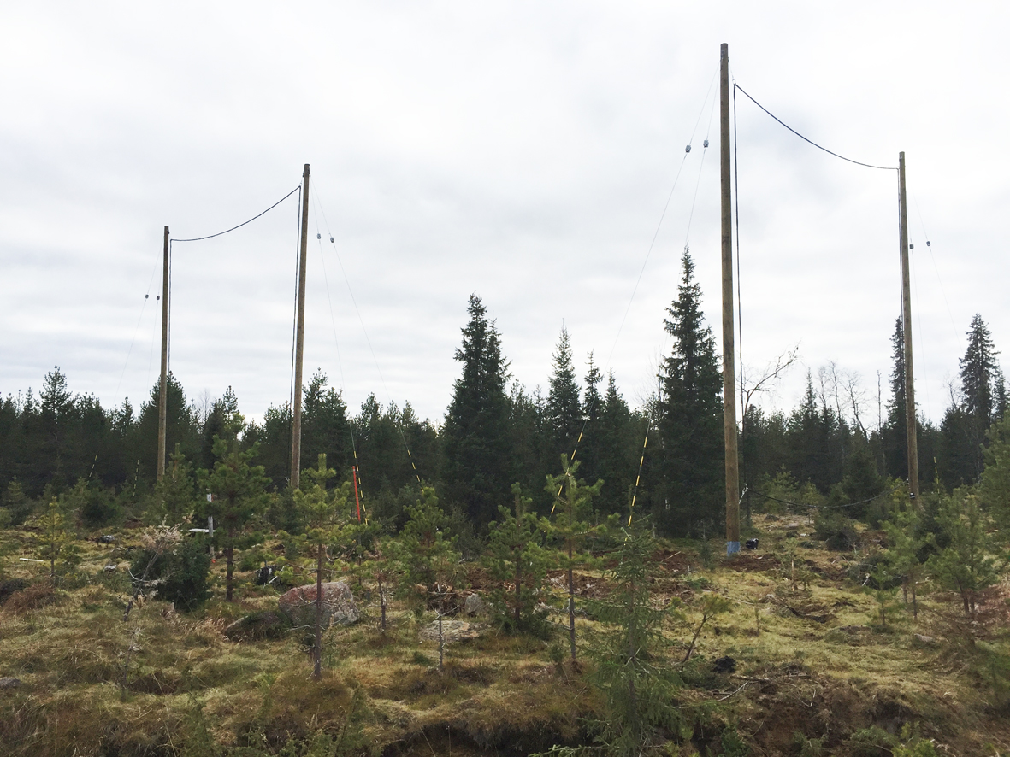
10 m
10 m

Slide 4
Some facts about Kannuslehto
Kannuslehto CGM: +64.31°; 119.66°; L = 5.5
  electron gyrofrequency at the equator f_{ce} ≈ 5.2 kHz -> f_{ce} /2 ≈ 2.6 kHz
9 km
Nearest power line
45 km

Slide 5
Simultaneous observations with ERG/ARASE
Spring 2017: 10 night-time simultaneous obs.
Autumn 2017: 13 afternoons simultaneous obs.
Winter 2017-2018: 58 day-time simultaneous obs.
  Altogether 81 suitable conjunctions
  Among them 46 (6+5+35) interesting conjunctions
Different kind of events observed on the ground
  Auroral hiss
  Heating, MLR, unknown transmitter signals
  QP emissions
  Chorus, ‘normal’ and ‘high-frequency’
  Chorus with pulsating aurora

Slide 6
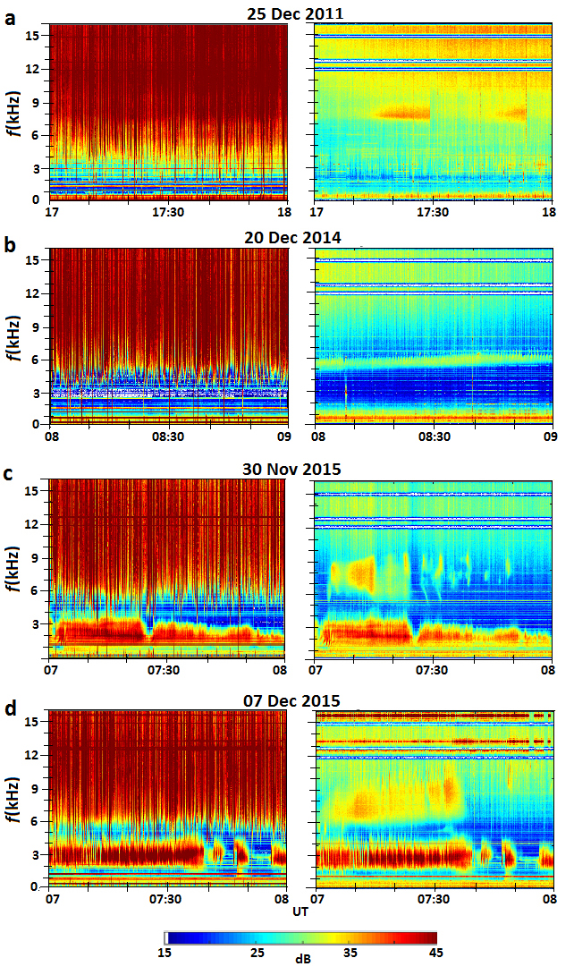
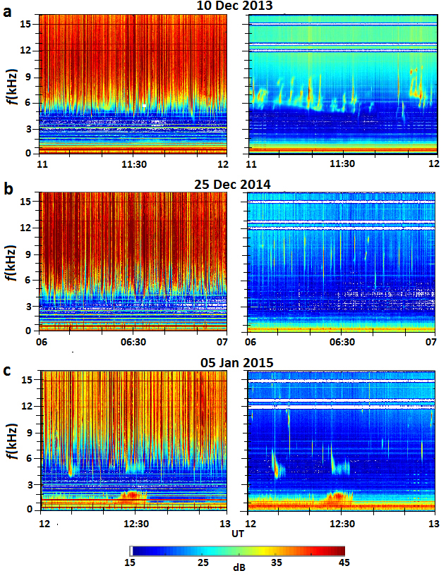
Manninen et al., 2016, ERL

Slide 7
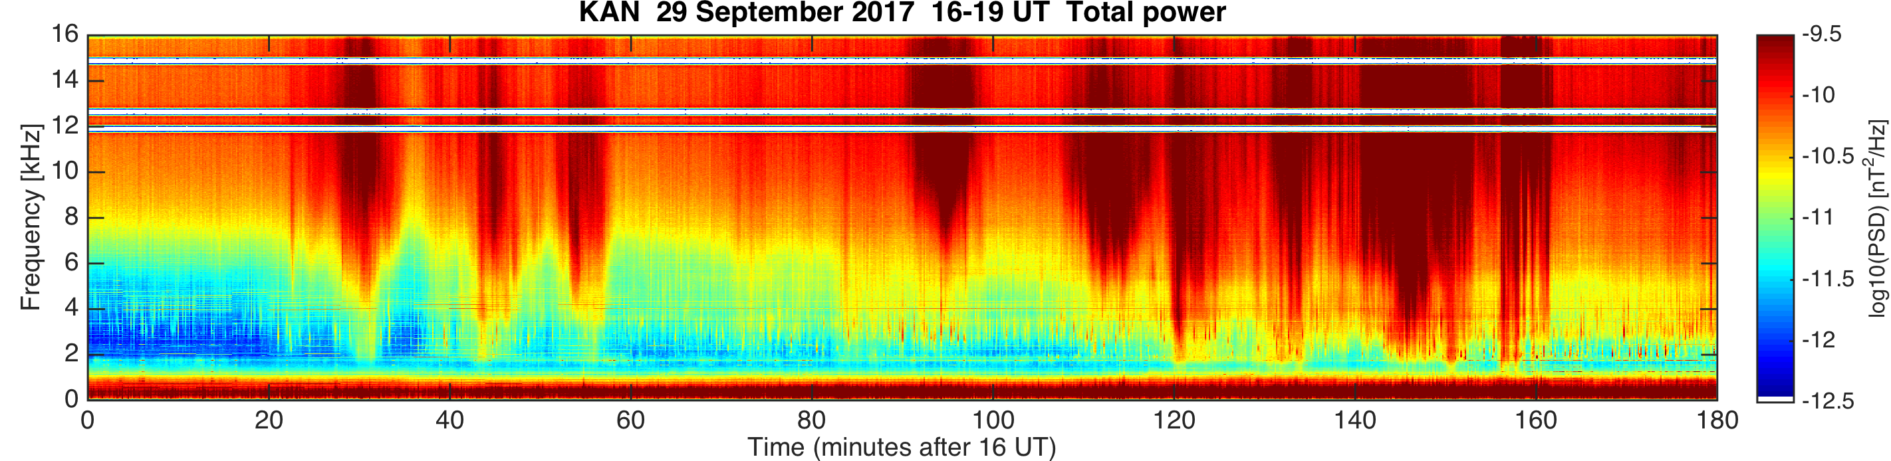
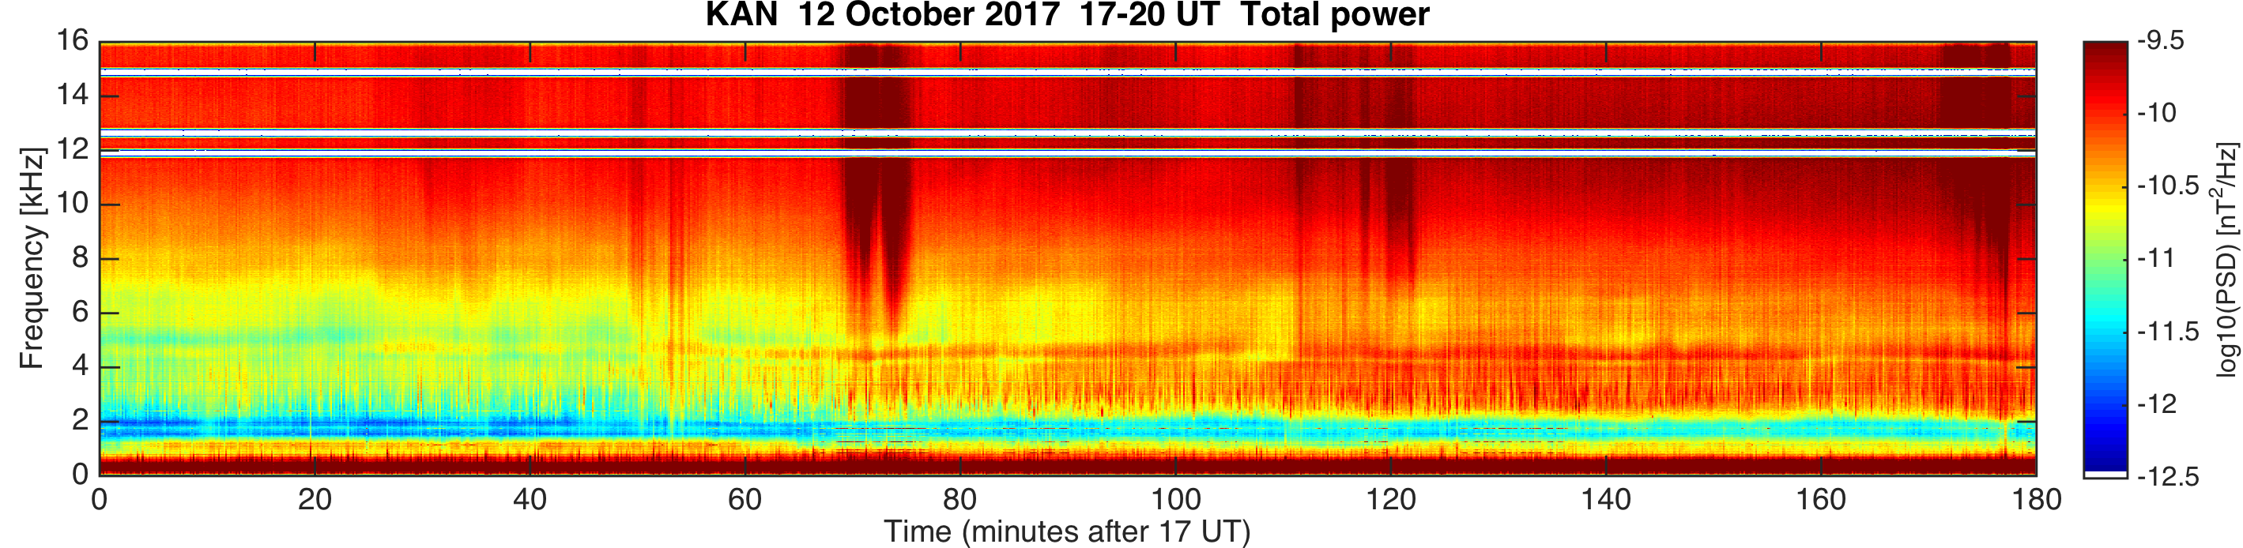
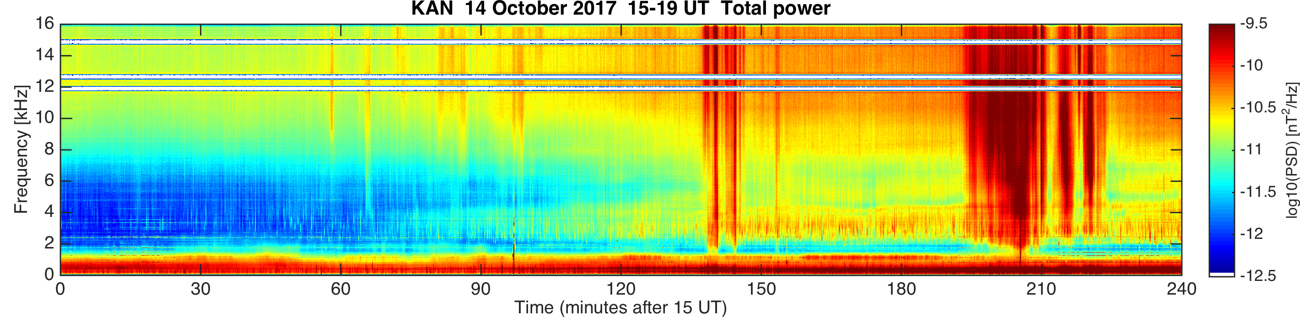
Auroral hiss

Slide 8
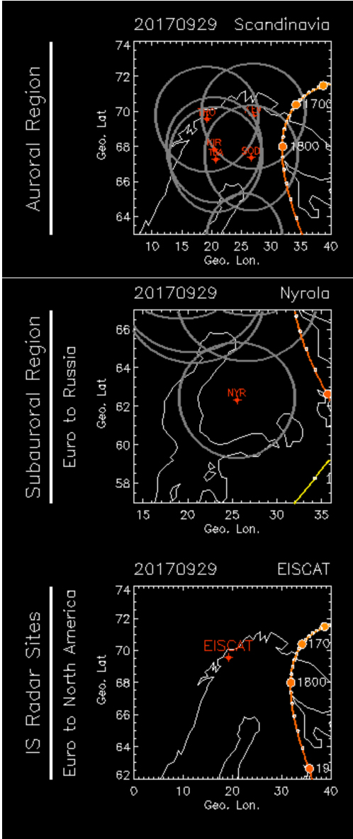
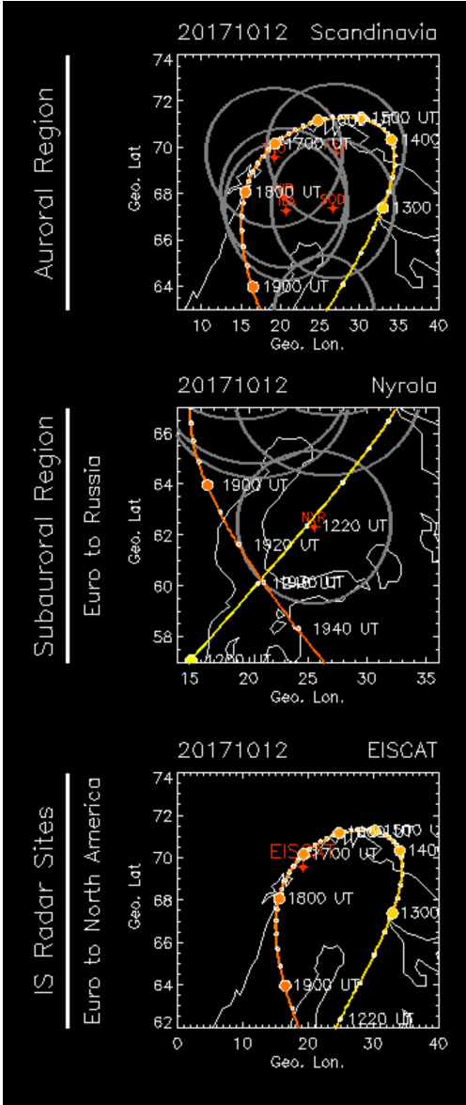
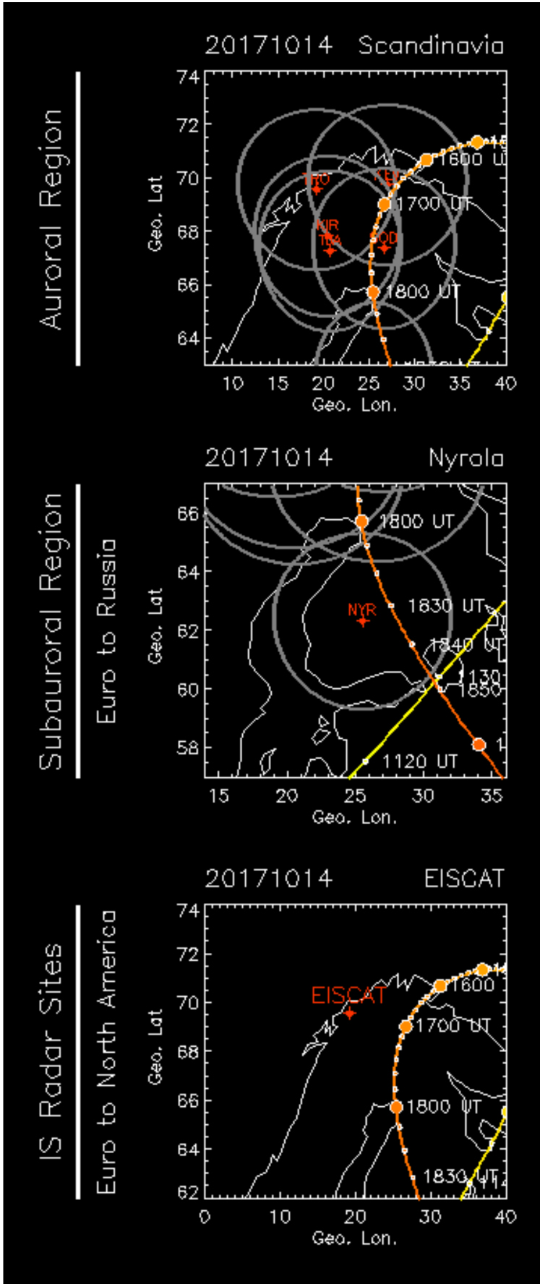
Auroral hiss

Slide 9
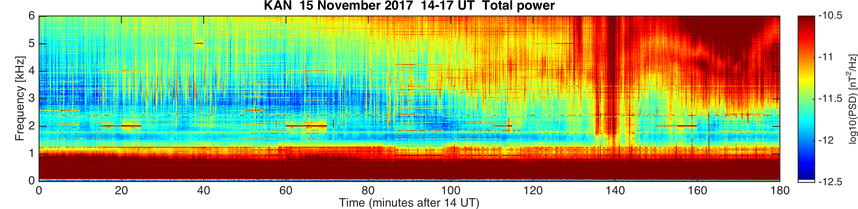
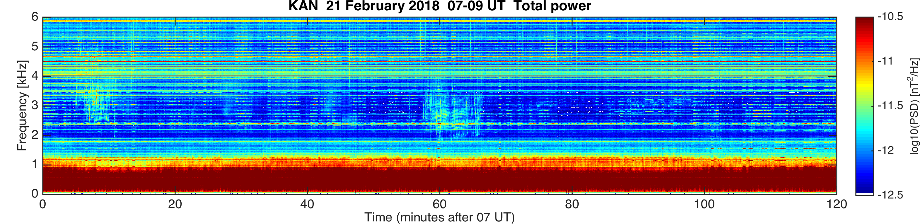
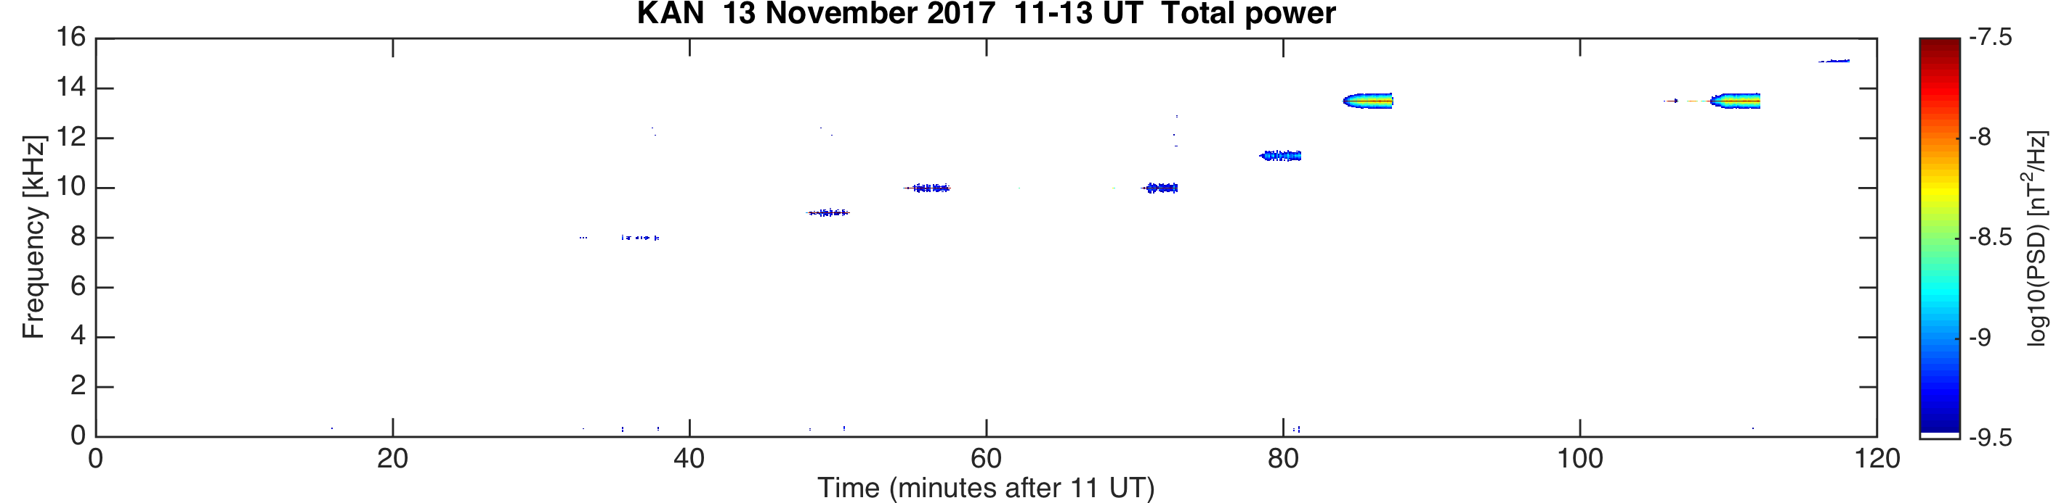
Heating, MLR, and unknown transmitter

Slide 10
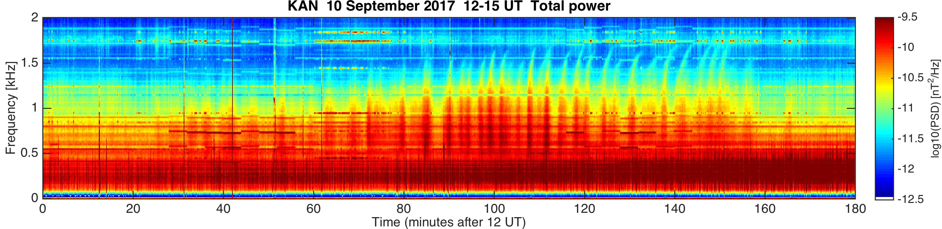
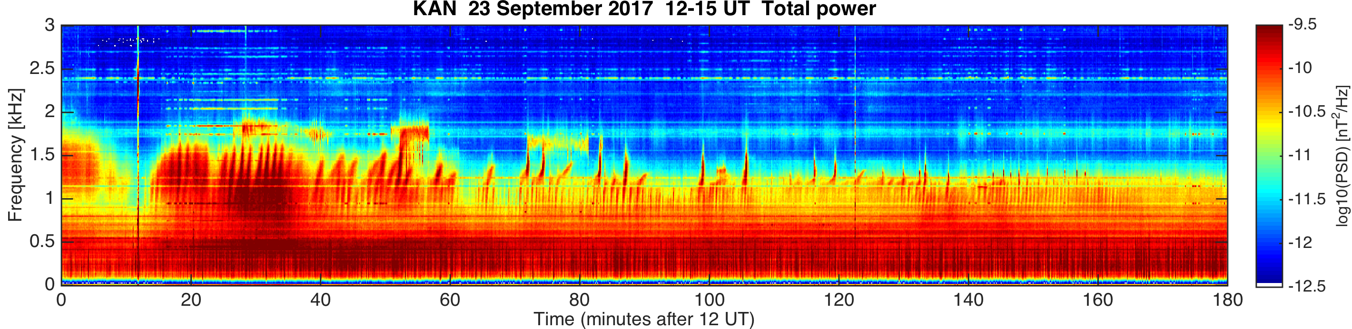
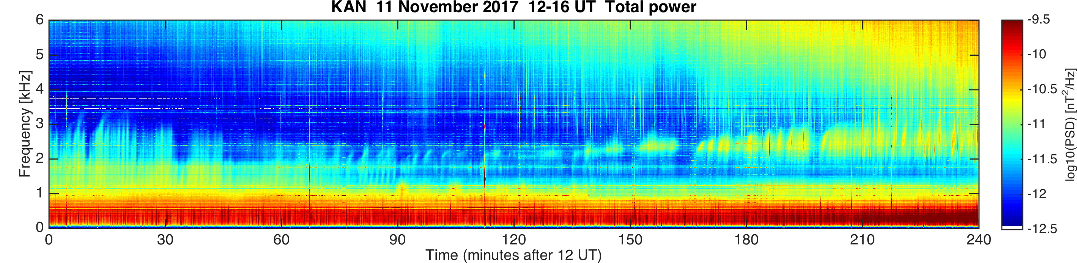
QP events (1/4)

Slide 11
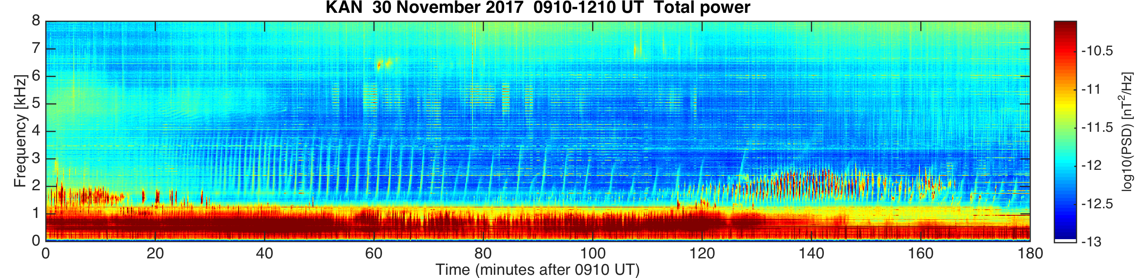
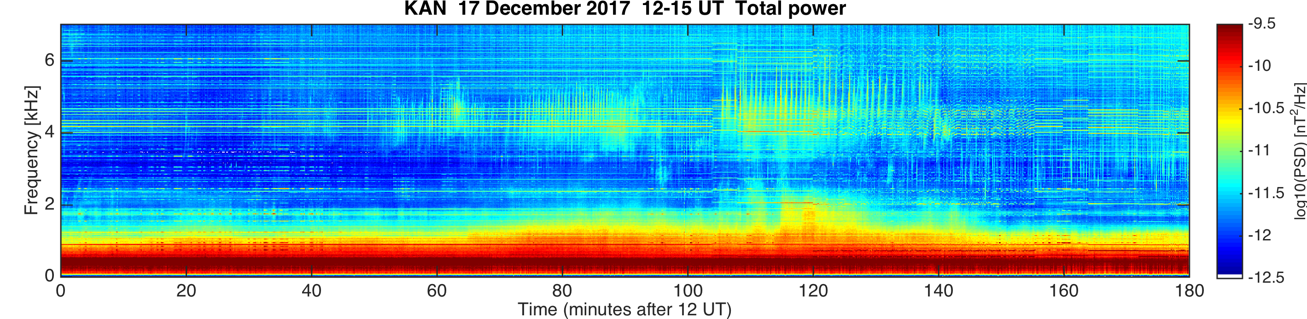
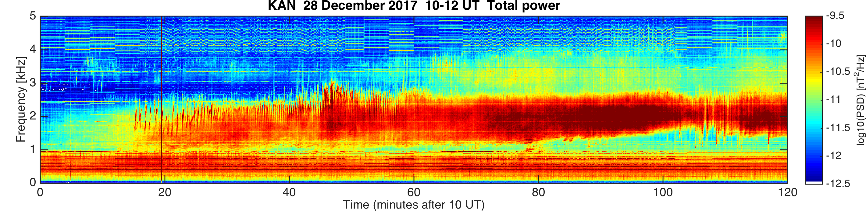
QP events (2/4)

Slide 12
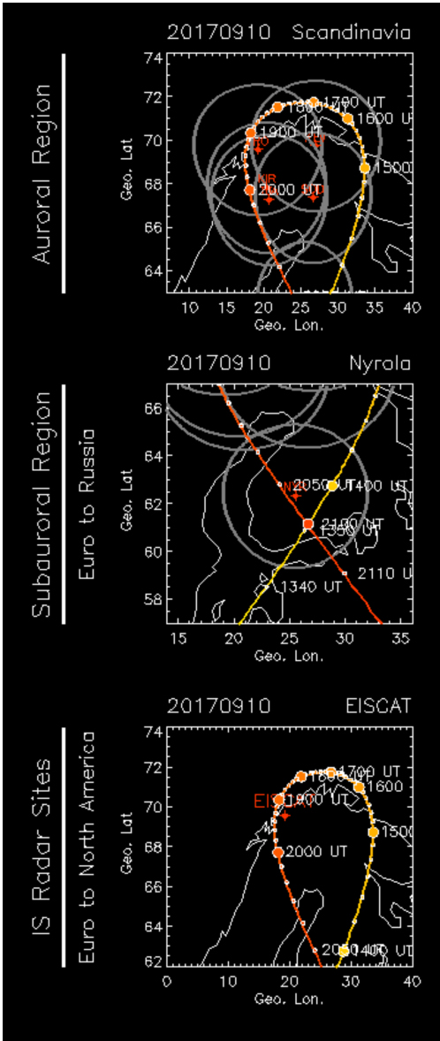
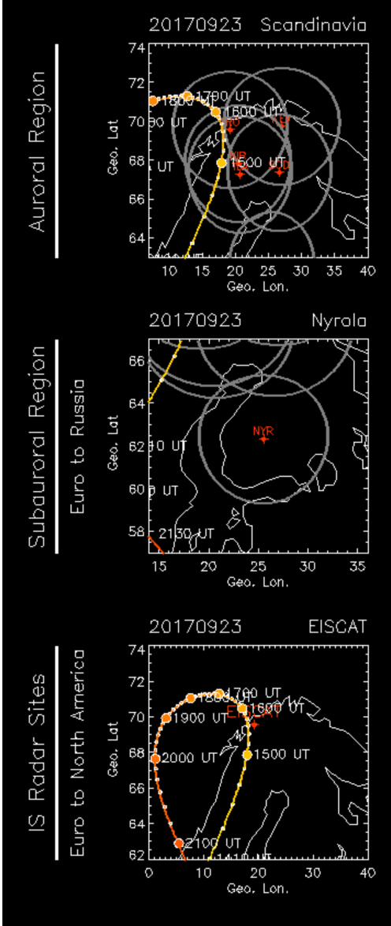
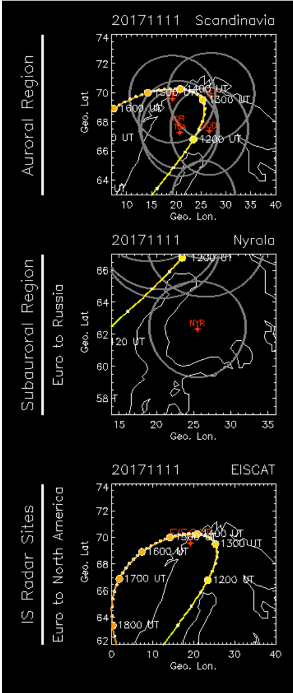
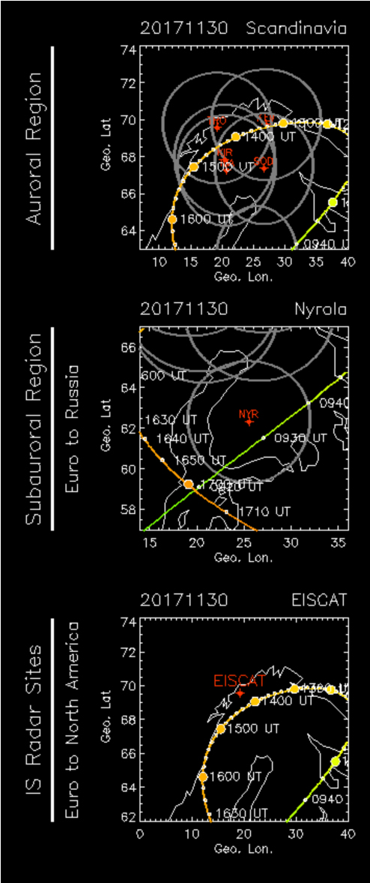
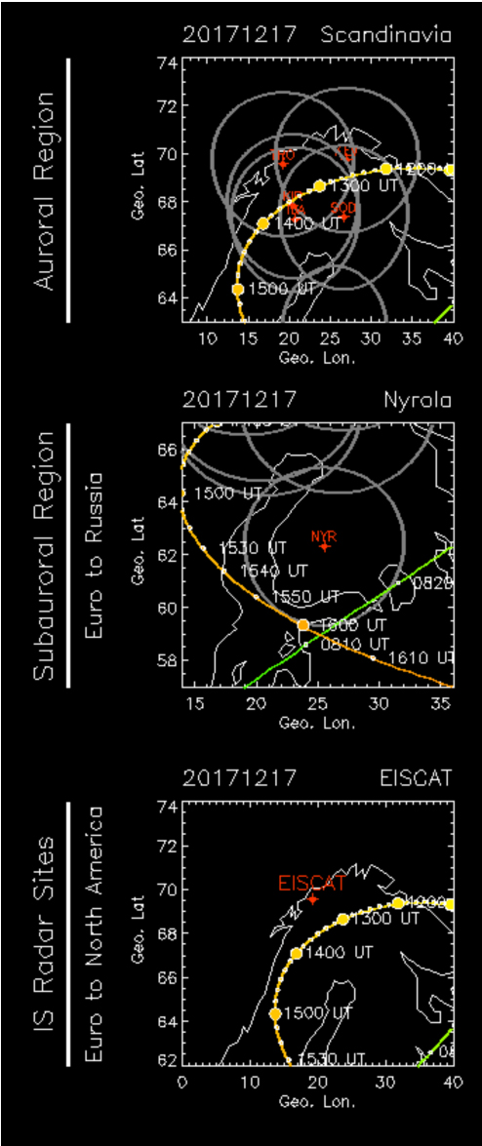
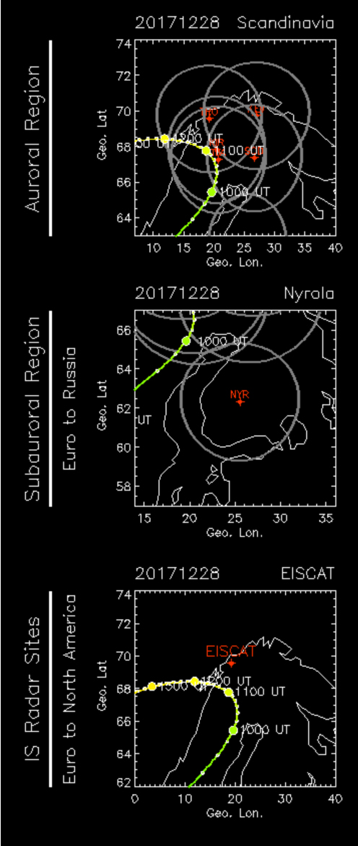
QP events 1-6

Slide 13
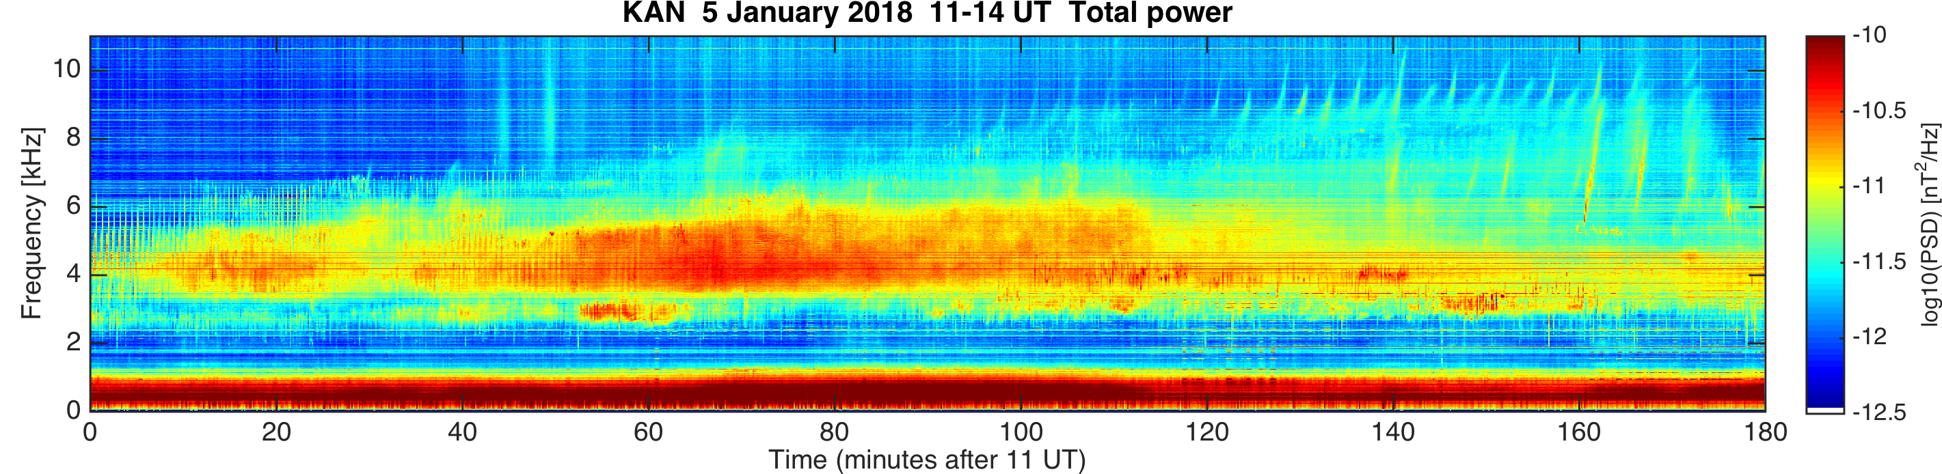
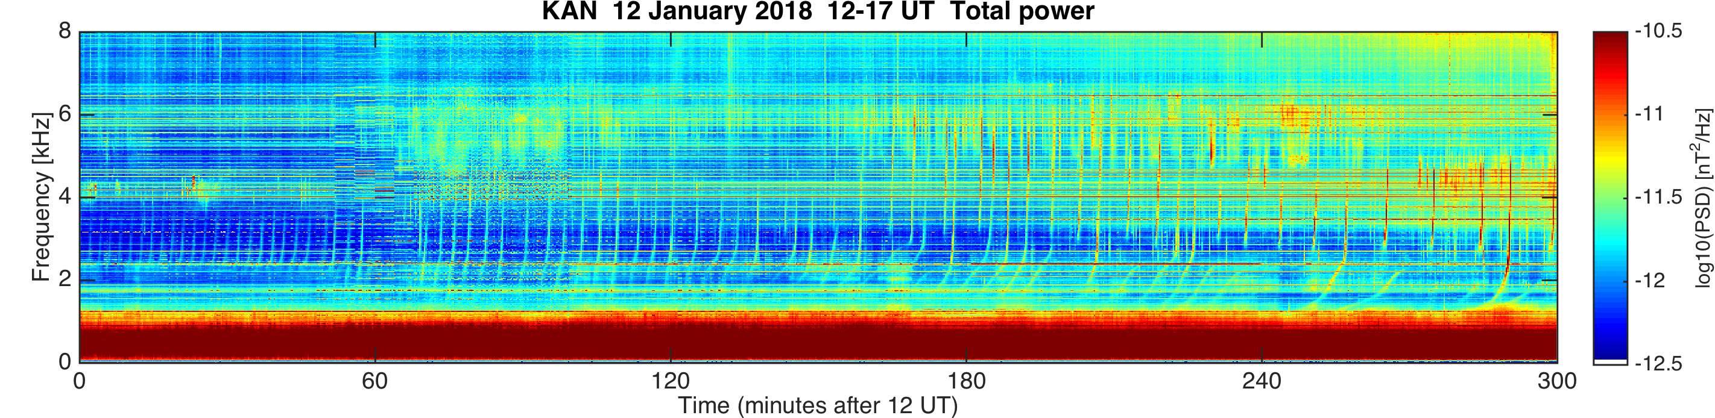
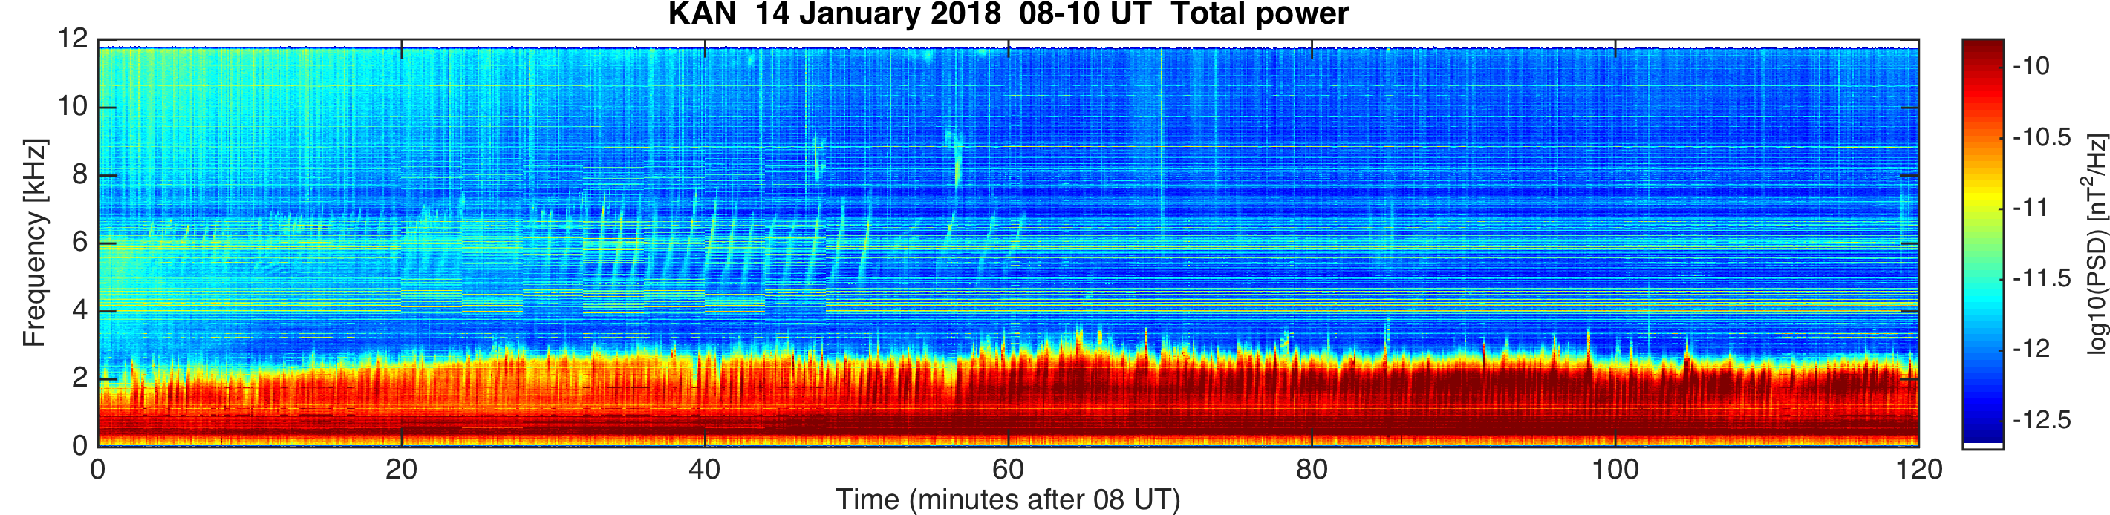
QP events (3/4)

Slide 14
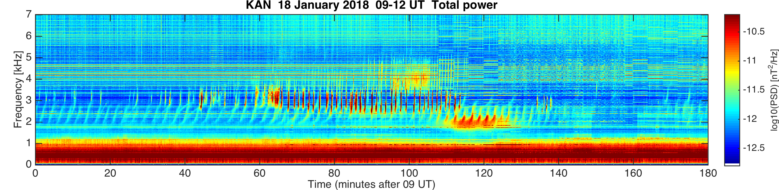
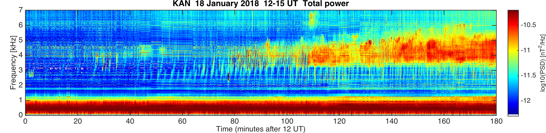
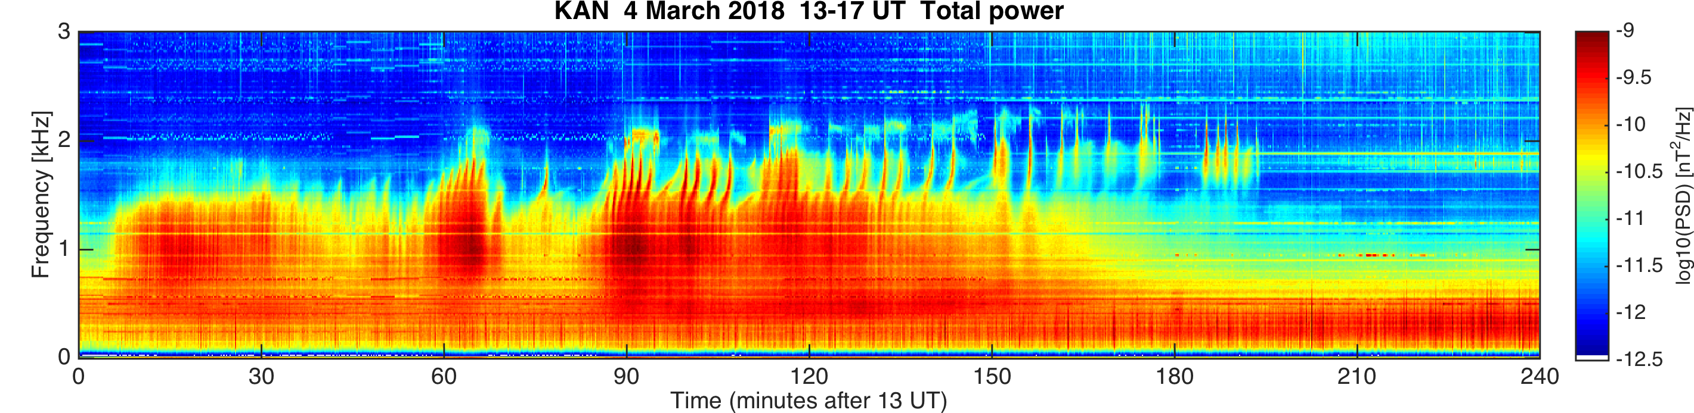
QP events (4/4)

Slide 15
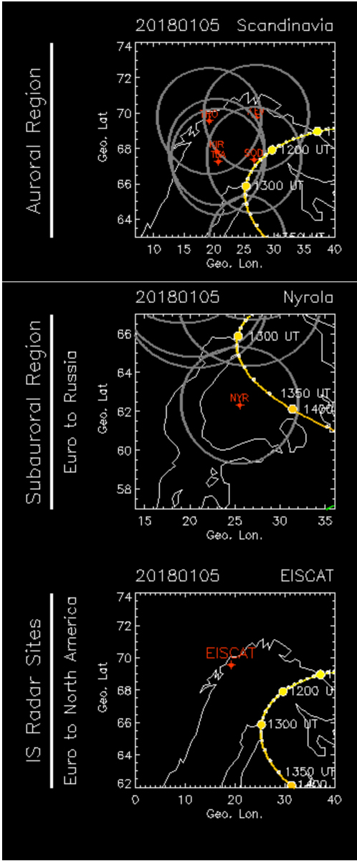
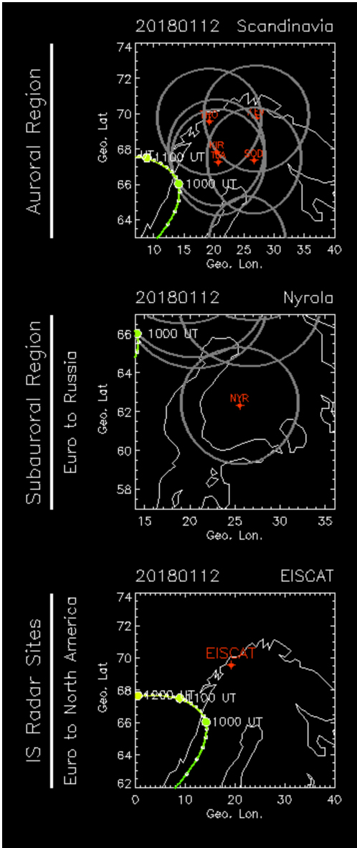
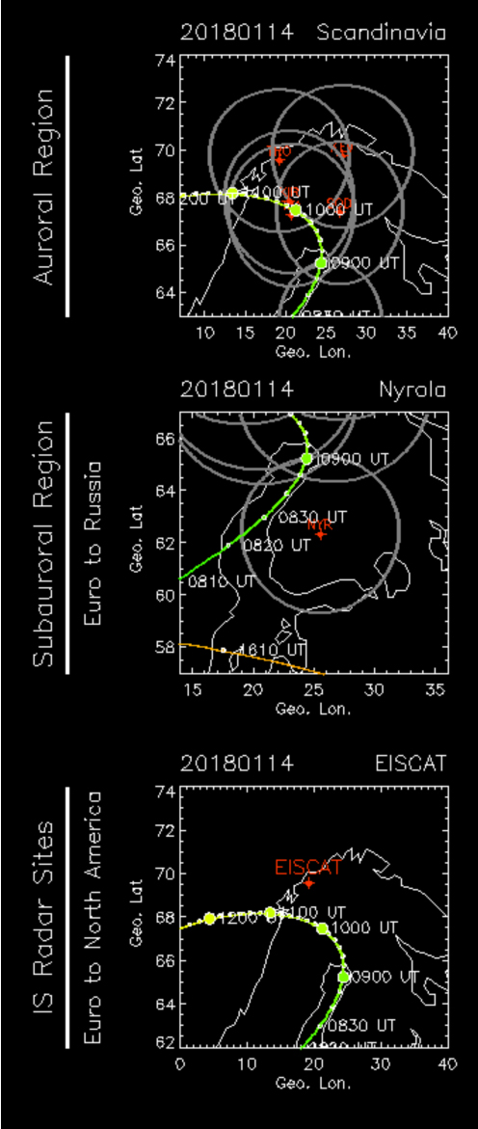
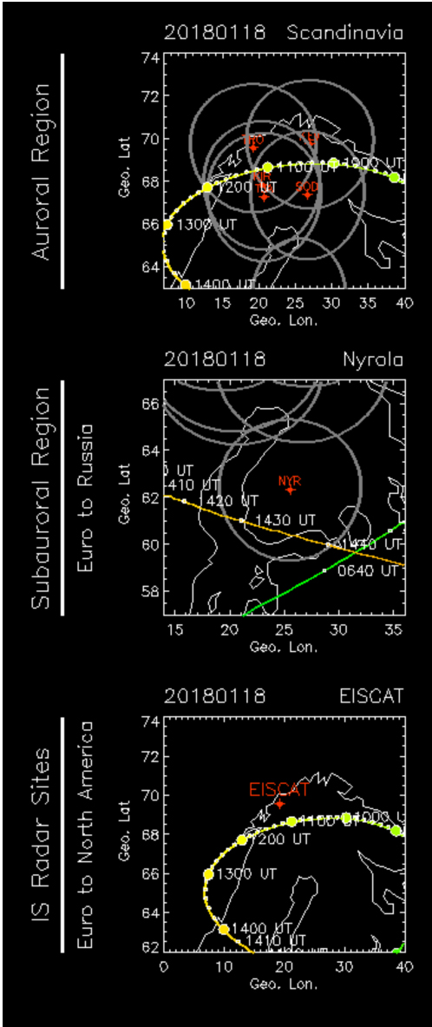
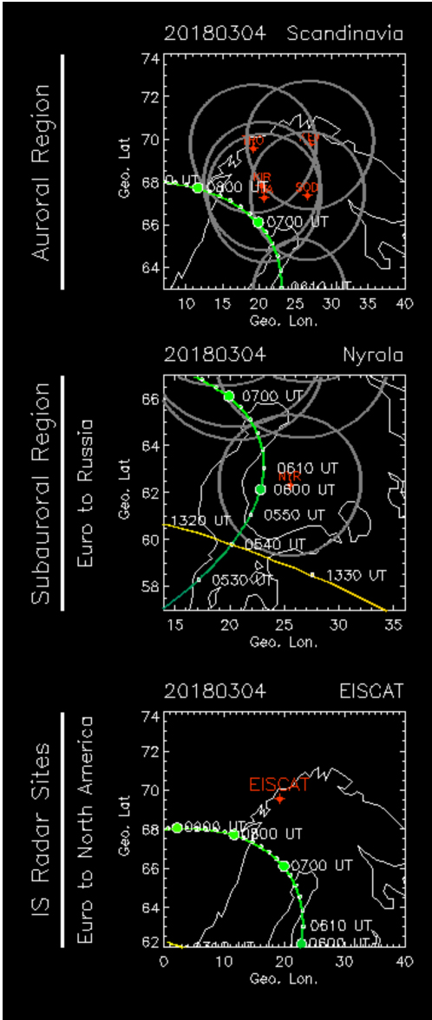
QP events 7-12

Slide 16
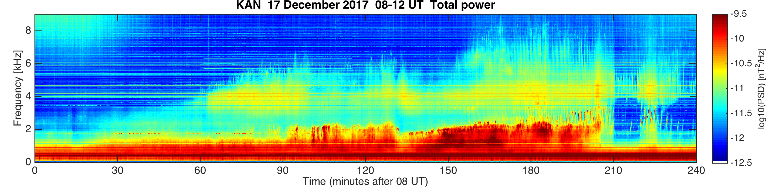
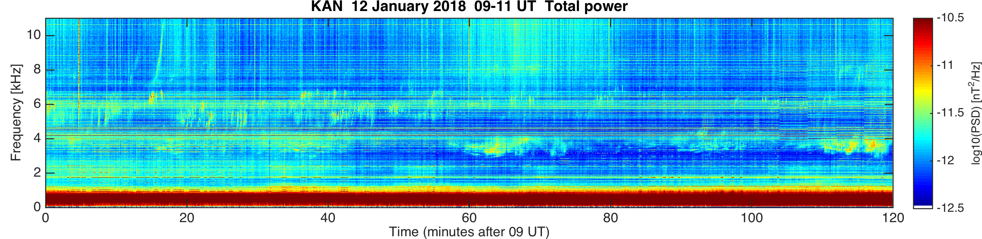
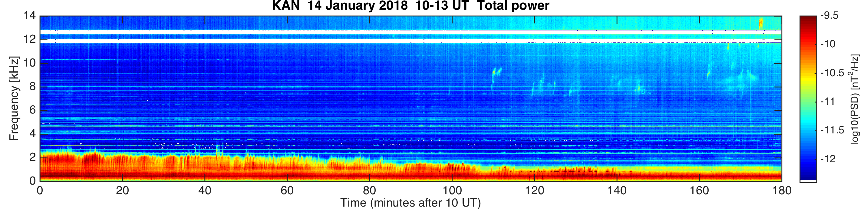
“High-frequency” VLF (1/3)

Slide 17
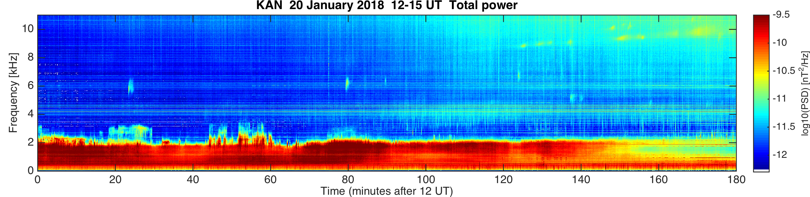
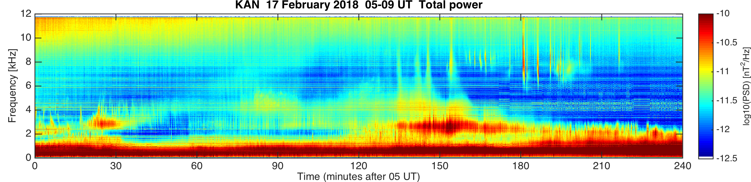
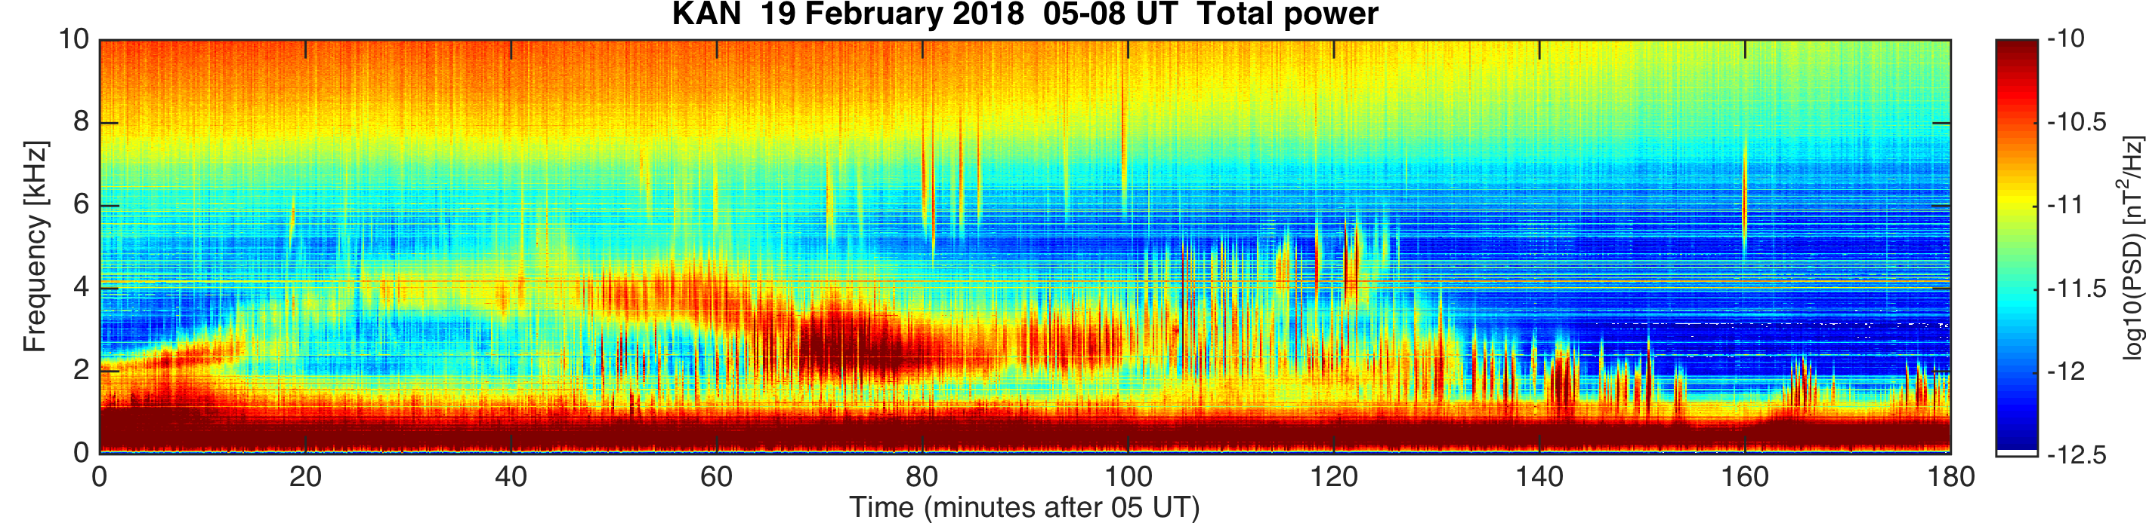
“High-frequency” VLF (2/3)

Slide 18
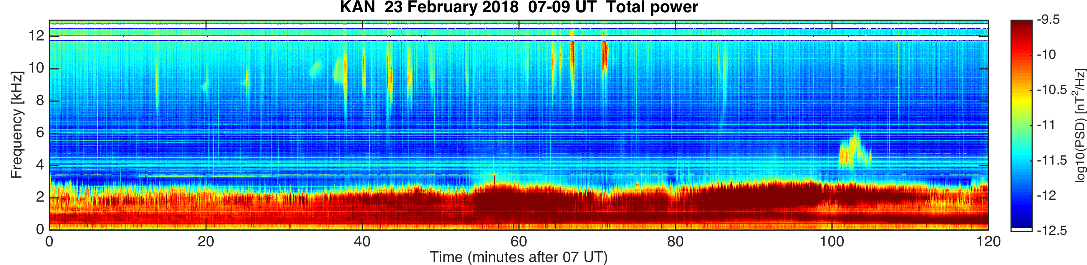
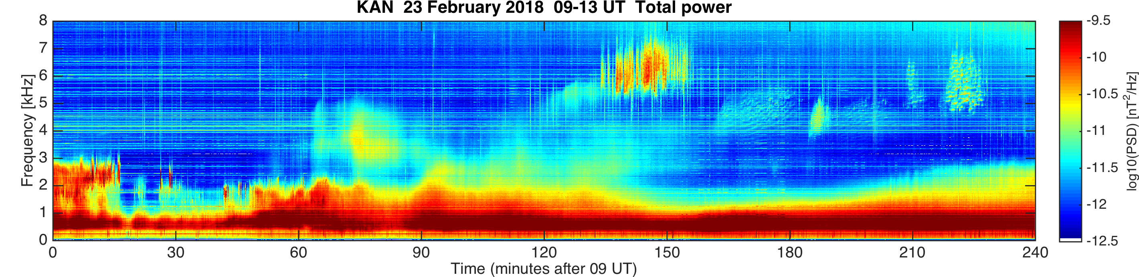
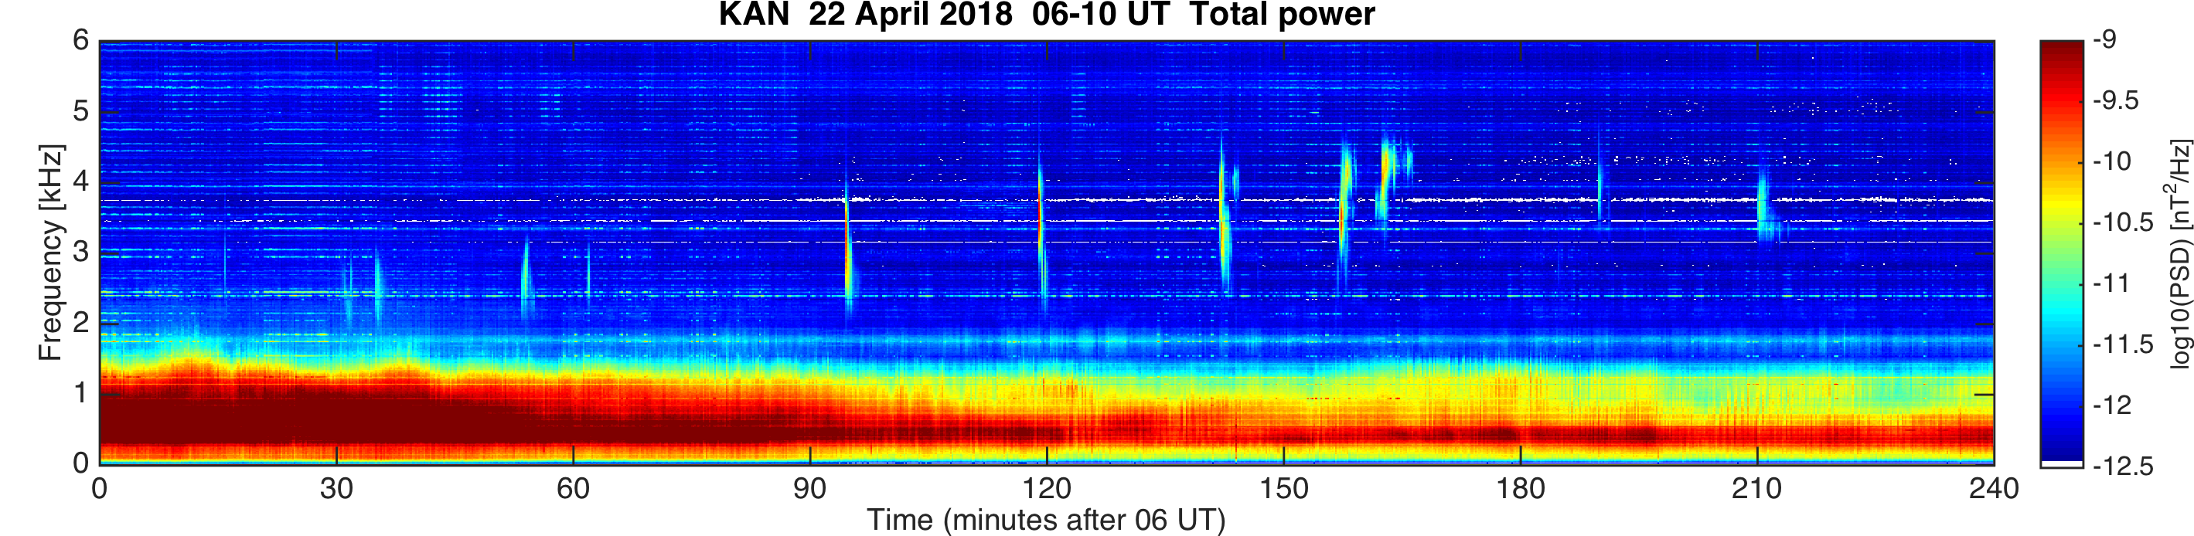
“High-frequency” VLF (3/3)

Slide 19
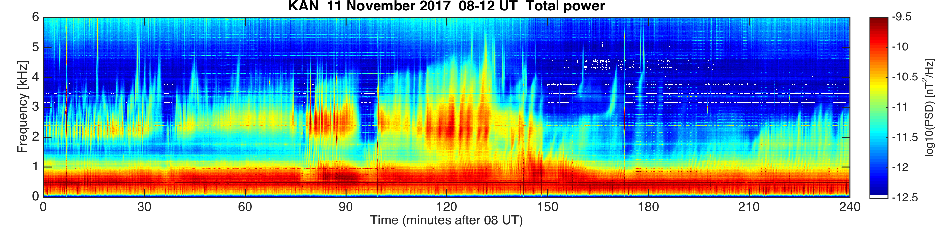
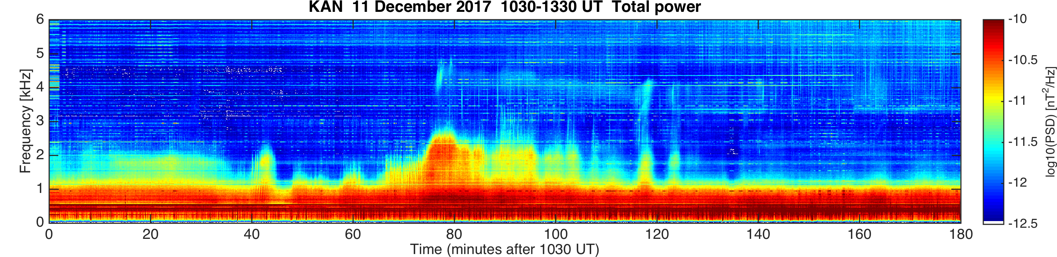
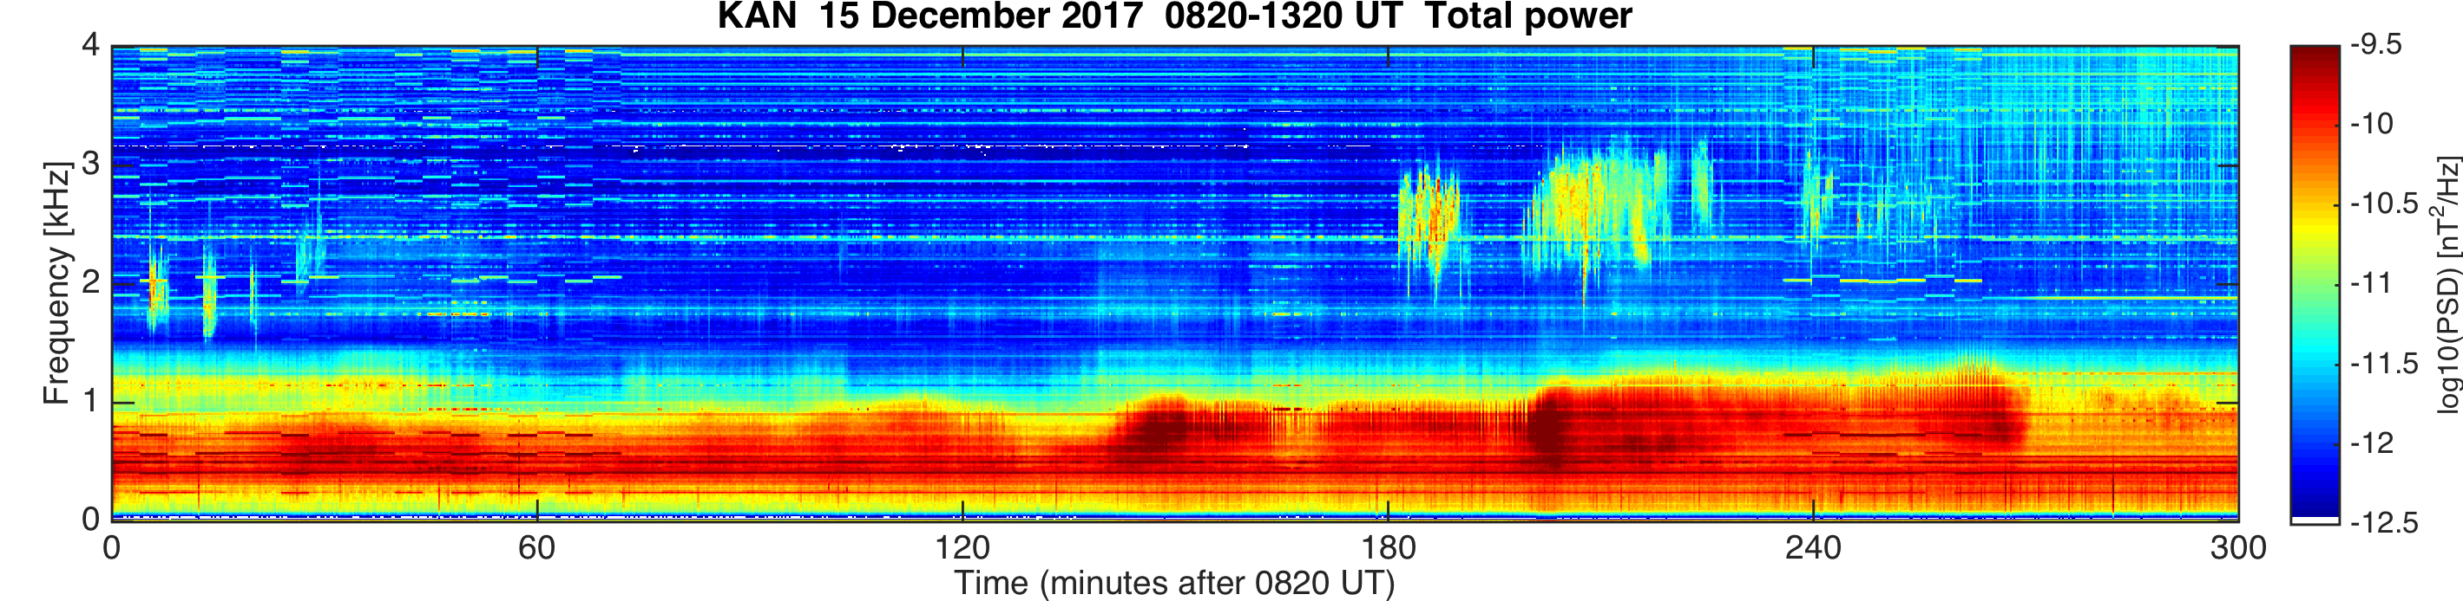
Chorus (1/7)

Slide 20
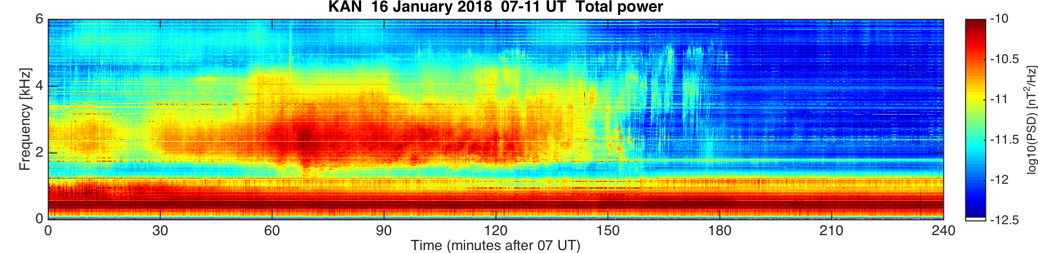


Chorus (2/7)

Slide 21


Chorus (3/7)

Slide 22


Chorus (4/7)

Slide 23



Chorus (5/7)

Slide 24



Chorus (6/7)

Slide 25


Chorus (7/7)

Slide 26

Conclusion
Several examples of the ELF-VLF events during ARASE conjunctions have been shown including:
  E.g., auroral hiss, QP events, “high-frequency” emissions, and chorus
46 days with interesting conjunctions found
www.sgo.fi/pub_vlf/
THANK YOU!

