Slide 1

KARESUVANTO, FINLAND

Slide 2
EISCAT_3D

Slide 3
Old hotel
EISCAT_3D

Slide 4
100 m

Slide 6
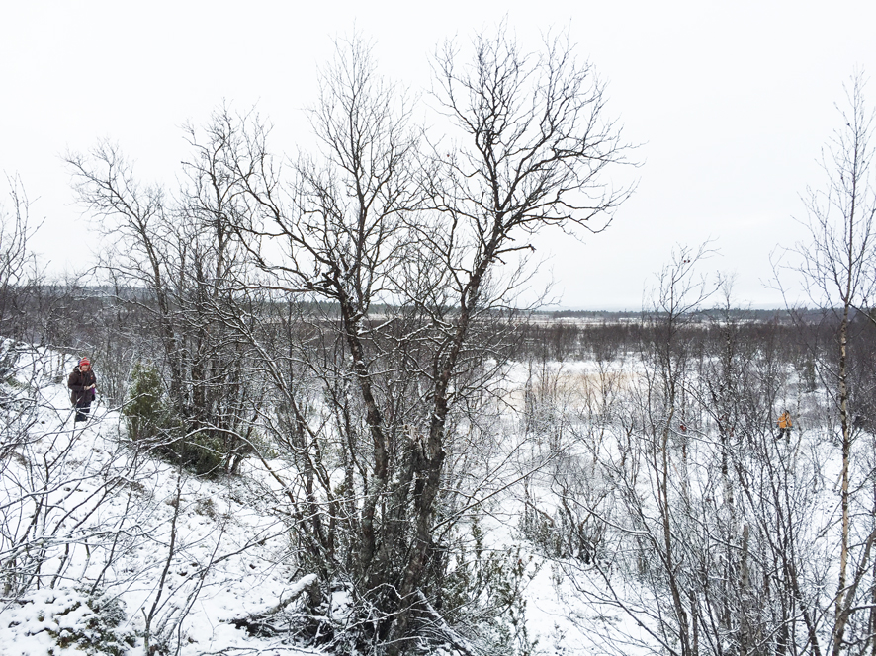
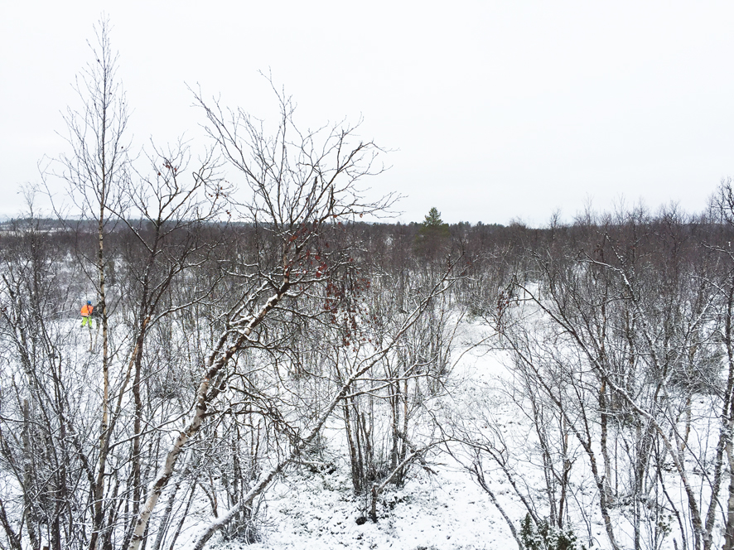

Slide 7
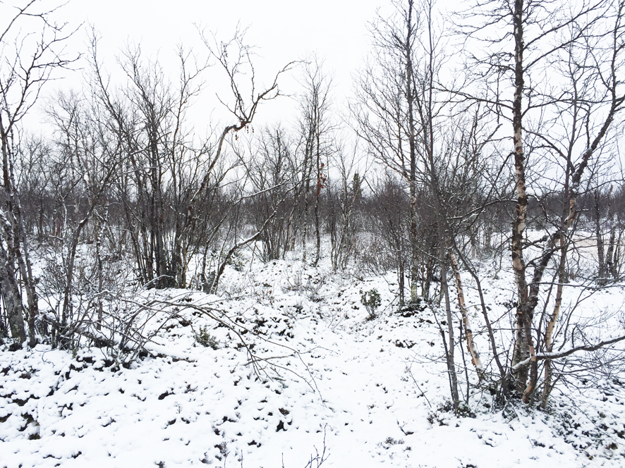
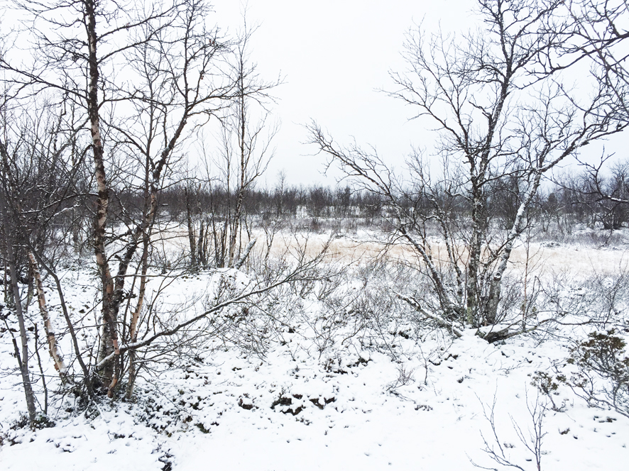

Slide 8
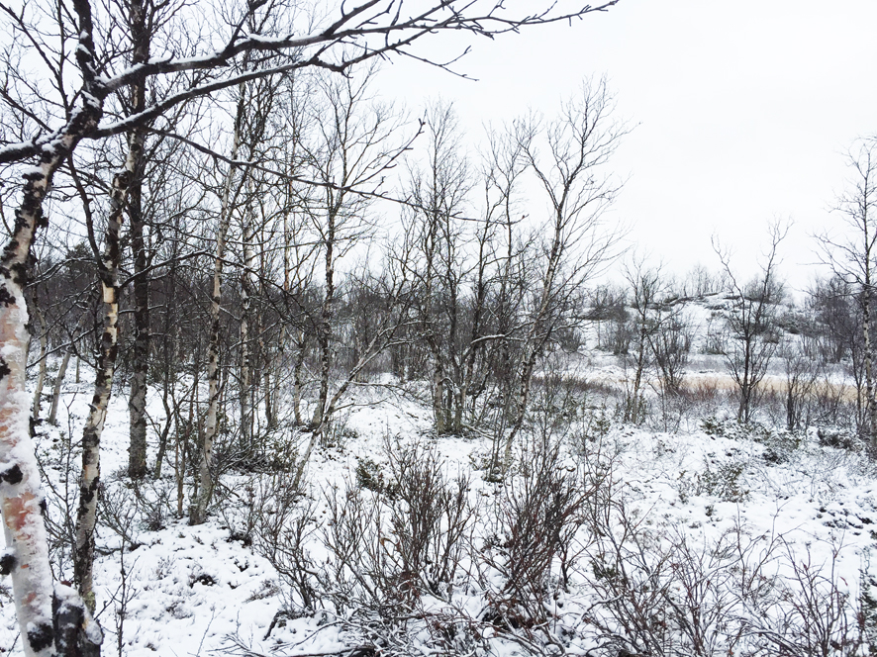
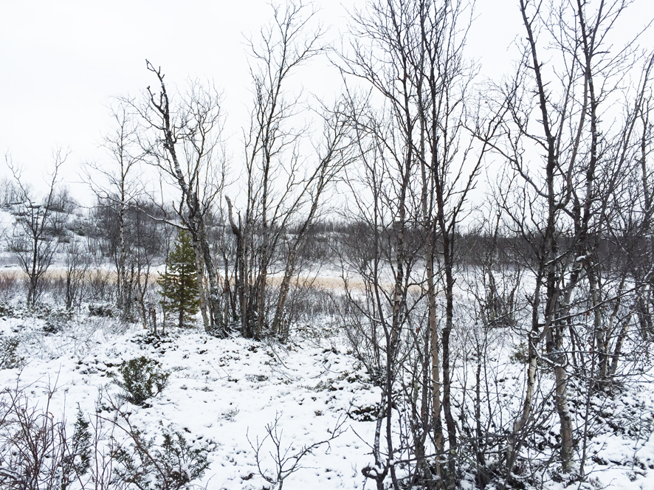

Slide 9
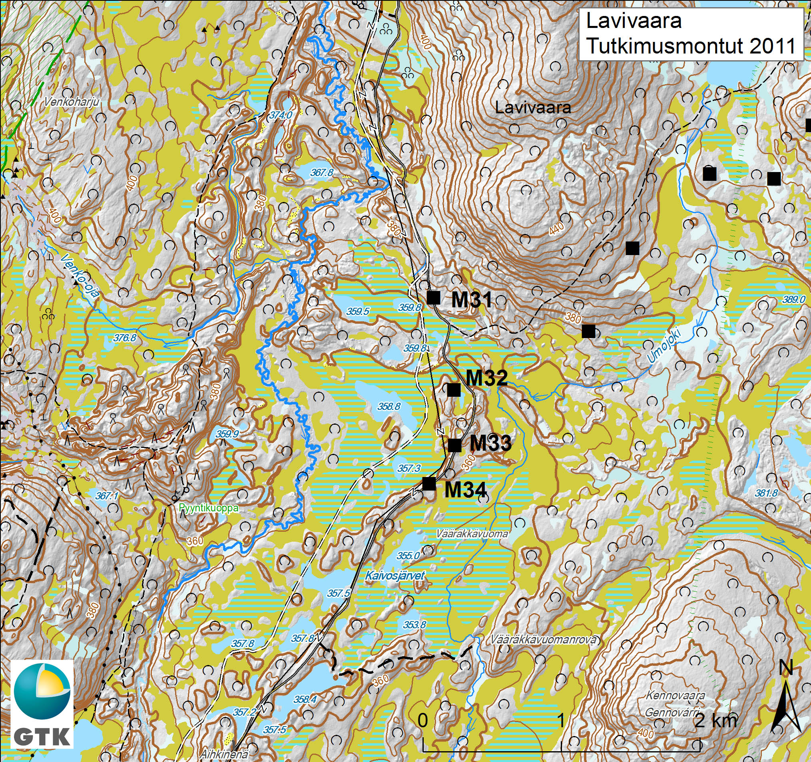
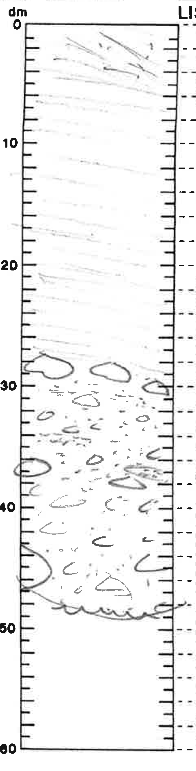
clay
moraine

Slide 10
Done so far
Most probable location for station found
Discussed with local people and municipality
Evaluation Plan for Participation and Impact (both Finnish and English)
Contract for land renting is in progress
Preliminary discussions with the local electricity distribution company (owned by municipality)
Preliminary discussions with Teijocon about the station building (www.teijocon.com)

