Slide 1
VLF antenna setup manual
University of Oulu
Finland 2021
Claudia Martinez, ISEE
Nagoya University

Slide 2
Receiver Schematics

Slide 3
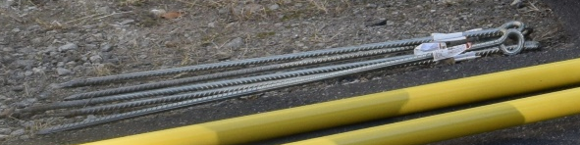
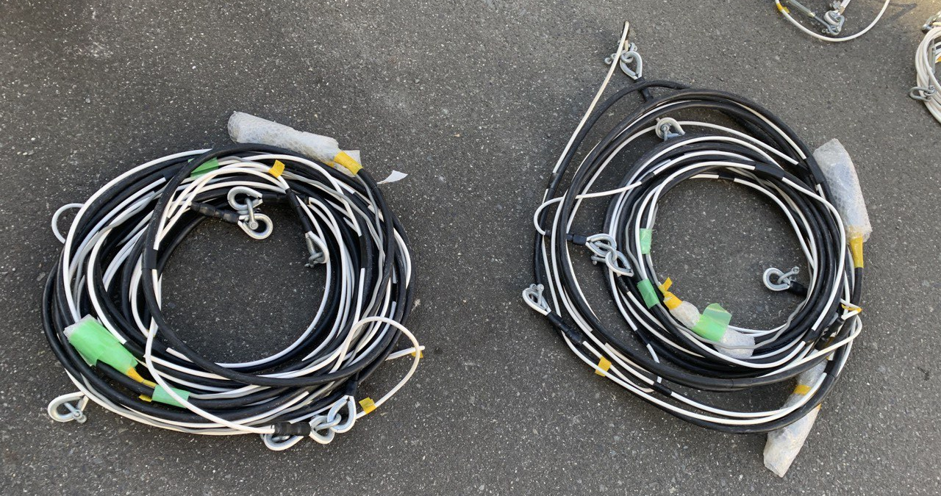
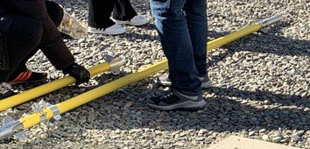
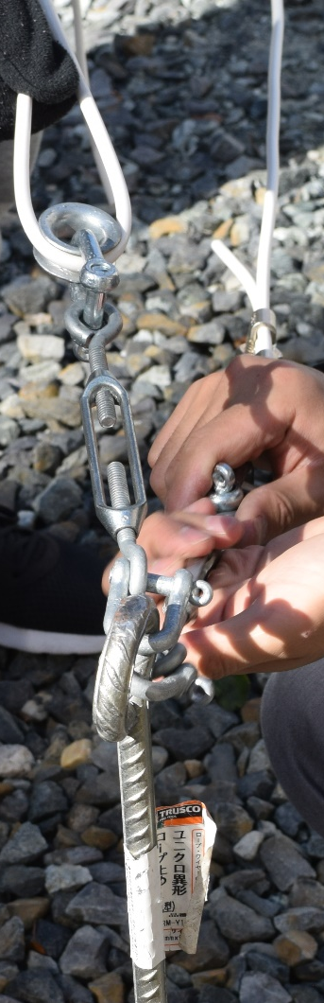
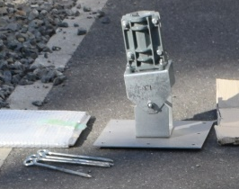
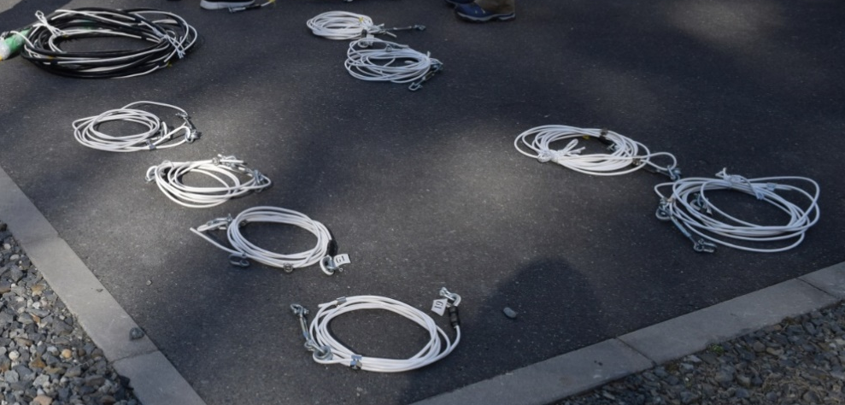
Part list
Not pictured:
Extra anchors and connector parts
Stay anchor x 4
Antenna cables x 2
(NS x 1, EW x 1)
Mast x 2
Stay cables x 8
(short x 4, long x 4)
Mast base x 1
(base anchor x 4)
Stay connectors x 8

Slide 4

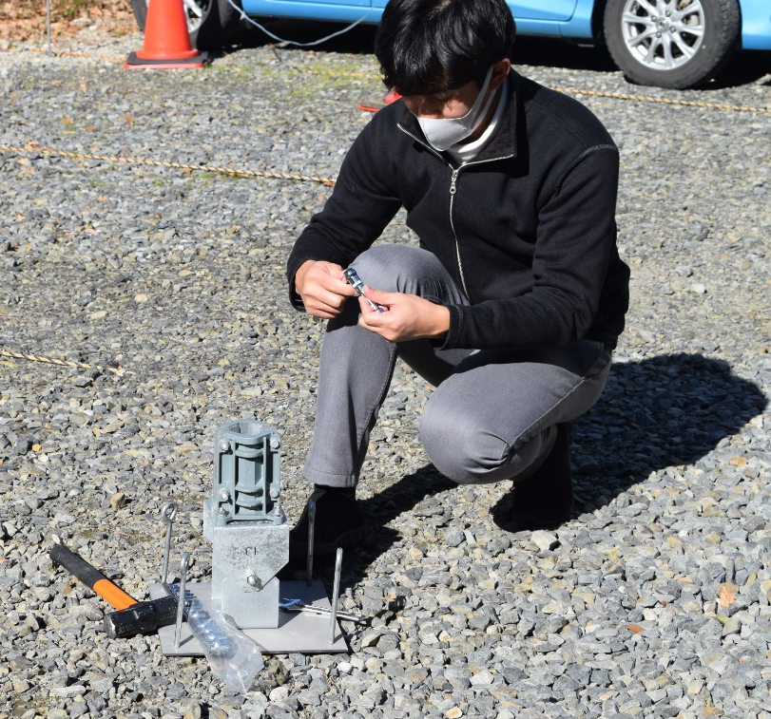
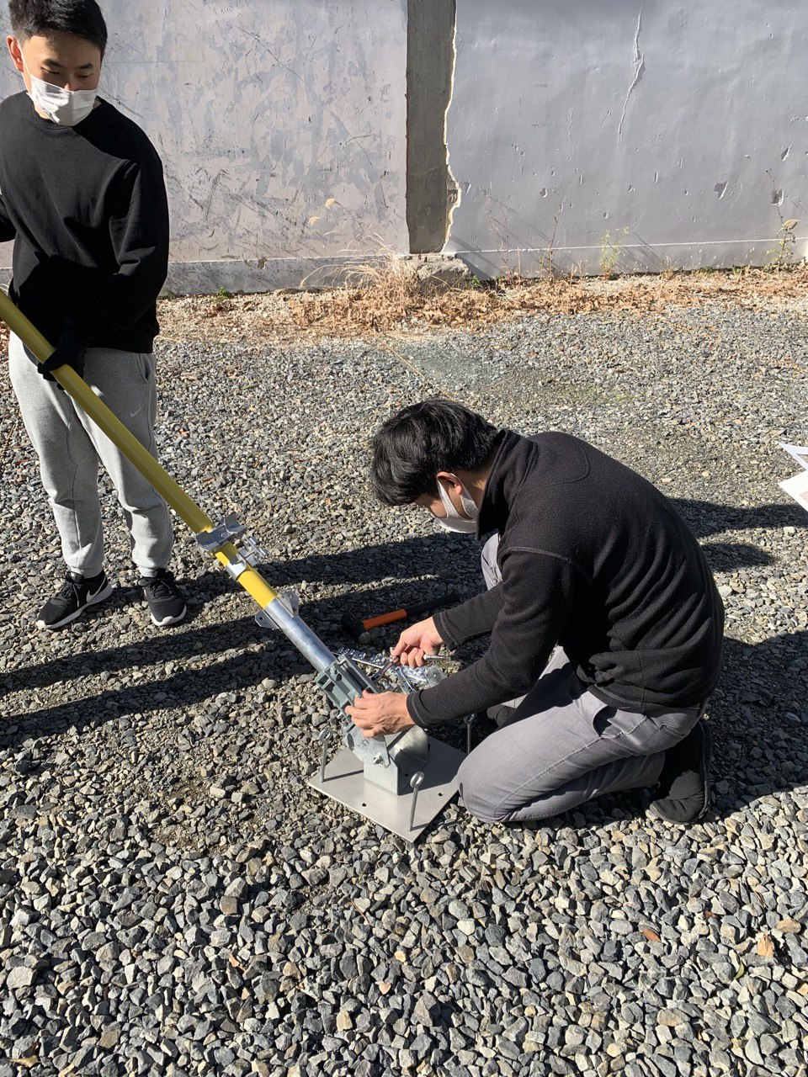
Set up [1]
Drive the 4 stay anchors as shown below
N
North
7.5 m
anchors
7.5 m
W
E
Base
S
Set up the mast base and fix using the 4 anchors
Orient the base with pivot in the north direction

Slide 5



Set up [2]
bolt and nut
North
bolt and nut
Connect the upper and lower masts.
Careful when putting the bolts as too much force can break the mast.
Connect the base and lower mast

Slide 6
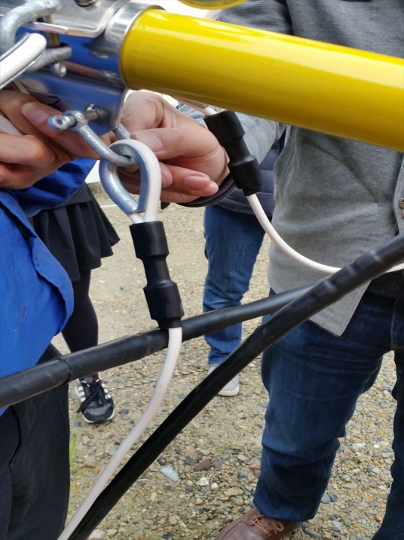

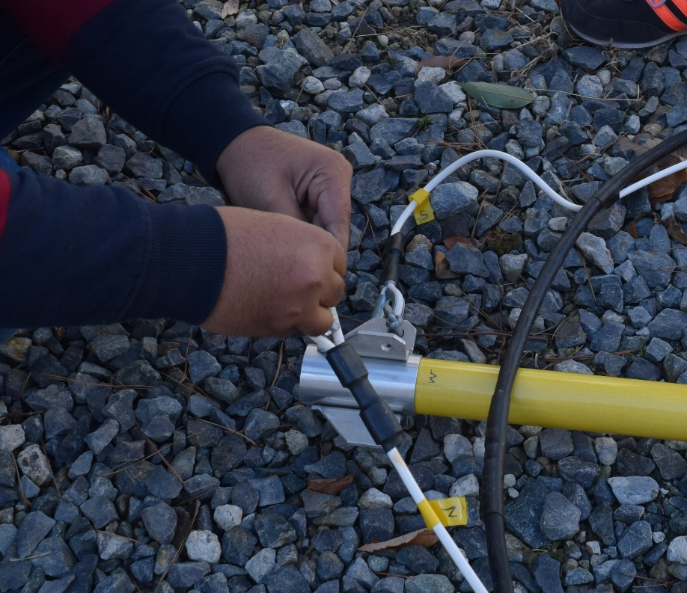
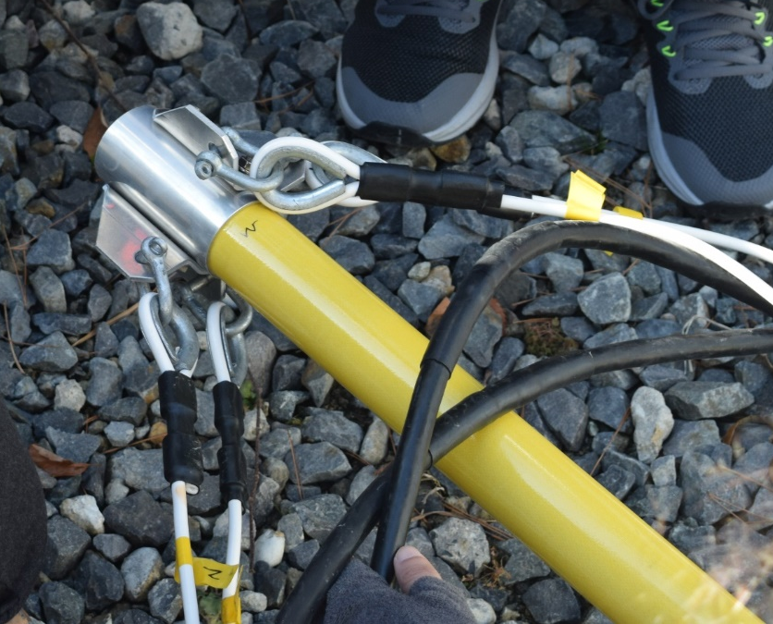
Set up [3]
S
☹✗
☺✓
Make sure the cables don’t cross
W
E
N
Attach the antenna cables to the top of the mast in their respective directions (follow yellow tape/marker letters)

Slide 7
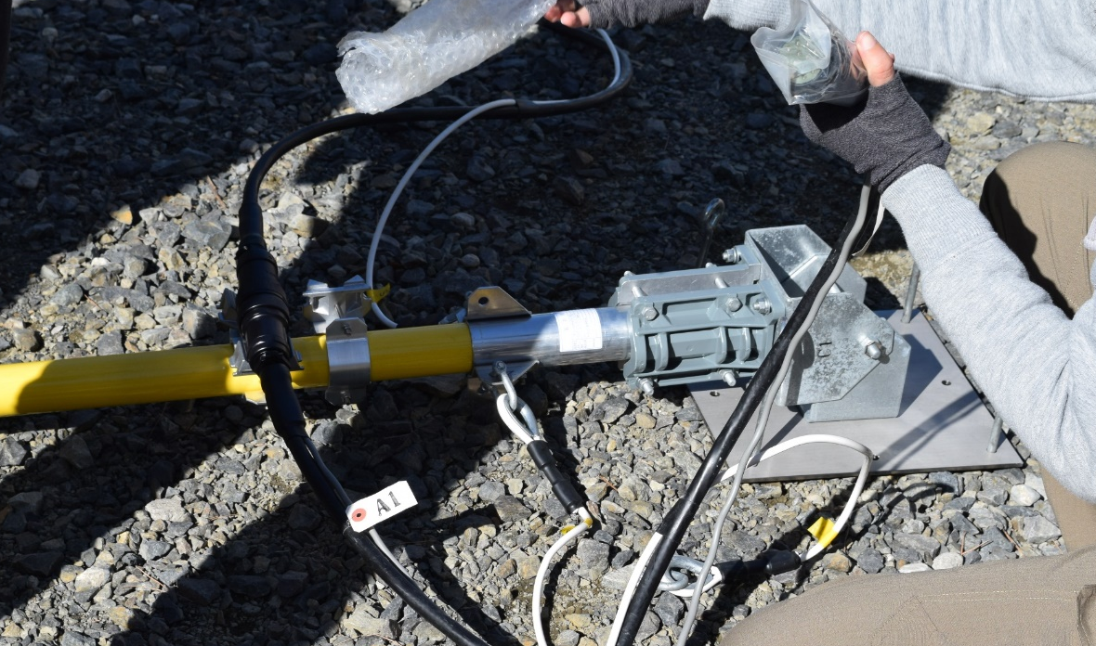
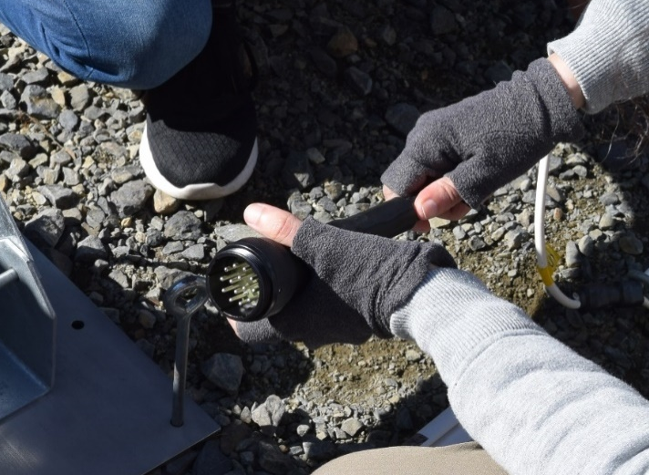

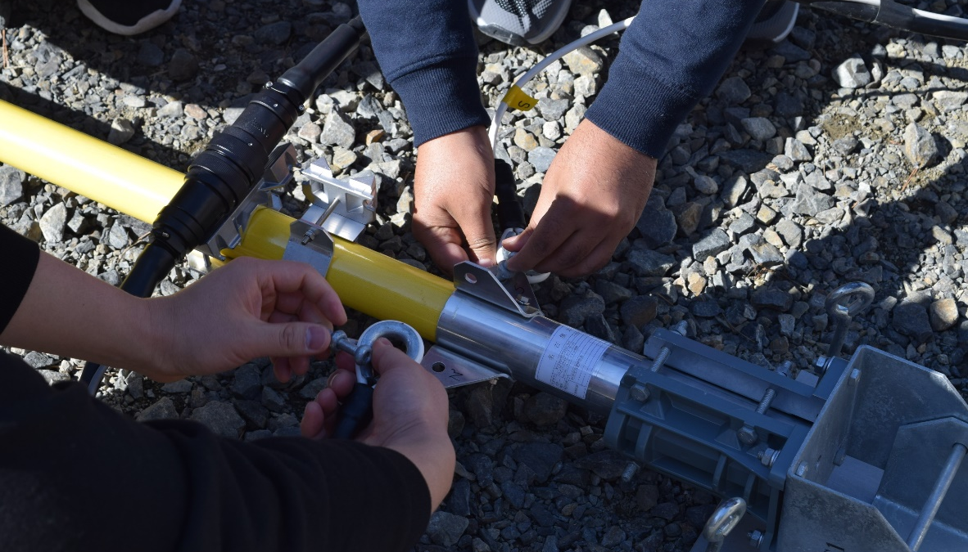
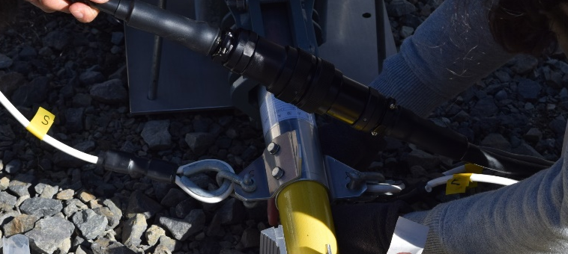
Set up [4]
Remove the protection and connect the cable connectors
Attach antenna cables to the mast just above the base (pay attention to directions) being careful with the connectors

Slide 8
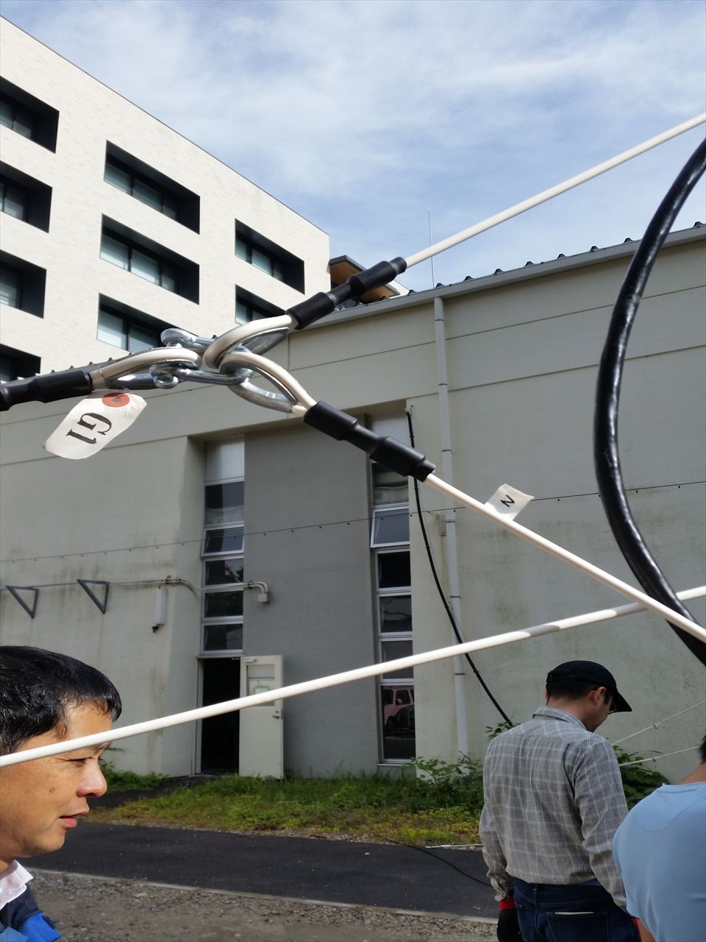
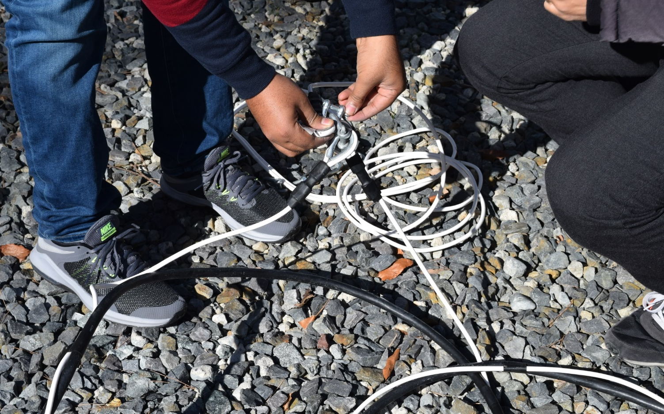
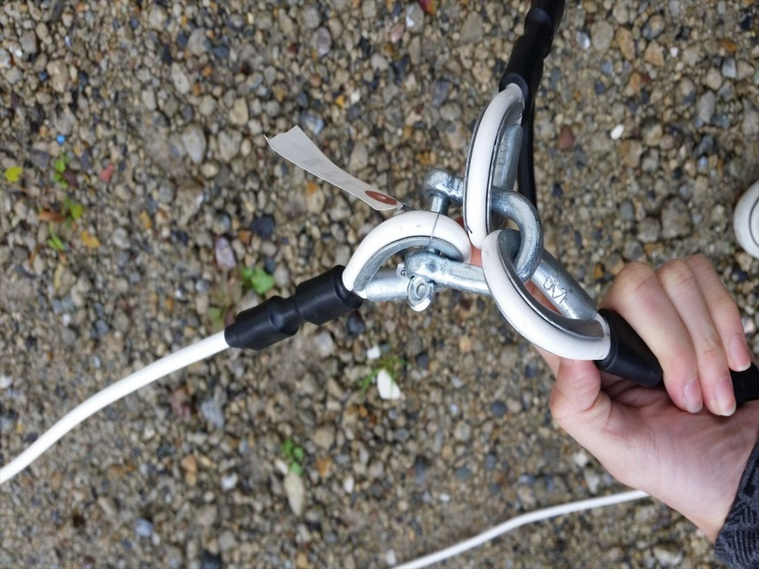
Set up [5]
To anchor
Antenna cable
To antenna
Attach the short stay cables to the antenna cables
To anchor

Slide 9
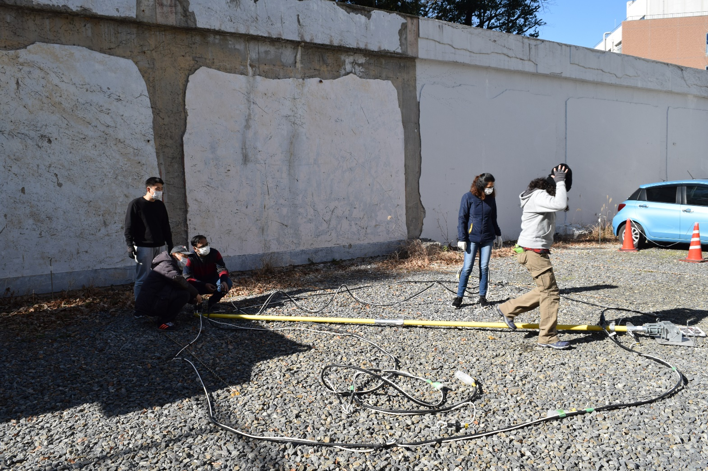

Slide 10
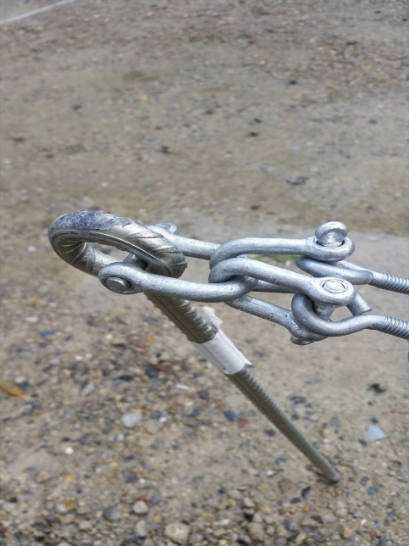
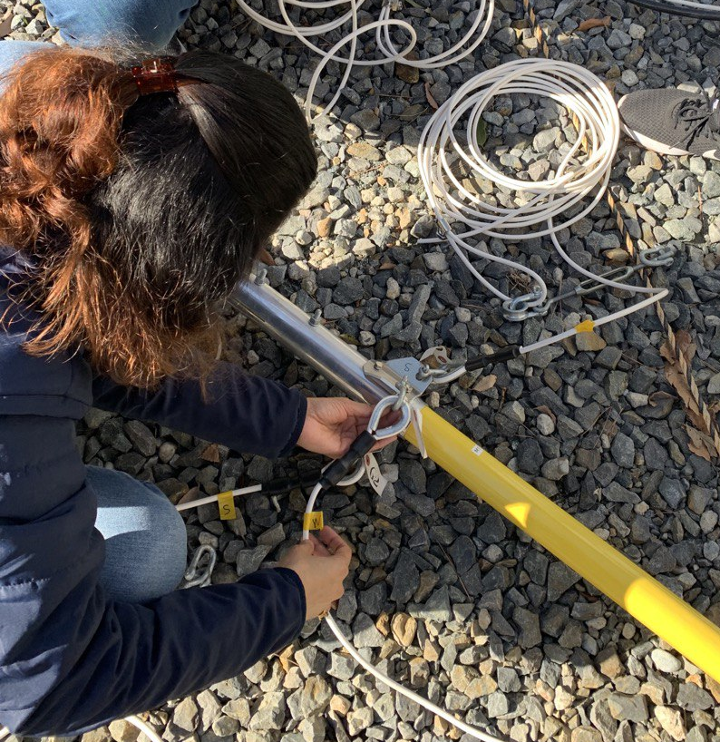
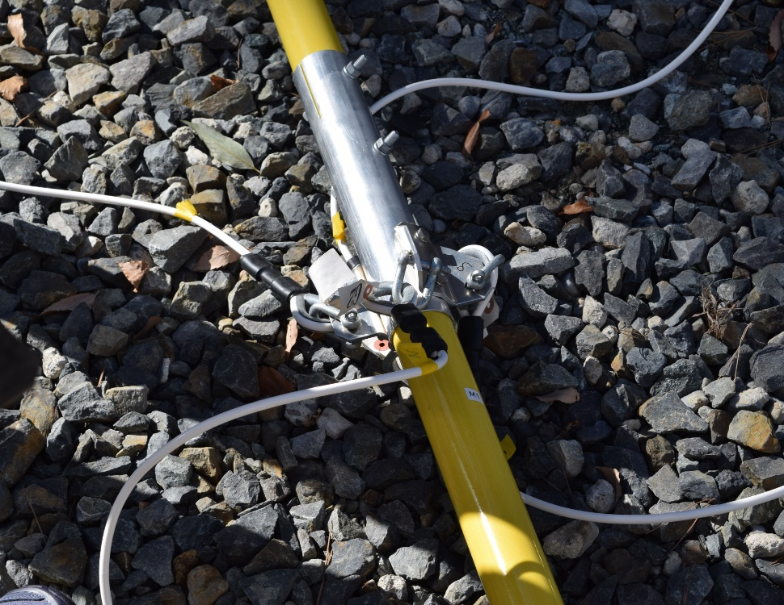
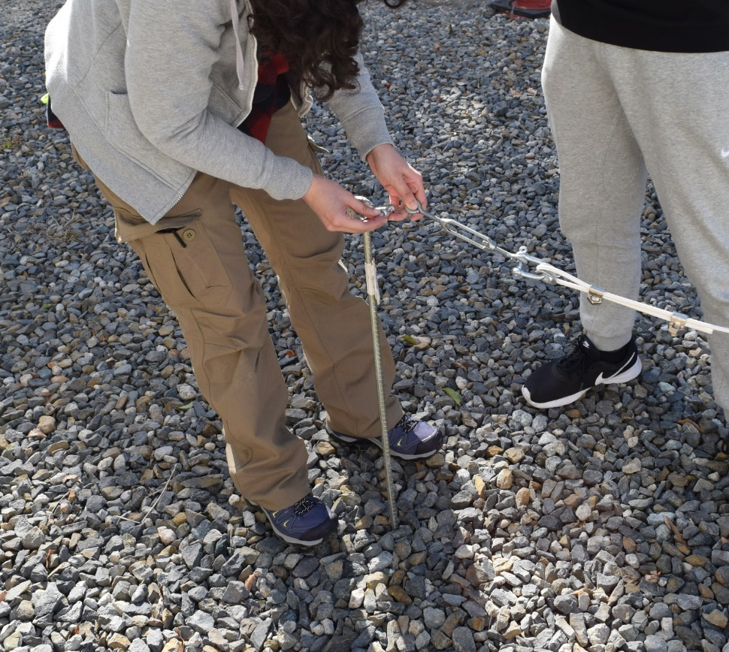
Set up [6]
To the four anchors
To antenna
Attach the long stay cables to the middle of the mast from their unadjustable side.
Loosely attach the long stay cables to the anchors on the adjustable side

Slide 11
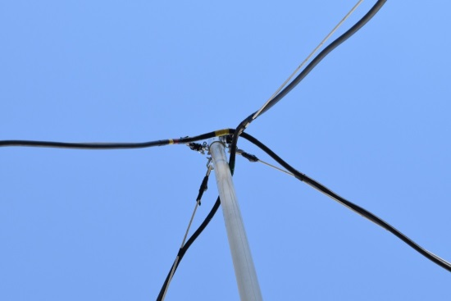
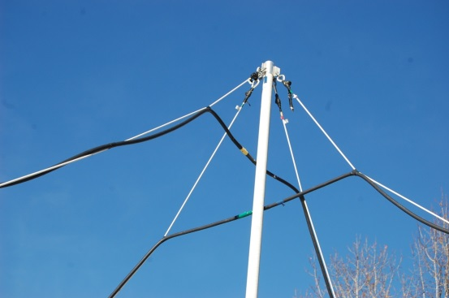
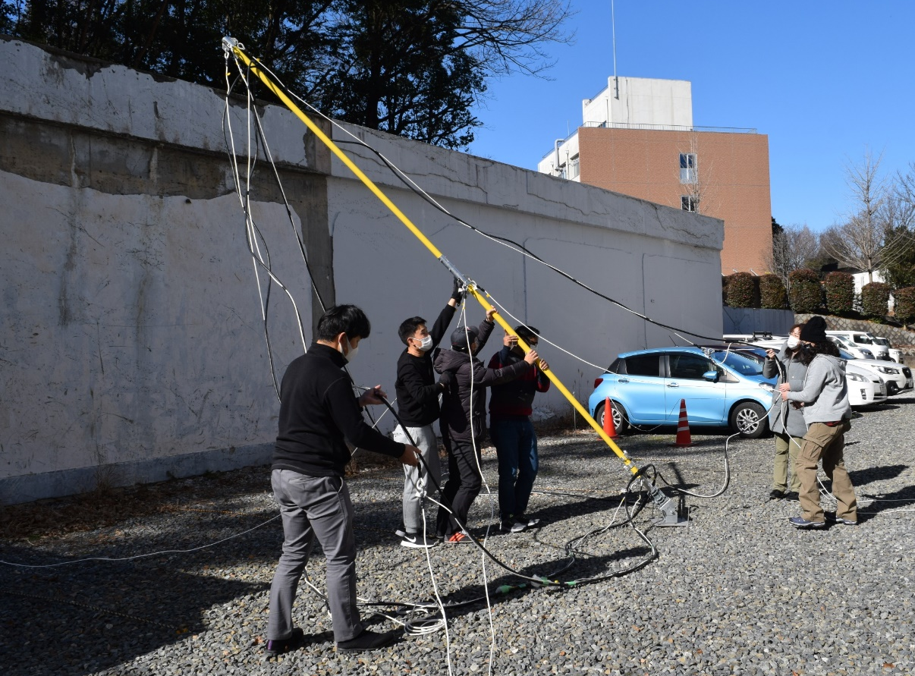
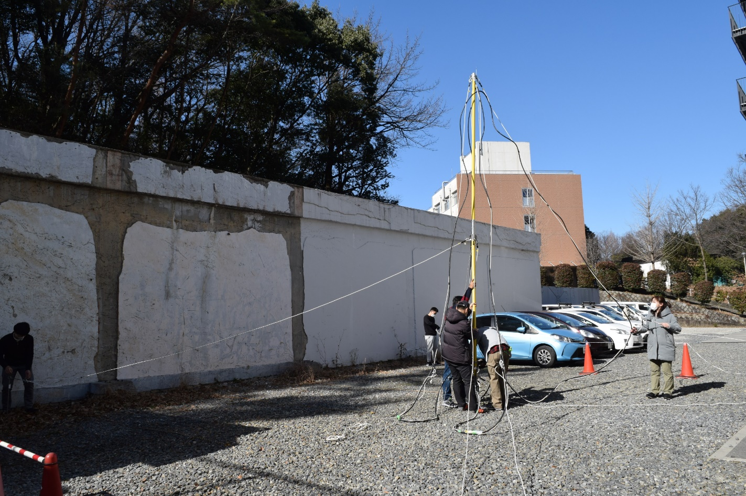
Set up [7]
☹✗
☺✓
Check that the loops are not crossed
Raise the mast
(being careful that the connectors are not in the way)
Start adjusting the length of the stay cables

Slide 12


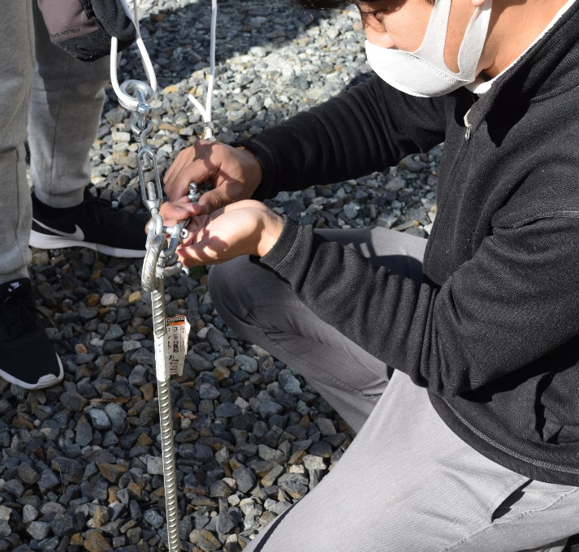
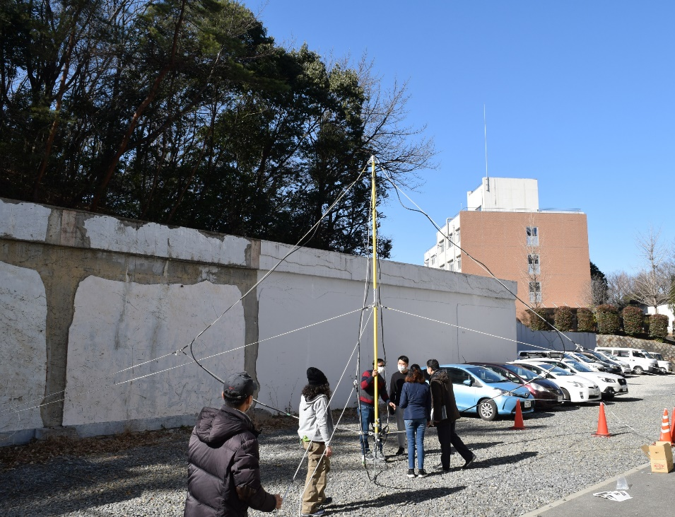
Set up [7]
Adjust the cables until the mast is straight and not tilted. Attach antenna cables to anchor points.
Loops are extended but not pulling too much on the connectors.

Slide 13
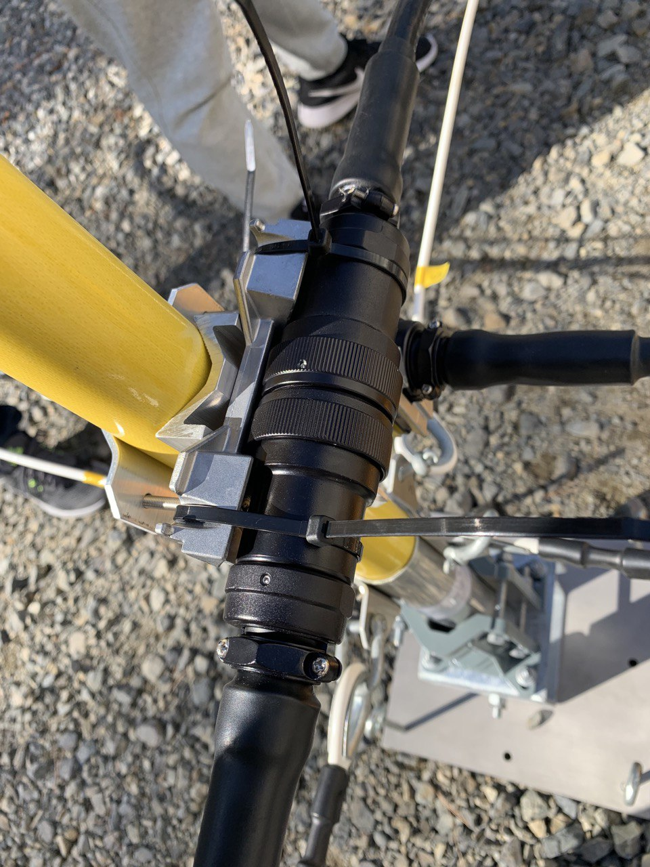

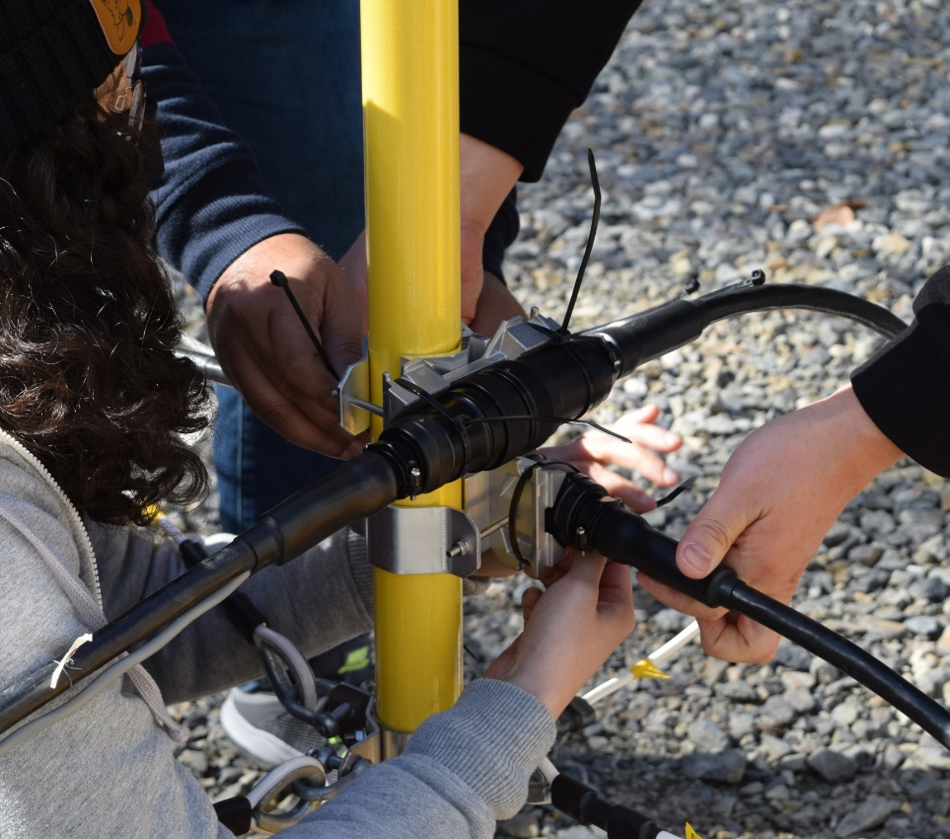
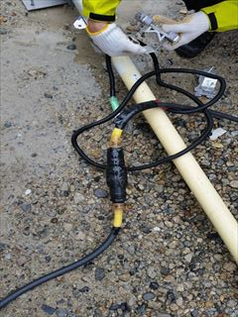
Set up [8]
Make sure the connectors are covered in waterproof tape and set each connector cable to its mount. Securely fix the connectors using zip ties.

Slide 14
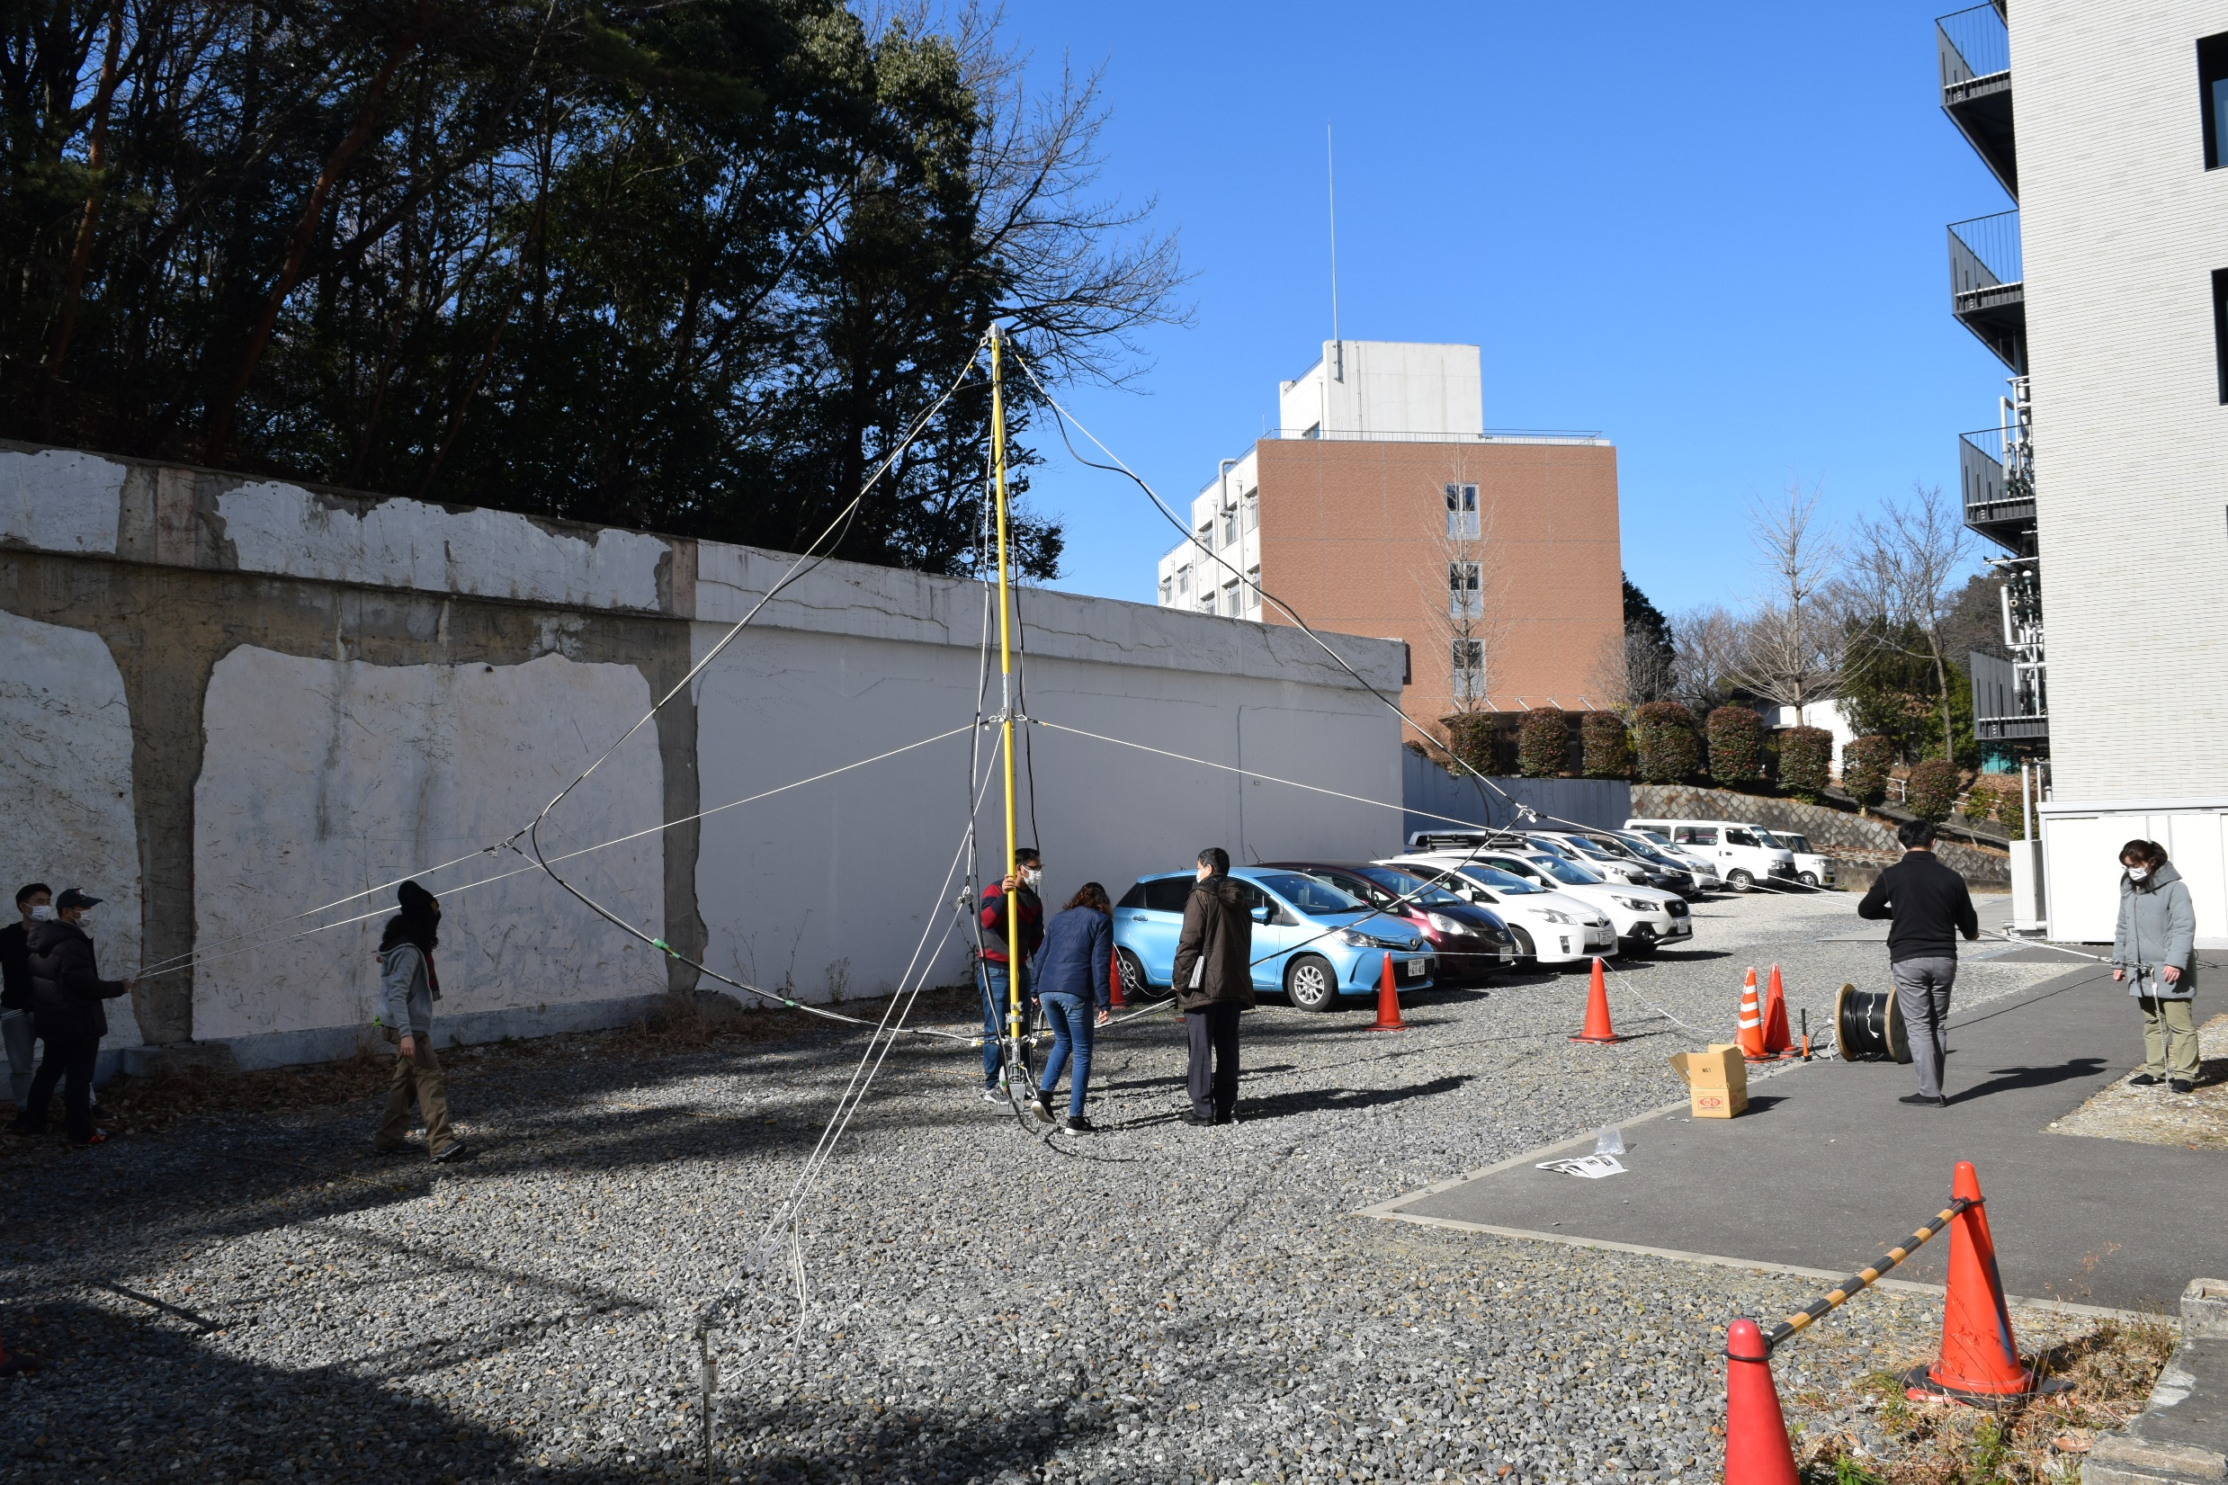
Final Product

Slide 15
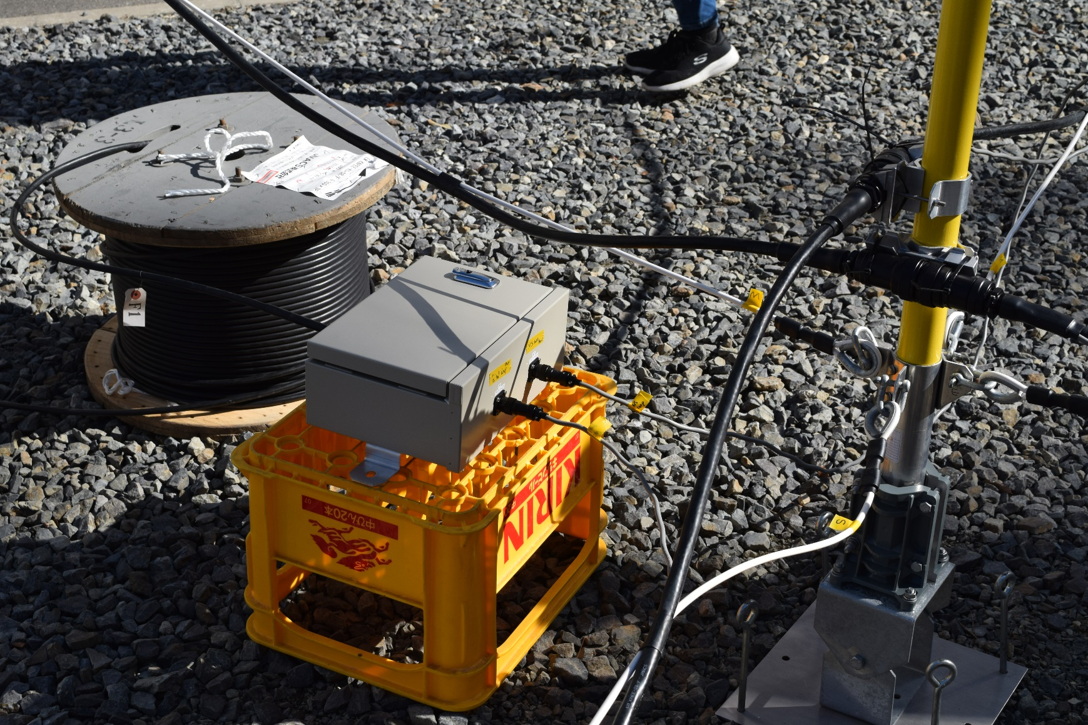
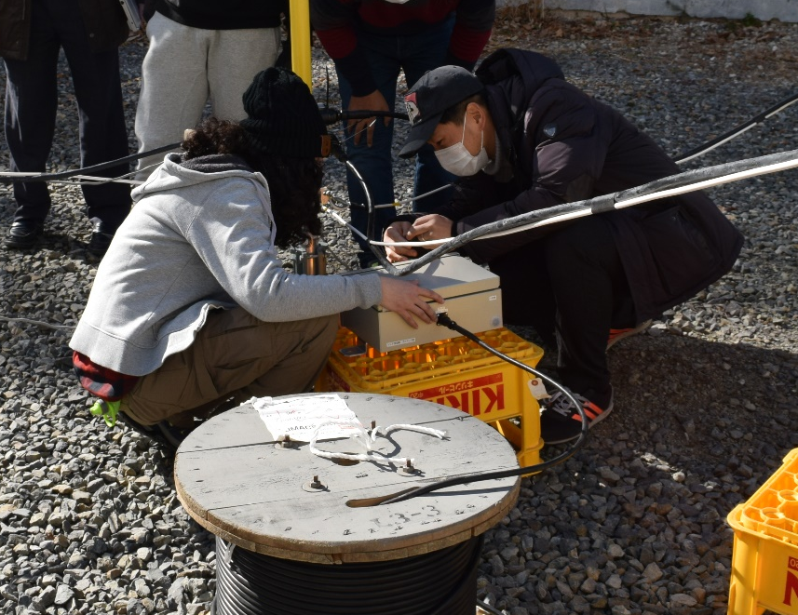
Set up [9]
Connect each loop antenna to the pre-amplifier making sure they are in their appropriate directions (indicated by tape).
Connect signal cable to amplifier and then to the computer.

Slide 16
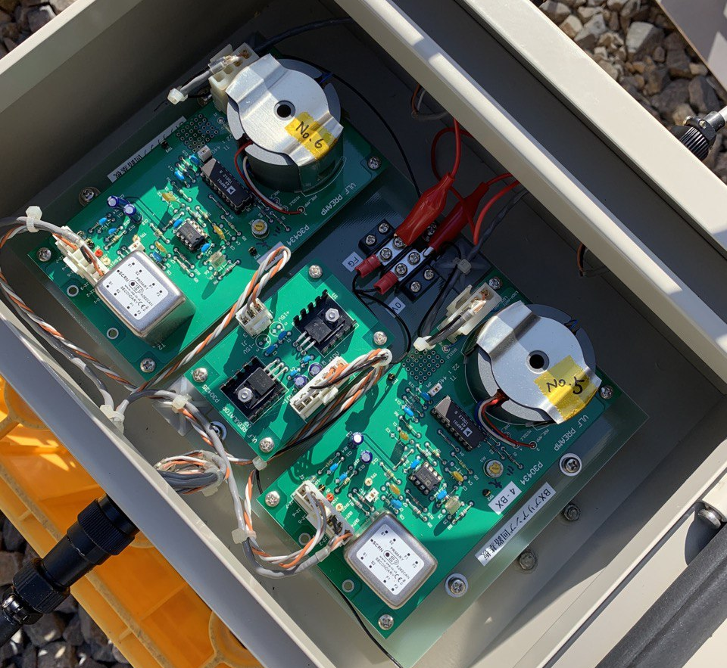
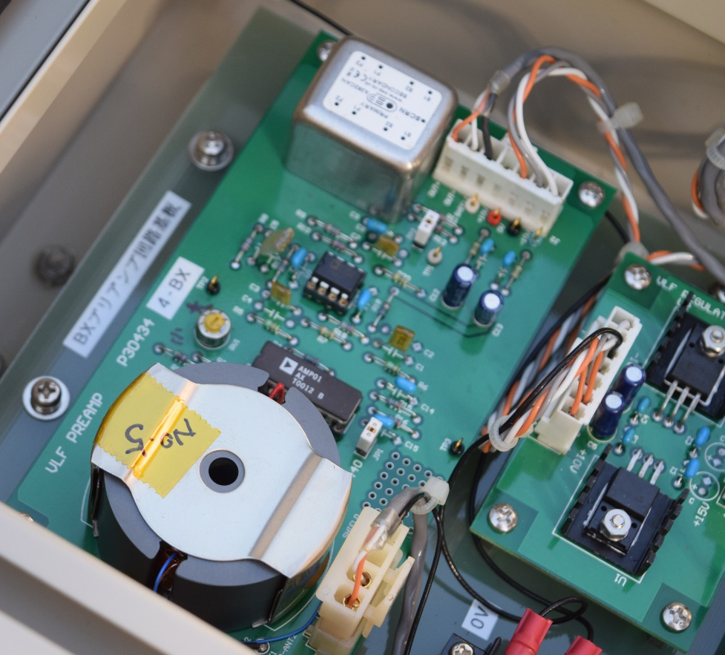
Set up [10]
大 bigger
小 smaller
大 (big) 小 (small)
The gain in the pre-amplifier has been maxed (amp output saturates at +/- 5V) however this might have changed during shipping. Please make sure that the gain is maximized using a screwdriver on the yellow screws moving the screw all the way to 大. If the gain is not maximum, we cannot make measurements of natural VLF waves. When all is ready please put the pre-amp in a weather proof box.

Slide 17
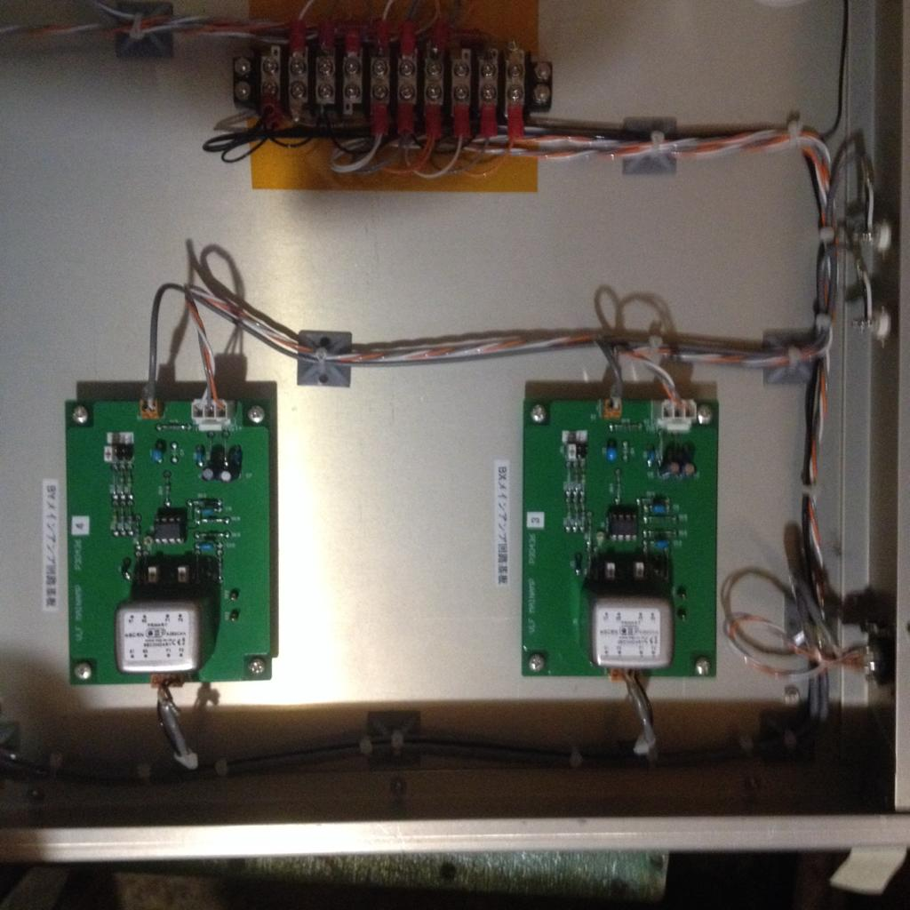
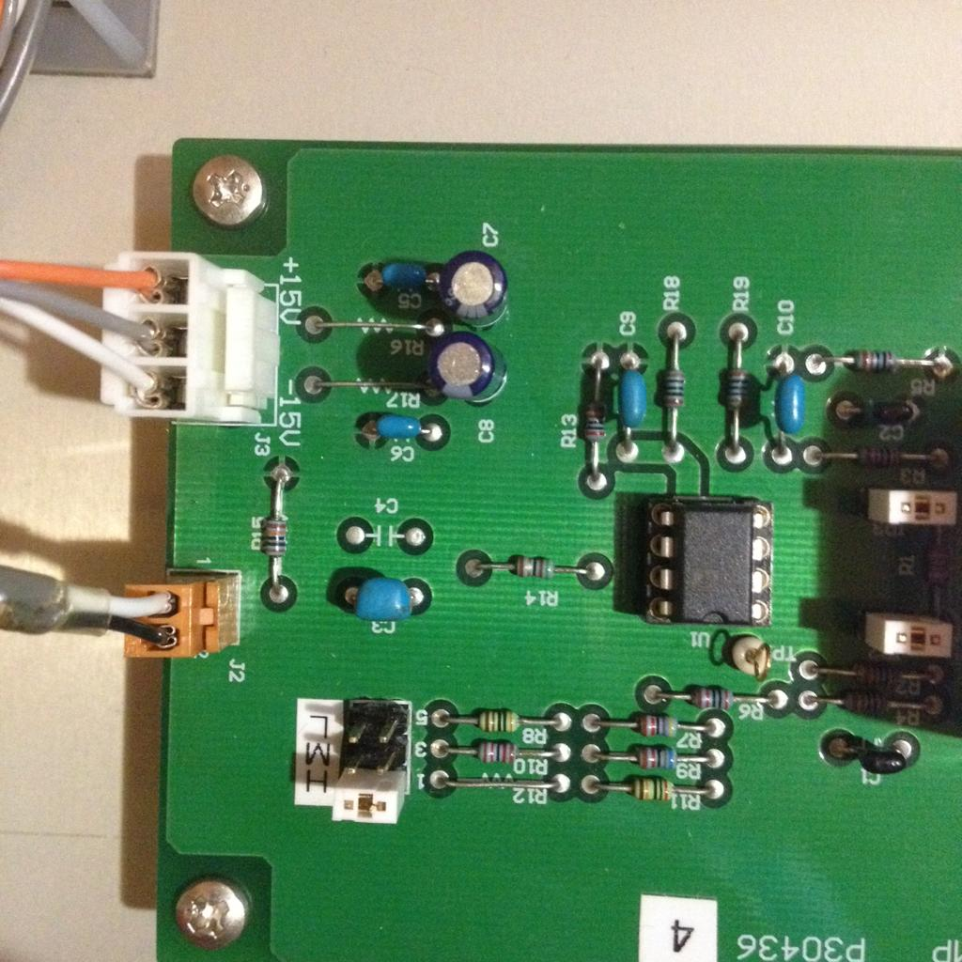
Note Gain
As the same with attached pictures, please check the "high" gain of the main amplifier in the install.

Slide 18
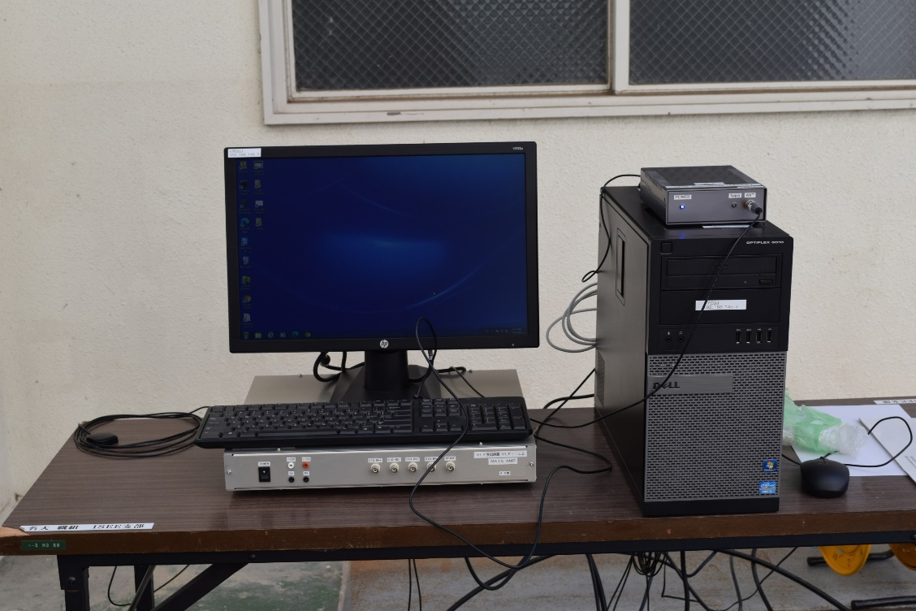
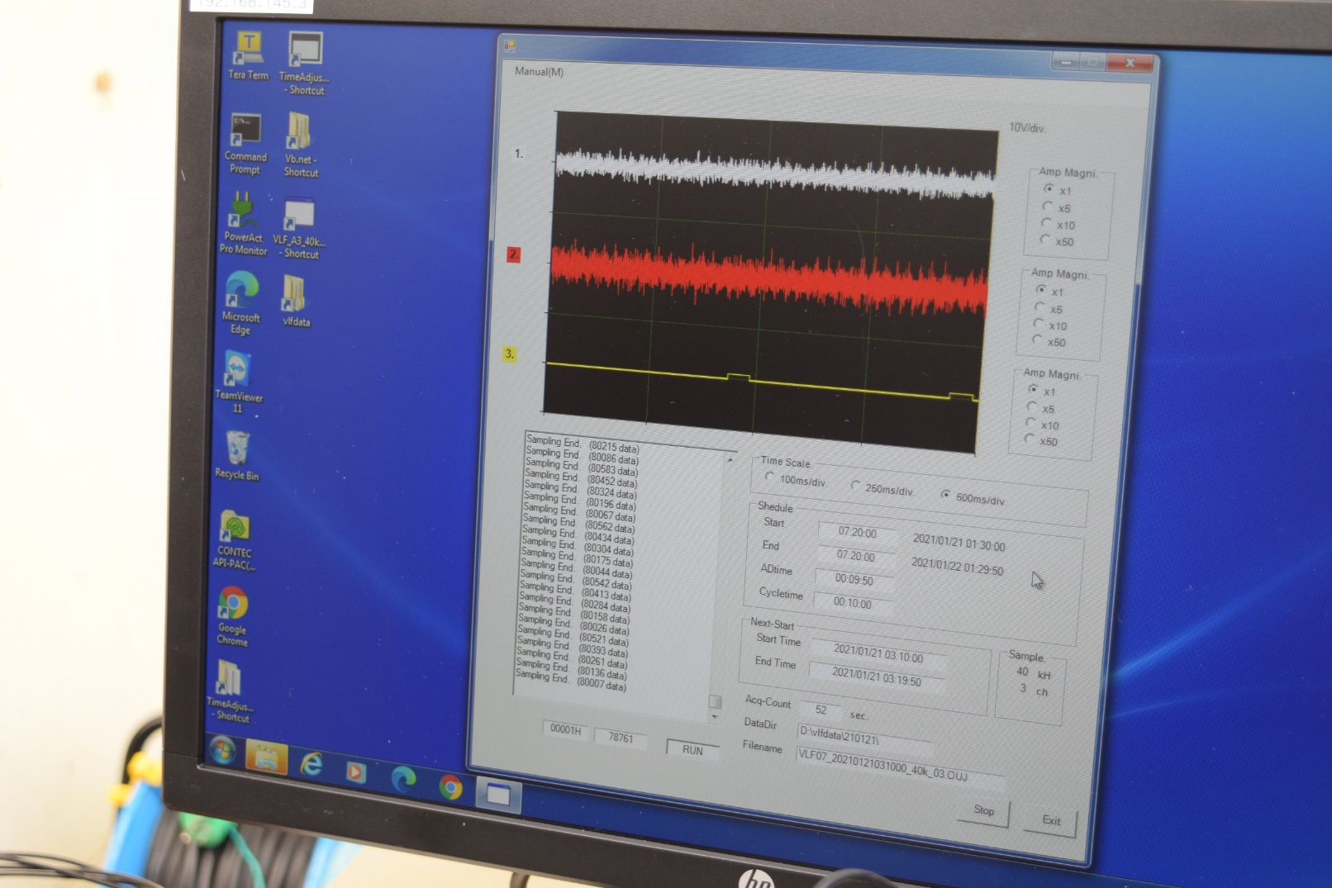
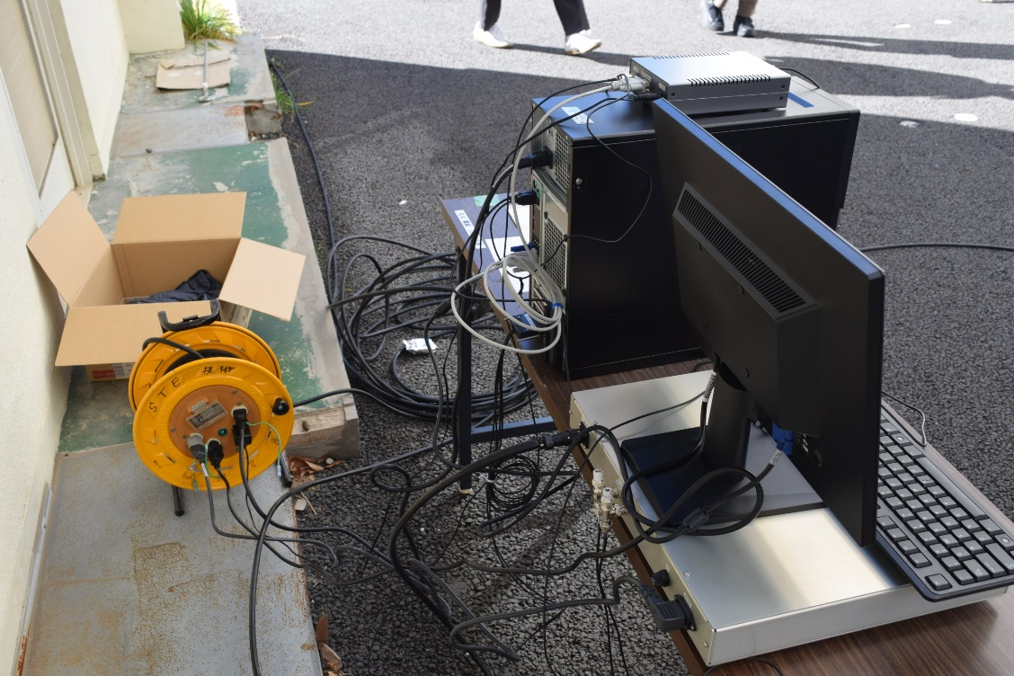
PC Set up [11]
GPS
GPS
antenna
Channel 1
Channel 2
Main Amp
Win PC
GPS
Signal cable
to antenna
GPS
Main Amp

Slide 19
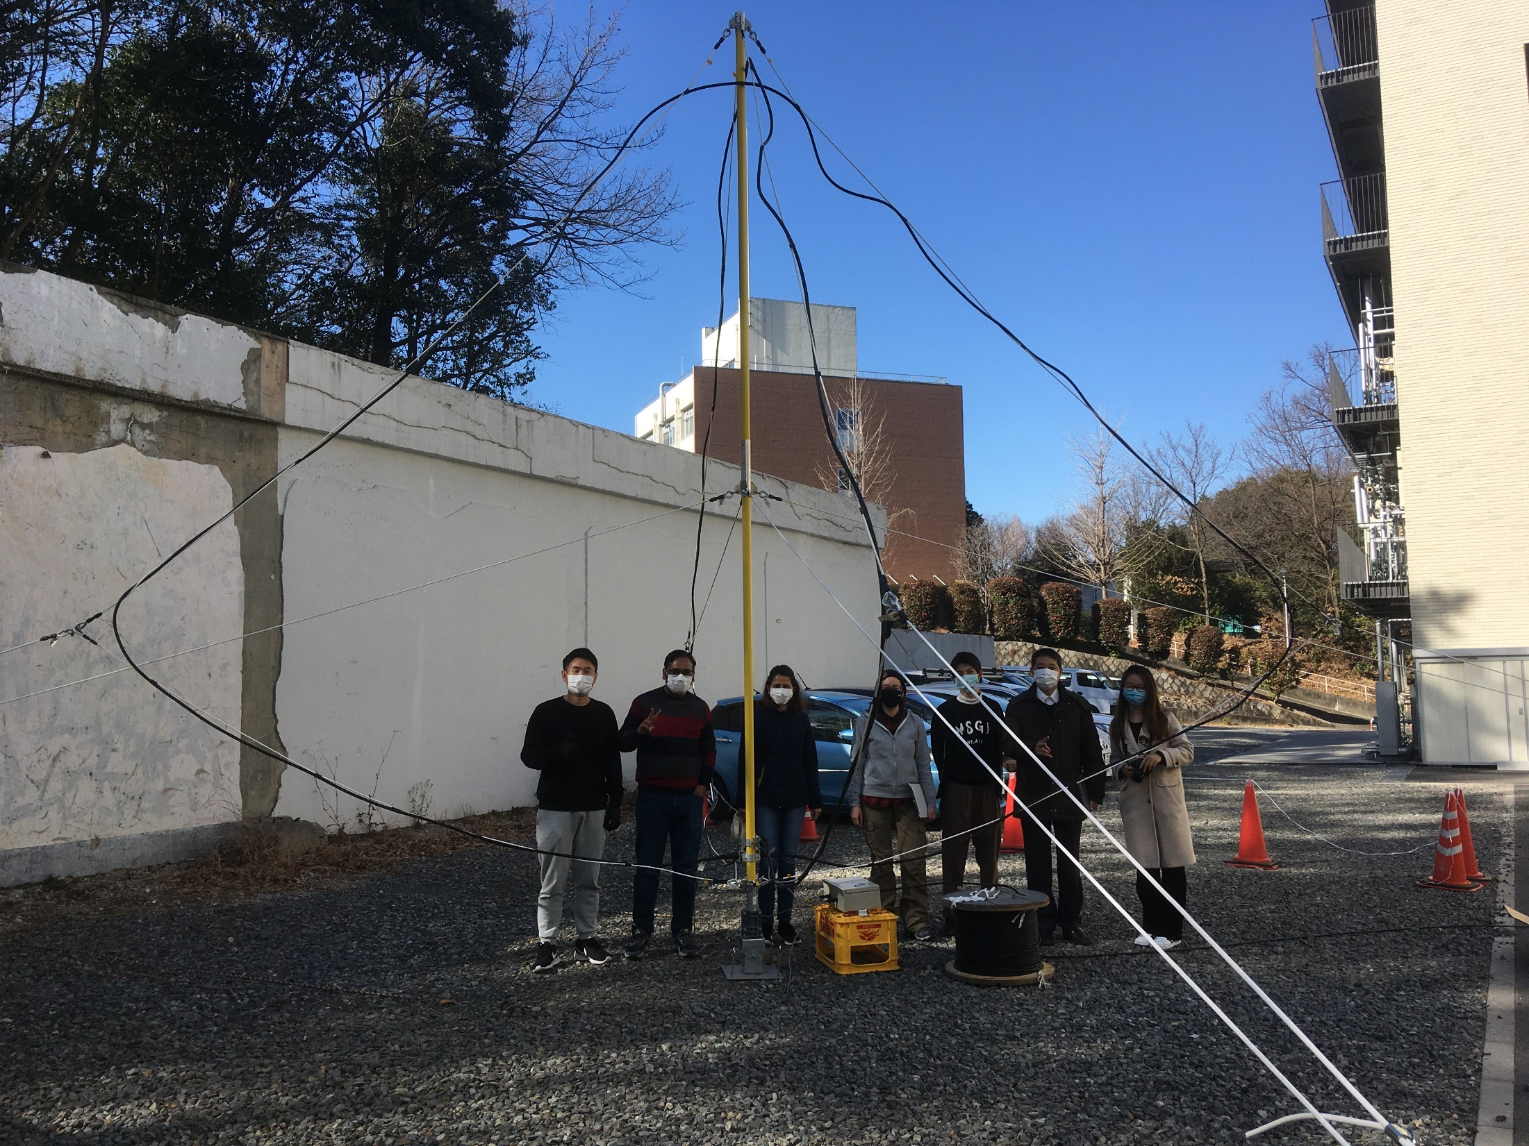
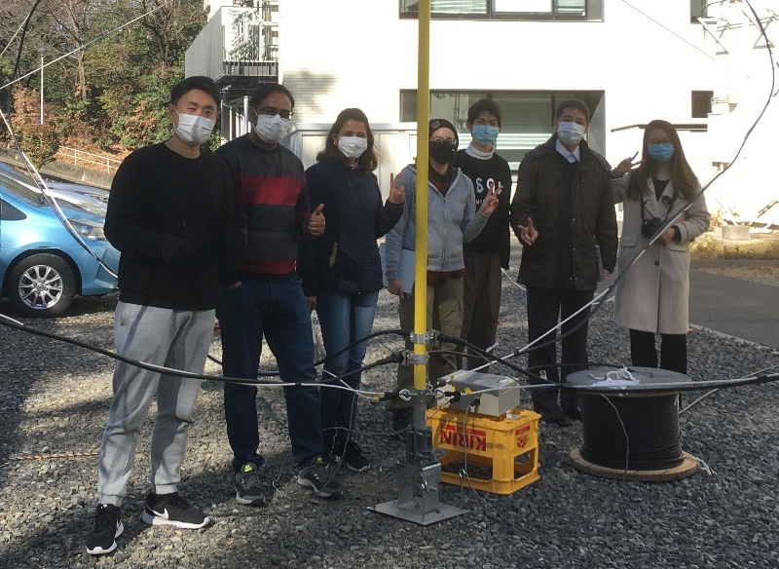

Slide 20
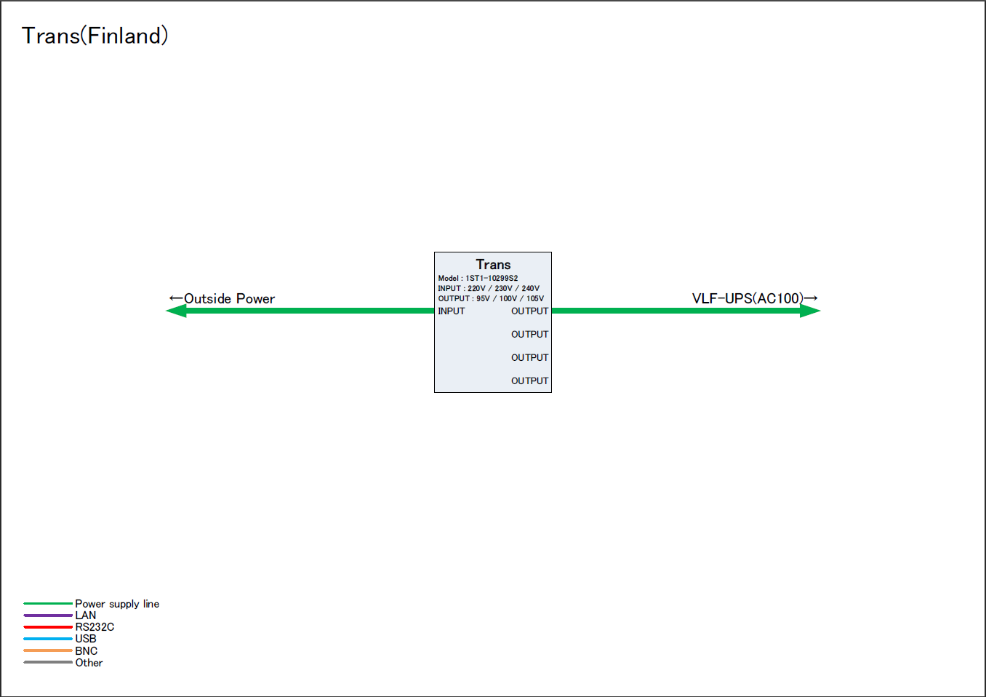

Slide 21
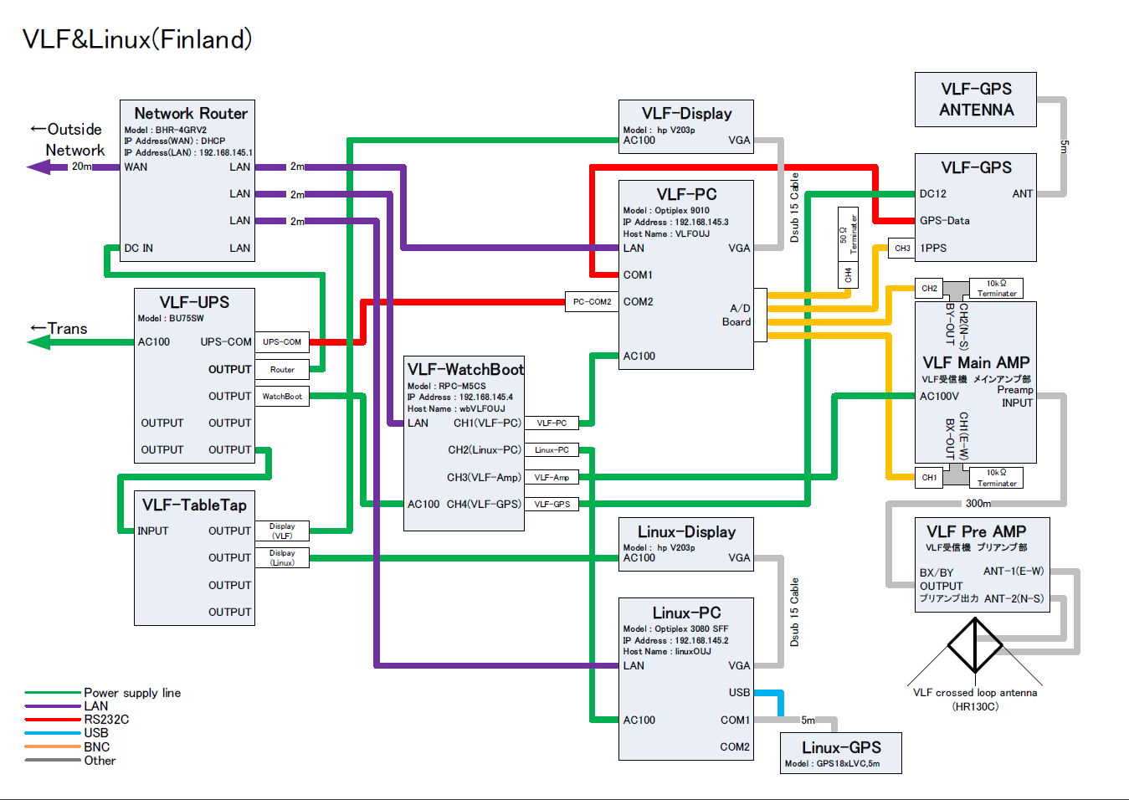

Slide 22
  Conf_VLF.txt
  -nOUJ
  -s02
  -d1F:\vlfdata\
  -a110
  -a210
  -a310
  # -n: Station Name
  # -s: System Number(Antenna Number)
  # -dN: Data spool Directory (N:1-9)
  # -aN: Graph View AmpGain(N:Ch No.1-3)
  Shedule_VLF.txt
  00:00:00,00:00:00
  00:09:50
  00:10:00
  starttime (hh:mm:ss) ,endtime (hh:mm:ss)
  ADtime (hh:mm:ss)
  cycletime (hh:mm:ss)
  To make continuous measurement, set the same time for both starttime and endtime.
  VLF system
  bipolar-5 - +5V Differential Inputs
  40kHz 3ch Sampling
  config files: Conf_VLF.txt and Shedule_VLF.txt at C:\Vb\VLF_A3_40kHz
  data files: F:\vlfdata

Slide 23
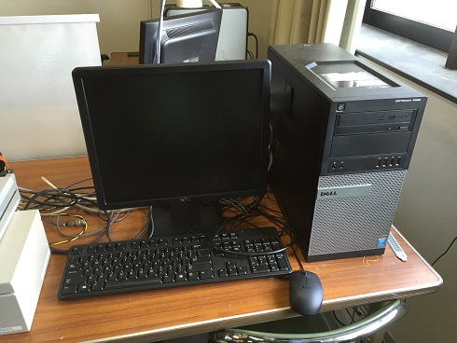
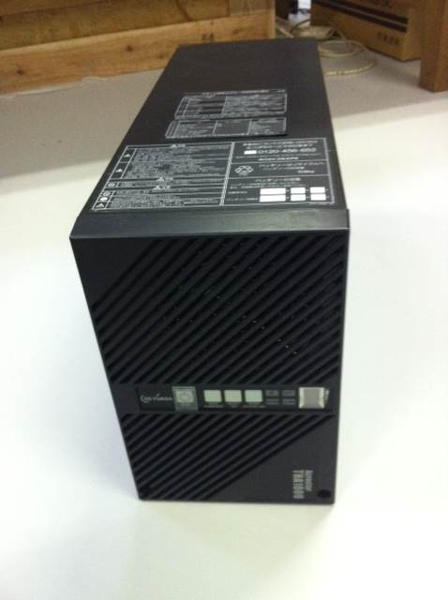
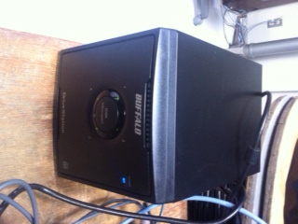
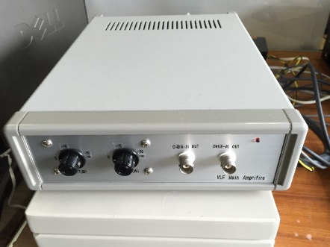
How to restart the system
Turn on the Windows PC.
Turn on the External Hard Disk Drive.
Automatically turn on when plugged to power cable.
Turn on the UPS backup battery
Turn on the main amplifier
Push the button for ~3 seconds
until the buzzer sounds,
then turn “INV” LED ON.
switch
Automatically turn on when PC powered on.
UPS power backup battery
switch
backside

Slide 24

Data Acquisition Program (VLF_A3_40kHZ.exe)
  Description of the Program
  “C:\Vb\VLF_A3_40kHz\VLF_A3_40kHz.exe” automatically starts up when Windows OS is started.
  When the program is started, it initialize the A/D board, and start data acquisition at the time of starttime.
  The setup parameters of A/D board initialization is as follows:
    Input Range: -5 - +5V
    Memory Type: FIFO
    Clock Type: Internal
    Sampling Clock (usec): 10 (10μsec)
    Start Trigger Type: Software
    Stop Trigger Type: Command
  If you want to start data acquisition manually, choose [Manual] -> [Manual Run] in menu bar. Then the program make data acquisition from the current time over 1 file.
  The data filename is “VLF02_20yymmddhhnnss_40k_Ch.OUJ”
  The acquired data is stored at the external-HDD at F:\ vlfdata\yymmdd\.
  To stop data acquisition, click “stop” button. Then you will see a message like “A/D Stop. 2016/10/15 02:21:01” in the textbox in the leftside. After that, click “Exit”

Slide 25

  UPS Shutdown Driver
  “Acroware-iGYupsDriver”
  This driver is to shutdown the OS when the electric power stops.
  When the OS is started, this driver is automatically started.
  Service name:AcrowareGupsd
  Startup type: Automatic
  This driver is installed in the following folder
  C:\Program Files (x86)\GSYUASA\AcrowareGYupsd
  Setup Tool
  C:\Program Files (x86)\GSYUASA\AcrowareGYupsd\gyconftool.exe
  Even Log File
  C:\Program Files (x86)\GSYUASA\AcrowareGYupsd\log\EventS.log
  It the connection is correct, the following log is stored in the log file (in Japanese).
  "Acroware UPS シャットダウンドライバ開始(VersionInfo.）"
  "通信に成功しました(COM3)"
  Check of the driver at the time of power stop
  The OS is started to be shutdown 70 second after the power stop.
  The UPS output power will be stoped at 240 second after the start of the OS shutdown.
  When the power is recovered, the UPS output is recovered, and the OS is automatically started.
← COM port number

