Slide 1

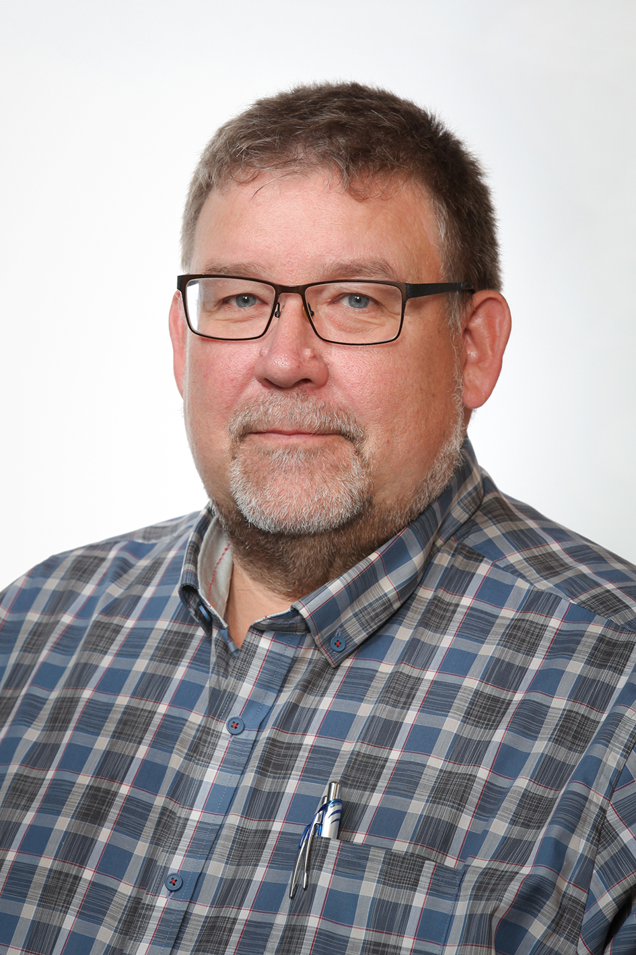
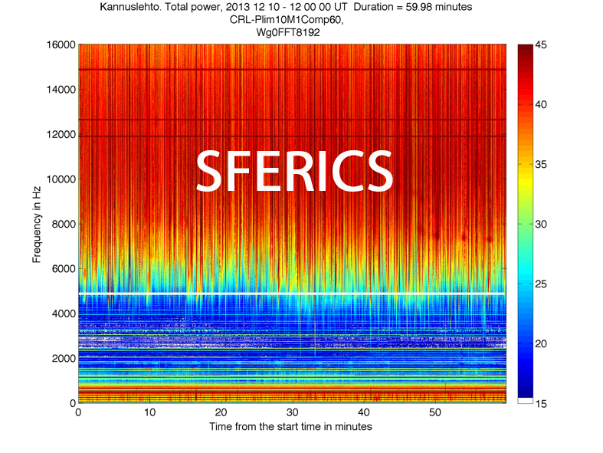
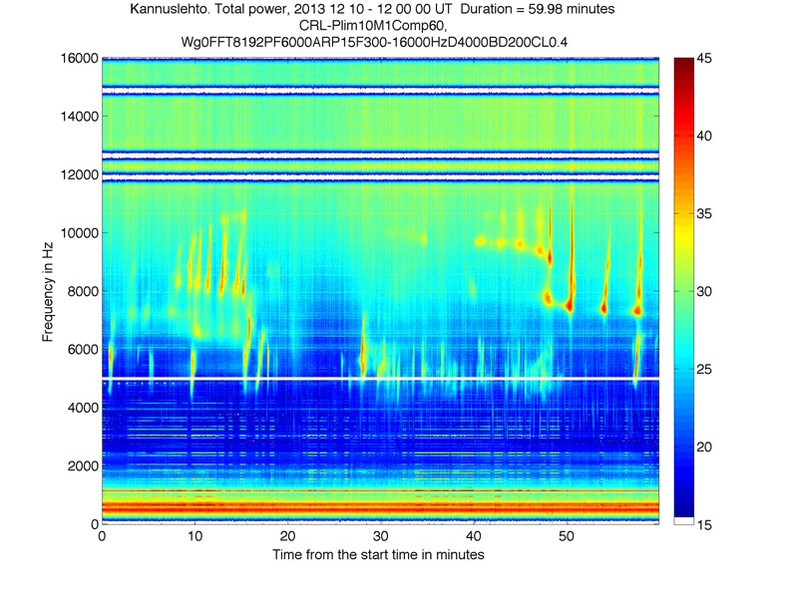
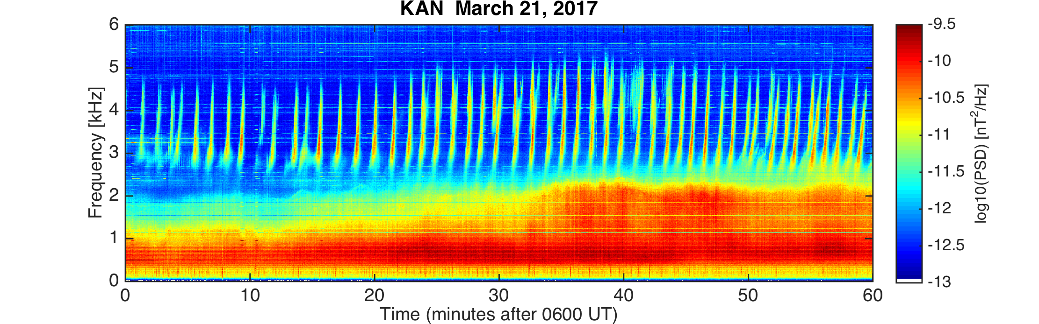
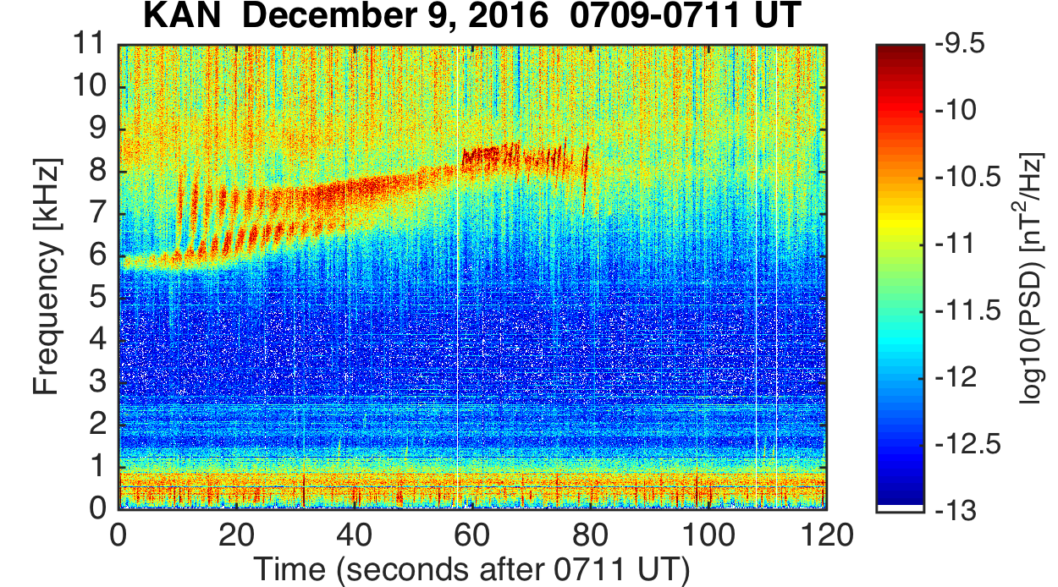
Dr. Jyrki Manninen, deputy director of SGO since 1.11.2019
Docent of space physics since 2011
Tasks:
Assisting the director in leading the observatory,
preparing HR, financial, and project things for
the director,
science on the Sun-Earth coupling and state of the
magnetosphere,
teaching and supervision
ELF-VLF observations and research based mostly on KAN data
2017-2021 Vice chairman of Comm. H in URSI
2021-2023 Chairman of Comm. H in URSI
• 106 peer-reviewed publ.
+ 3 submitted
(1st – 3rd author in 51)
• 26 other publications
• Project manager of LAPBIAT
1 and 2 (2001-2010)
• Project manager of
EISCAT_3D Suomi (2015-2021)
1995 Moved from Oulu to SGO
2005 PhD in space physics, Oulu U., ELF-VLF waves in geophysics
2008-2010 Director of Economical Development in Municipality of Sodankylä
2011-2012 Vice director of SGO
2011-2012 Manager of Observations (Head of Observation Division) at SGO
2016 – 2017 Manager of Laboratory (Head of Technical Division) at SGO
2010 – 2019 Geophysicist at SGO, ELF-VLF waves, aurora, magnetosphere

Slide 2

New VLF receiver at OUJ in Finland
SGO
Rovaniemi
Oulu

Slide 3
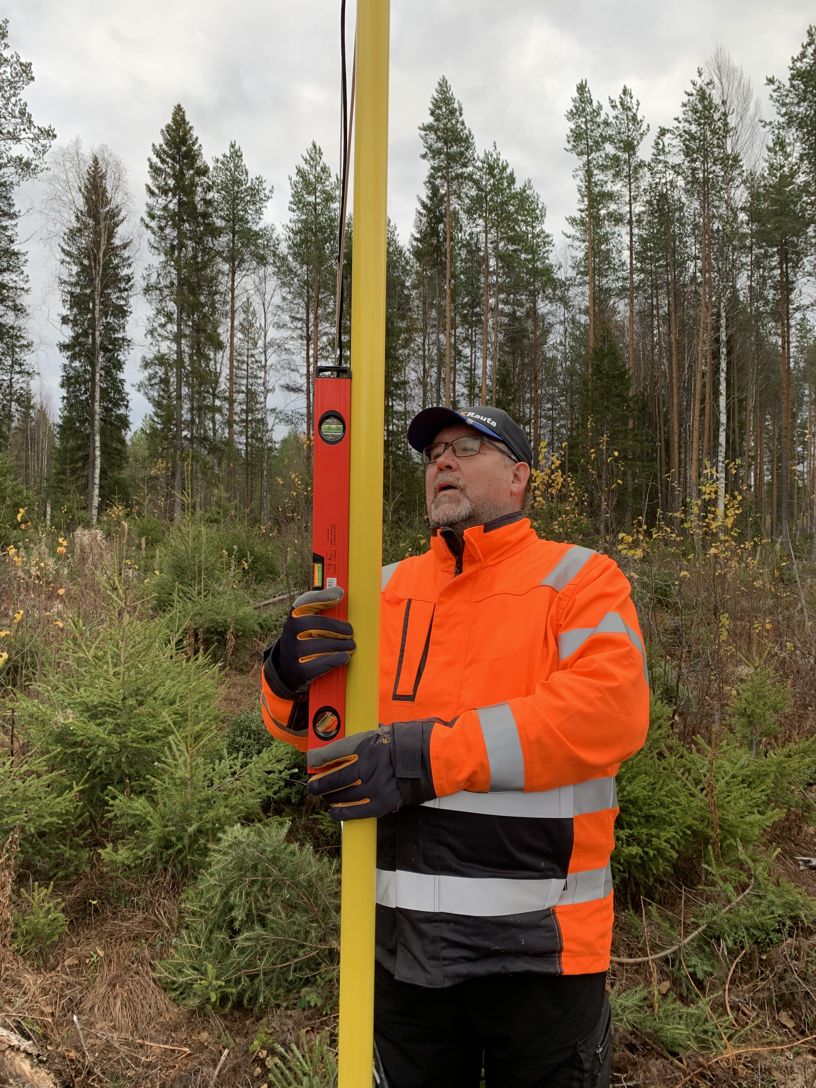
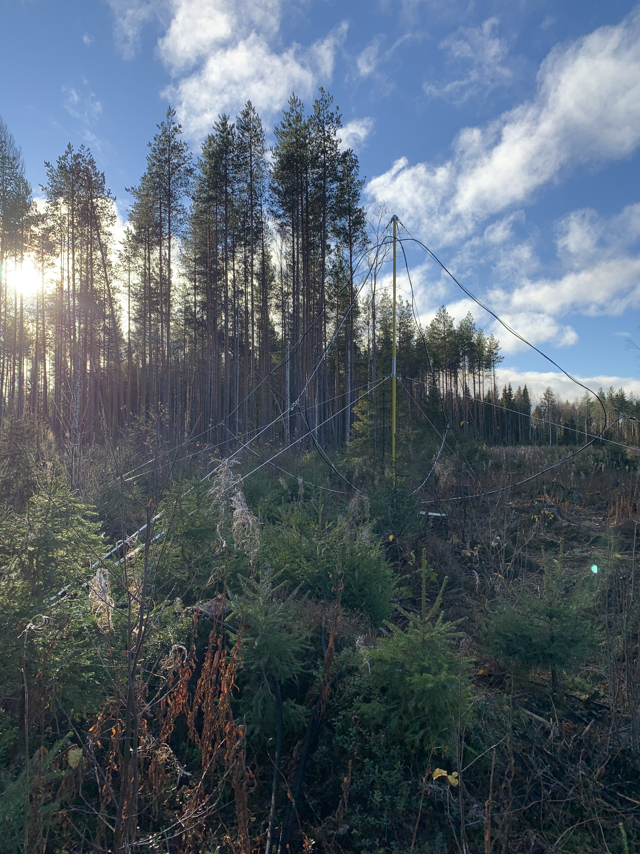
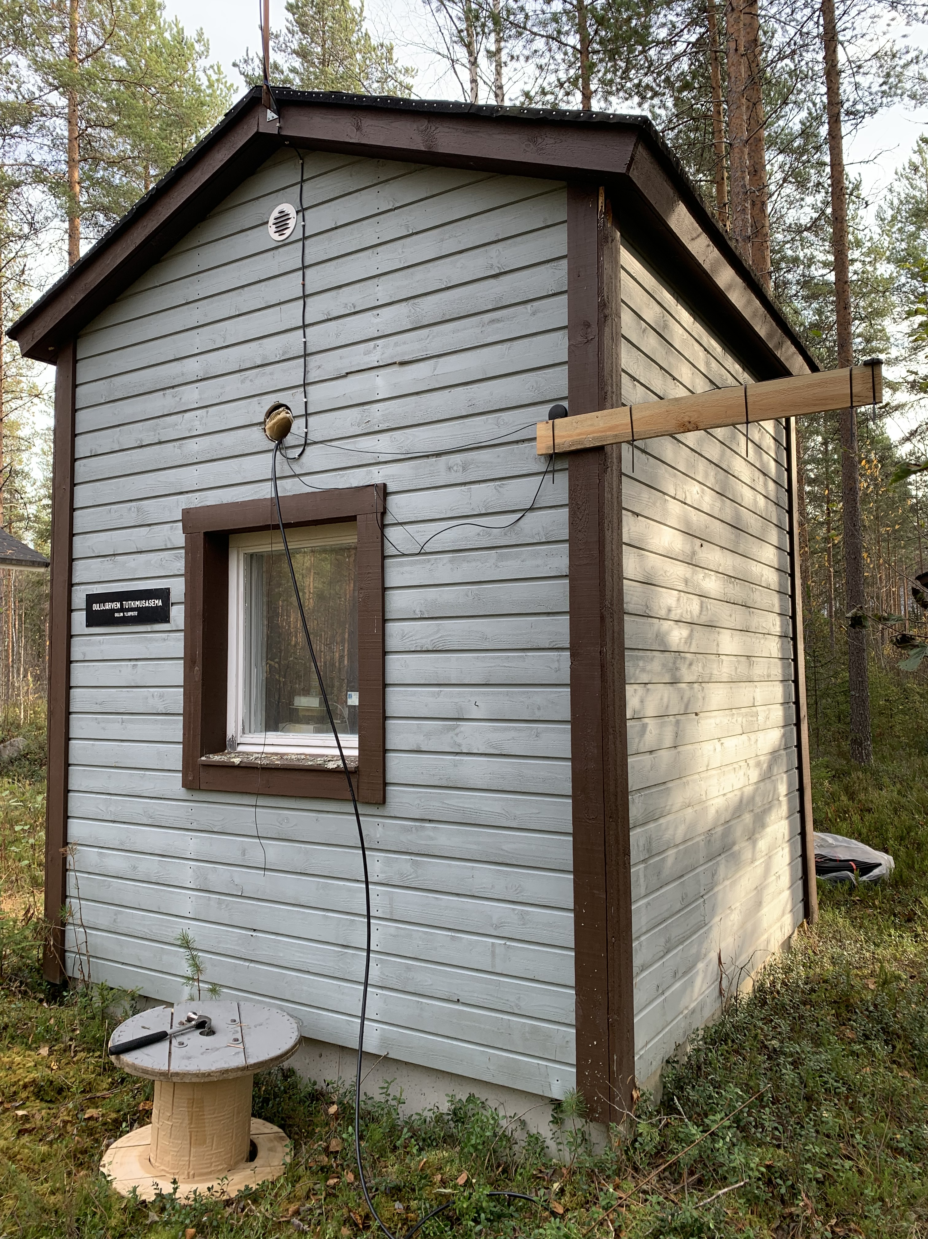
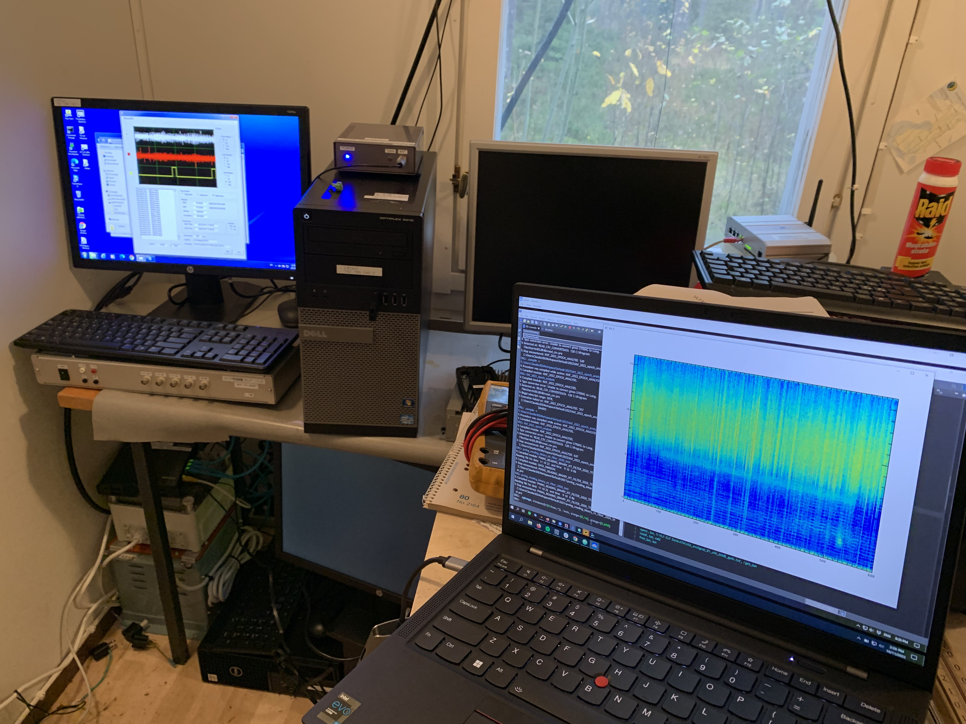
New VLF receiver at OUJ in Finland

